Slide 1
Irradiation of polymer foil using single MeV-energy heavy ions
Seminar in Research in Physics
a.y. 2021/22
Nora Reinić
Supervisor: Georgios Provatas
Laboratory for ion beam interactions
Ruđer Bošković Institute

Slide 2
Brief summary of the experiment
1. Irradiation of the foil with single ions from the ion beam
2. Chemical etching
ion
$$⟹$$
Ion beam
polymer foil
FINAL PRODUCT:
a foil with μm-sized pores arranged in rectangular pattern
Ions pass through the foil and create permanent damage
Etching enchances that damage

Slide 3
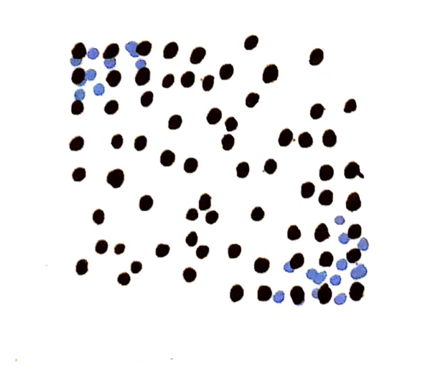
Theoretical background
What happens when an ion passes through a dielectric solid?
1.
Direct ion-target interaction
2.
Electron collision cascade
3.
Atomic collision cascade
Coulomb explosion
${≈ 10}^{−17}$s
${≈10}^{−14}$ s
A region full of point defects!
${≈10}^{−12}$ s
4.
Relaxation of defects
Specifically in polymers:
electron collisions can cause breaking or linking of the long chain molecules
A cylindrically shaped track core is formed
${≈10}^{−10}$ s
- the defects tend to aggregate along the ion’s trajectory

Slide 4
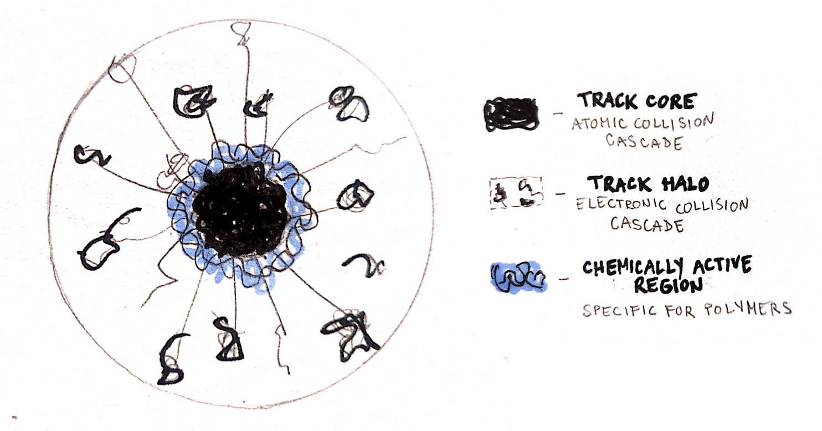
Theoretical background
latent tracks – permanent tracks of aggregated defects
radial cut through a track:
TRACK CORE
atomic collision cascade
10 nm
TRACK HALO
electronic collision cascade
1000 nm
CHEMICALLY ACTIVE REGION
specific for polymers
100 nm

Slide 5
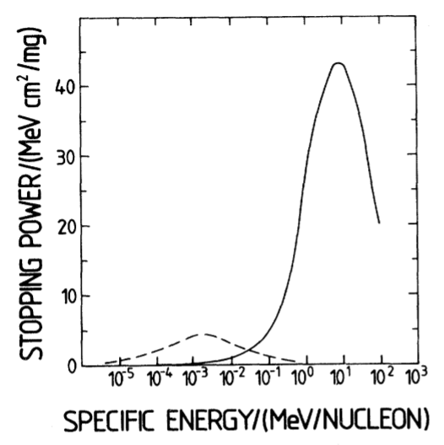
Theoretical background
How do we know if an ion will create latent tracks?
Important quantity:
STOPPING POWER
= energy loss per unit length of path, dE/dx
Nuclear stopping power – ion-nuclei interactions
dominant for small ion energies
causing abrupt changes in ion’s trajectory
causes only short tracks because the ion stops very soon
nuclear
electronic
Electronic stopping power – ion-electron interactions
dominant for large ion energies
slows down the ion smoothly
can cause formation of latent tracks

Slide 6
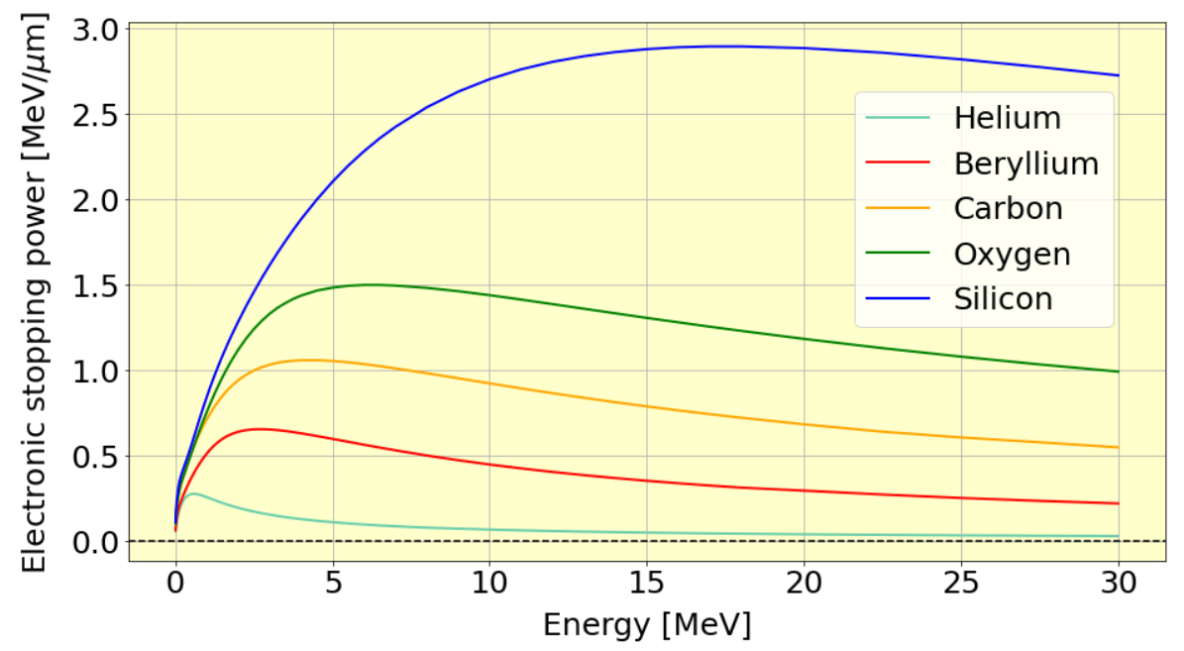
Theoretical background
Electronic stopping power curves computed with SRIM software
$⟹$ we need heavy ions of MeV energies!

Slide 7
Theoretical background
The latent tracks are too small, what do we do?
nm
$$⟶$$
CHEMICAL ETCHING
$$⟶$$
μm
Chemically very active regions!
KOH/NaOH
$⟹$ the damaged
zones get disolved
Immersing the irradiated material in a suitable solution triggers the chemical reactions along the latent track
POLYMERS: the damaged area extends radially further in comparison to other dielectrics
$⟹$ ideal for etching

Slide 8
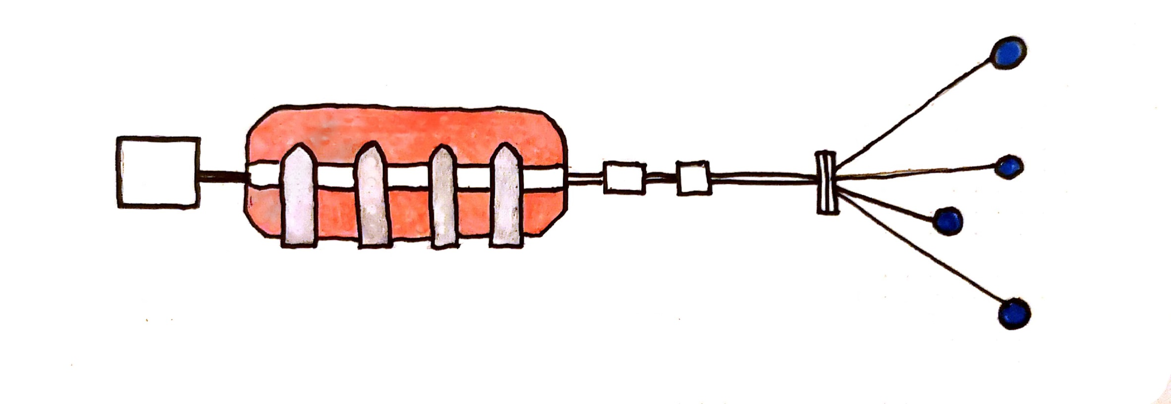
Experimental method
Ruđer Bošković Institute – Laboratory for ion beam interactions
There are two (and one more in the making)
tandem accelerators in the facility
in reality this is not a straight line, there are magnets directing the beam
accelerator
ion source
ion microprobe
6.0 MV EN Tandem Van de Graaf accelerator
multiple experimental beam lines with different purposes

Slide 9
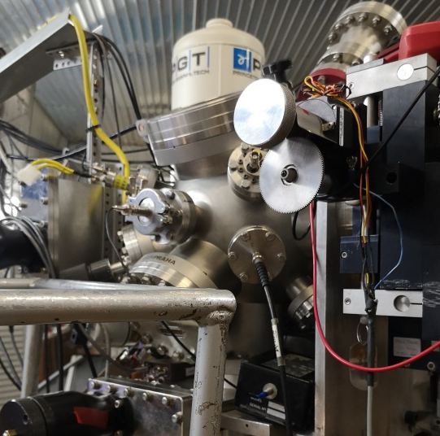
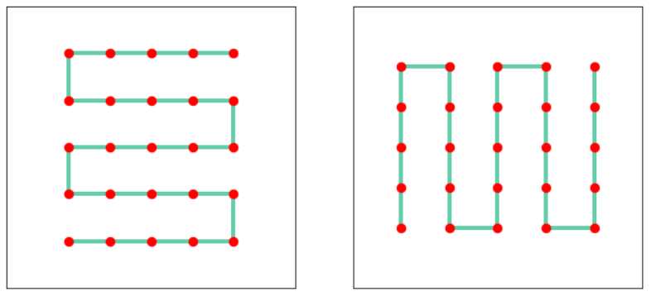
Experimental method
Ion microprobe
detectors
Two operational modes:
HIGH CURRENT MODE
1-1000 pA
LOW CURRENT MODE
< 1 fA
Scanning pattern:
32 x 32

Slide 10
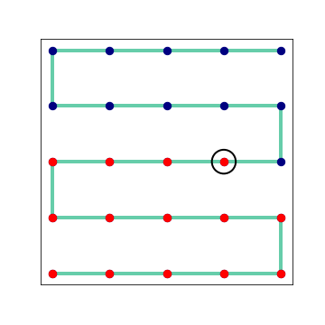
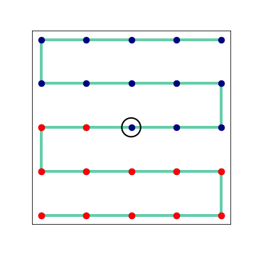
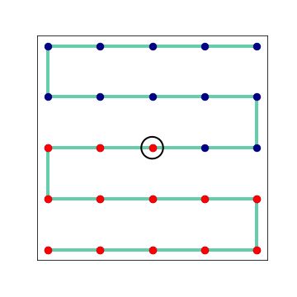
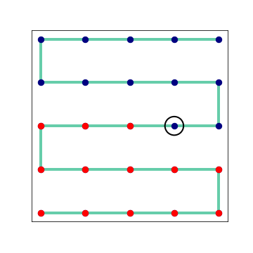
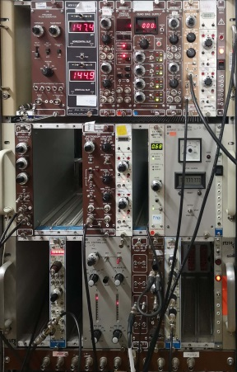
Experimental method
Target chamber
Transmitted ion triggers the detector
It takes a few seconds to scan the entire area
Beam scanner
Tells the beam scanner to switch to the next position

Slide 11
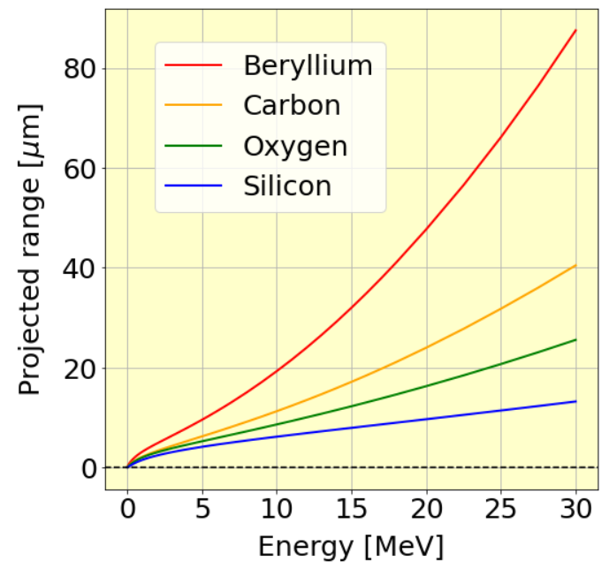
Experimental method
20 MeV carbon ions
6 μm thin polycarbonate foil
We used:
+
How do we know the ions will pass through the foil, not stop in it?
SRIM software
Stopping ranges for different ion species
ion species and energy
target composition and width
Input:
simulations of the ion target interactions
stopping ranges
stopping power
Output:

Slide 12
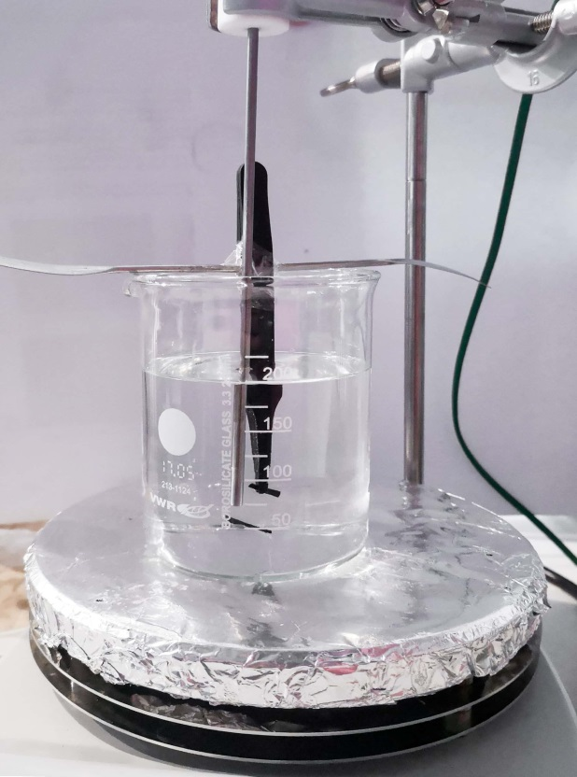
Experimental method
Chemical etching recipe
200 mL KOH solution (n = 3 mol/L)
heat to 50 °C
put the foil in the solution for 40 min
After the etching, the foil was left to dry for several days and then examined with optical microscope

Slide 13
Results
We irradiated 6 spots on a foil with different
scanning parameters:
Scanned area dimensions:
(213 ± 5) μm
or
(426 ± 5) μm
Number of ions per spot:
1 ion/spot
or
2 ions/spot
Order of scanning:
longer side length
or
Finding the pores with optical microscope – wasn’t easy
Foil diameter:
1.5 cm
Irradiated area surface:
< 1 x 1 mm²
+
other minor damages on the foil surface
+
folds on foil

Slide 14
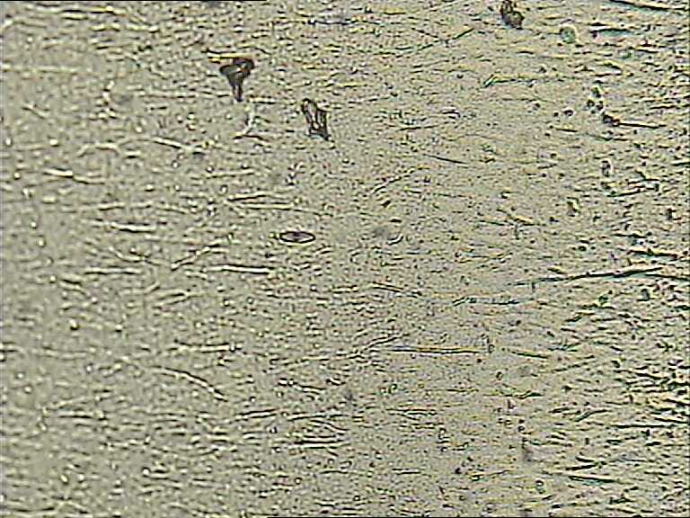
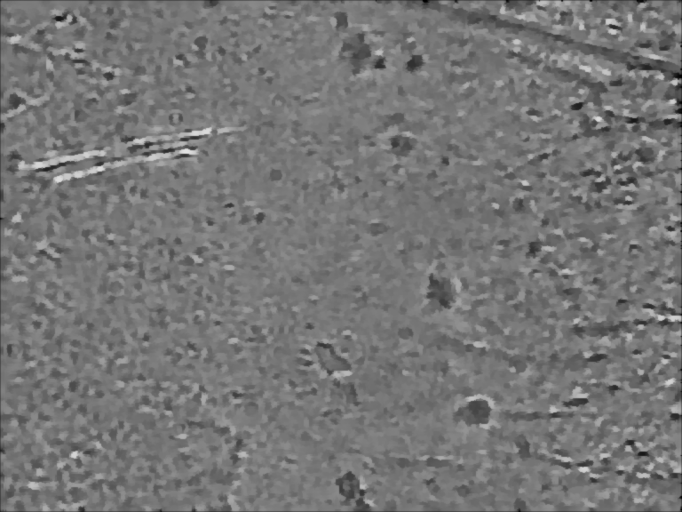
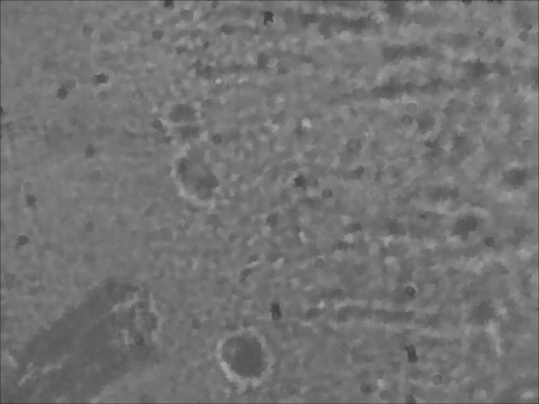
Results
10x
10x
10 μm
40x
60x
10 μm
5 μm

Slide 15
Conclusion
The results are satysfactory
- we succesully created the pores and they were arranged in a regular pattern
Possible improvements:
even the very small damages of the foil surface are clearly visible under the microscope
be more careful with handling the foil, trying to minimize the contact with the surrounding surfaces
small folds significantly
alter the image under the microscope
more care should be devoted to fixating and stretching the
foil over a sample holder
it could not be recognized
which of the observed pores correspond to which of the six scanned regions.
each irradiated area should be marked during the scanning with, for example,
a bigger, easily noticeable damage focused next to it
use heavier ions for bigger irradiation damage and better defined pores

Slide 16
The end
Thank you for attention!

