Slide 1
Kvantne korekcije entropije crne rupe
Axel Hrelja
mentor: dr. sc. Tajron Jurić

Slide 2

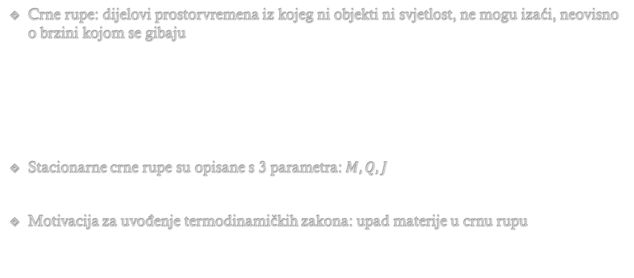

Uvod
Crne rupe: dijelovi prostorvremena iz kojeg ni objekti ni svjetlost, ne mogu izaći, neovisno o brzini kojom se gibaju
Stacionarne crne rupe su opisane s 3 parametra: $M, Q, J$
Motivacija za uvođenje termodinamičkih zakona: upad materije u crnu rupu
$$R=\frac{1}{2}Rg_{μν}+Λg_{μν}=8πGT_{μν}$$
$$ds^{2}=−\left(1−\frac{2MG}{r}\right)dt^{2}+{\left(1−\frac{2MG}{r}\right)}^{−1}dr^{2}+r^{2}dΩ$$

Slide 3

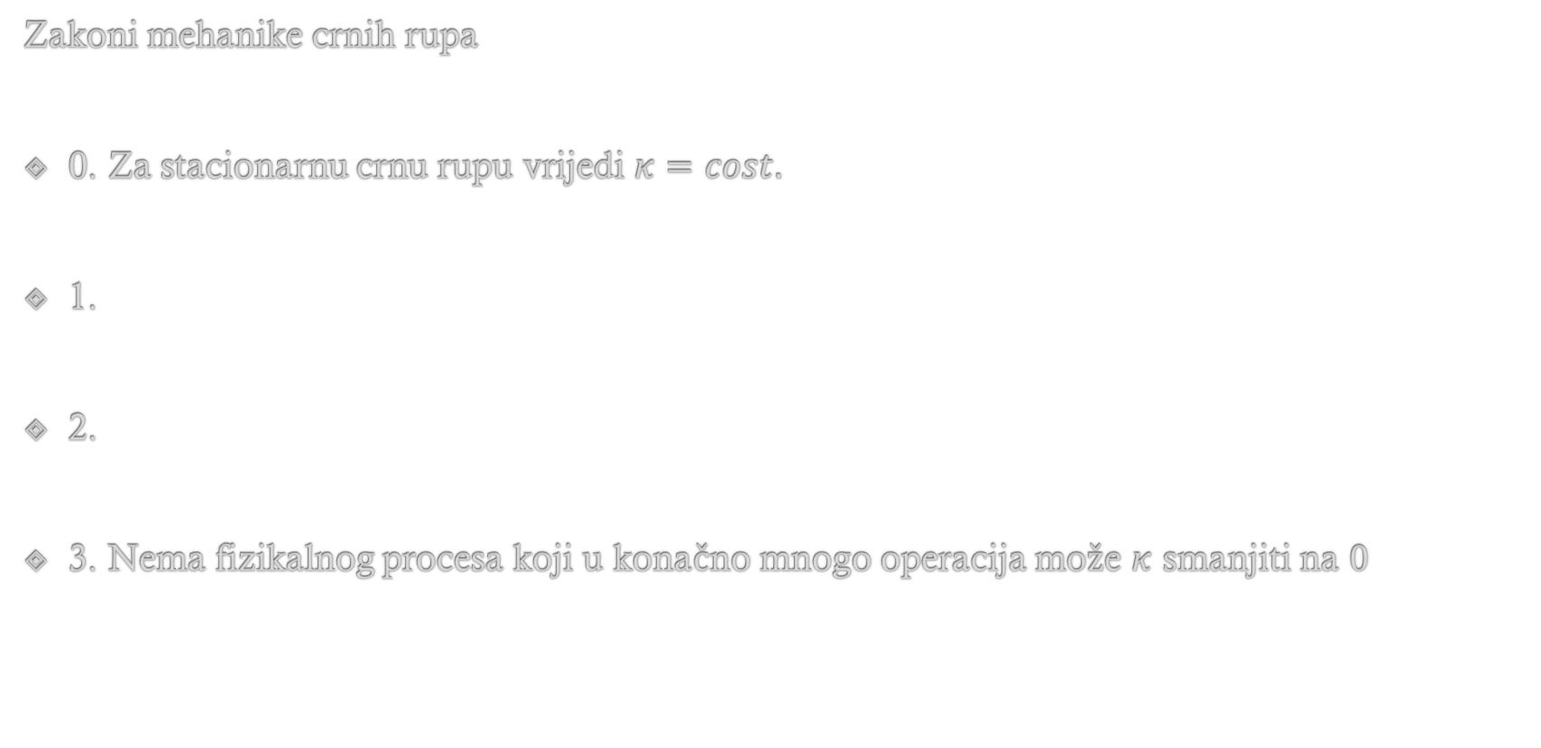

Zakoni mehanike crnih rupa
0. Za stacionarnu crnu rupu vrijedi $κ=cost.$
1.
2.
3. Nema fizikalnog procesa koji u konačno mnogo operacija može $κ$ smanjiti na $0$
$$dM=\frac{κ}{8π}dA+ΩdJ$$
$$\frac{dA}{dt}≥0$$

Slide 4








$$T_{H}=\frac{ℏκ}{2π}$$
$$dM=\frac{κ}{8π}dA+ΩdJ$$
$$S_{BH}=\frac{A}{4ℓ_{Pl}^{2}}$$
$$ℓ_{Pl}^{2}=Gℏ$$
$$dE= TdS−pdV$$
Schwarzschildova crna rupa:
Važnost entropije: uvid u mikroskopsku strukturu gravitacije
Broj energijskih nivoa dostupnih čestici blizu horizonta crne rupe divergira
Kvantna teorija polja: UV divergencija na horizontu$→$potrebno regularizirati
$$S_{BH}=\frac{4π}{ℏ}GM^{2}$$
$$S=k_{B}\ln\left(Ω\right)$$

Slide 5






Brick wall metoda za Schwarzschildovu crnu rupu
Razmatramo kvantna polja koja propagiraju unutar fiksne pozadine crne rupe
Određujemo broj mogućih mikrostanja brick wall metodom
$$Φ\left(r\right)=0, r≤r_{H}+h, r≥L$$
$$r_{H}$$
$$h$$
$$L$$
$$□=\frac{1}{\sqrt{−g}}∂_{μ}(g^{μν}\sqrt{−g}∂_{ν})$$
$$□Φ=0$$
$$Φ=e^{−iEt/ℏ}R_{ℓm}\left(r\right)Y_{ℓm}\left(Ω\right)$$

Slide 6







$$f\left(r\right)R^{′′}+\frac{2}{r}f\left(r\right)R^{′}−\left[\frac{ℓ\left(ℓ+1\right)}{r^{2}}−\frac{E^{2}}{f\left(r\right)}\right]R=0$$
$$f\left(r\right)=1−\frac{2GM}{r}$$
$$R_{ℓm}\left(r\right)=\exp\left[\frac{i}{ℏ}\int^{r}{dr^{′}k\left(r^{′}\right)}\right]$$
WKB approksimacija
Bohr-Sommerfeldovo pravilo za kvantizaciju
$k^{2}=\frac{1}{f\left(r\right)}\left[\frac{E^{2}}{f\left(r\right)}−\frac{ℏ^{2}ℓ\left(ℓ+1\right)}{r^{2}}\right]$
$$ℓ_{max}\left(ℓ_{max}+1\right)=\frac{E^{2}r^{2}}{ℏ^{2}f\left(r\right)}$$
$$k^{2}≥0$$
$$πn_{r}=\int_{r_{H}+h}^{L}{k\left(r,ℓ,E,m\right)dr}$$

Slide 7











$$N\left(E\right)=\sum_{ℓ=0}^{ℓ_{max}}{\sum_{m=−l}^{l}{n_{r}}}$$
$$N\left(E\right)=\frac{1}{π}\int_{2GM+h}^{L}{dr\int_{0}^{ℓ_{max}}{dℓ\left(2ℓ+1\right)k\left(r,ℓ,E\right)}}$$
$$x=r−2GM$$
$\int_{h}^{L−2GM}{dx}=\int_{h}^{R}{dx}$+ $\int_{R}^{L−2GM}{dx}$
Dominiraju članovi koji divergiraju za
$$h→0$$
$$L≫2GM$$
$$N\left(E\right)=\frac{32G^{4}M^{4}E^{3}}{3πh}+\frac{E^{3}L^{3}}{π}$$
Doprinos vakuuma
$$F=−\int{dE\frac{N\left(E\right)}{e^{βE}+1}}$$
$$F=−\frac{2π^{3}}{45h}{\left(\frac{2GM}{β}\right)}^{4}−\frac{L^{3}π^{3}}{15β^{4}}$$
$$S=β^{2}\frac{∂F}{∂β}$$
$$S=\frac{8π^{3}}{45h}\frac{{\left(2GM\right)}^{4}}{β^{3}}$$

Slide 8





$$S_{BH}, β=\frac{1}{T_{H}}, κ=\frac{1}{4GM}$$
$$S=\frac{8π^{3}}{45h}\frac{{\left(2GM\right)}^{4}}{β^{3}}$$
$$h=\frac{ℏ}{720πM}$$
$$h_{c}≡\int_{{r=r}_{H}}^{r=r_{H}+h}{ds}=\int_{2GM}^{2GM+h}{\frac{dr}{\sqrt{1−\frac{2GM}{r}}}}=\sqrt{\frac{Gℏ}{90π}}$$
Invarijantna udaljenost ne ovisi o veličini crne rupe, time interpretiramo da je zid svojstvo horizonta crne rupe
Entropija je opisana doprinosom blizu horizonta $→$ horizont daje kvantna svojstva crnoj rupi

Slide 9










Brick wall metoda za više redove WKB aproksimacije
$(D+2)$-dimenzionalno statičko sfernosimetrično prostorvrijeme
$$ds^{2}=−f\left(r\right)dt^{2}+\frac{dr^{2}}{g\left(r\right)}+r^{2}dΩ_{D}$$
$$κ=\sqrt{\frac{g\left(r_{H}\right)}{f\left(r_{H}\right)}}f^{′}\left(r_{H}\right)$$
$$h_{c}=\int_{r_{H}}^{r_{H}+h}{\frac{dr}{\sqrt{g\left(r\right)}}}$$
$$g\left(r\right)=g^{′}\left(r_{H}\right)\left(r−r_{H}\right)+\frac{1}{2}g^{′′}\left(r_{H}\right){\left(r−r_{H}\right)}^{2}+…$$
$$h_{c}=\sqrt{\frac{4h}{g^{′}\left(r_{H}\right)}}$$
$$f\left(r\right)=f^{′}\left(r_{H}\right)\left(r−r_{H}\right)+\frac{1}{2}f^{′′}\left(r_{H}\right){\left(r−r_{H}\right)}^{2}+…$$
$$\left(□−\frac{m^{2}}{ℏ^{2}}\right)Φ=0$$
$$Φ=e^{−\frac{iEt}{ℏ}}\left(\frac{R\left(r\right)}{r^{\frac{D}{2}}\sqrt{G\left(r\right)}}\right)Y_{ℓm_{i}}\left(θ,φ_{i}\right)$$
$$G\left(r\right)=\sqrt{f\left(r\right)g\left(r\right)}$$

Slide 10





$$R^{′′}\left(r\right)+\left[\frac{V^{2}\left(r\right)}{ℏ^{2}}−Δ\left(r\right)\right]R\left(r\right)=0$$
$$V^{2}\left(r\right)=\frac{1}{G^{2}\left(r\right)}\left(E^{2}−f\left(r\right)\left[m^{2}+\left(\frac{ℓ\left(ℓ+D−1\right)ℏ^{2}}{r^{2}}\right)\right]\right)$$
$$Δ\left(r\right)=\left(\frac{G^{′′}\left(r\right)}{2G\left(r\right)}\right)−\left(\frac{G^{′2}\left(r\right)}{4G^{2}\left(r\right)}\right)+\left(\frac{D}{2r}\right)\left(\frac{G^{′}\left(r\right)}{G\left(r\right)}\right)+\left(\frac{D\left(D−2\right)}{4r^{2}}\right)$$
$$R_{ℓm}\left(r\right)=\frac{c_{0}}{\sqrt{P\left(r\right)}}\exp\left[\frac{i}{ℏ}\int^{r}{dr^{′}P\left(r^{′}\right)}\right]$$
$$\left(\frac{1}{ℏ^{2}}\right)P^{2}\left(r\right)\left[P^{2}\left(r\right)−V^{2}\left(r\right)\right]=\left(\frac{3}{4}\right)P^{′}{\left(r\right)}^{2}−\frac{1}{2}P^{′′}\left(r\right)P\left(r\right)−Δ\left(r\right)P{\left(r\right)}^{2}$$
$$P\left(r\right)=\sum_{n=0}^{∞}{ℏ^{2n}P_{2n}\left(r\right)}$$
Viši redovi WKB aproksimacije

Slide 11










$$P_{0}\left(r\right)=±V(r)$$
$$P_{2}\left(r\right)=\left(\frac{3}{8P_{0}\left(r\right)}\right){\left(\frac{P_{0}^{′}\left(r\right)}{P_{0}\left(r\right)}\right)}^{2}−\left(\frac{P_{0}^{′′}\left(r\right)}{4 P_{0}\left(r\right)}\right)−\left(\frac{Δ\left(r\right)}{2P_{o}\left(r\right)}\right)$$
$$P_{4}\left(r\right)=−\left(\frac{5P_{2}^{2}\left(r\right)}{2V\left(r\right)}\right)−\left(\frac{4P_{2\left(r\right)Δ\left(r\right)}+P_{2}^{′′}\left(r\right)}{4V^{2}\left(r\right)}\right)+\left(\frac{3P_{2}^{′}\left(r\right)V^{′}\left(r\right)−P_{2}\left(r\right)V′′(r}{4V^{3}\left(r\right)}\right)$$
Sve funkcije vezane uz više redove WKB aproksimacije se mogu napisati preko početne, $P_{0}(r)$
$$N\left(E\right)=\sum_{n=0}^{∞}{N_{2n}(E)}$$
$$N_{2n}\left(E\right)=\frac{ℏ^{2n−1}}{π}\int_{r_{H}+h}^{L}{dr\int_{0}^{ℓ_{max}}{ dℓ\left(2ℓ+D−1\right)W\left(ℓ\right)P_{2n}\left(r\right)}}$$
$$W\left(ℓ\right)=\frac{\left(ℓ+D−2\right)!}{\left(D−1\right)!ℓ!}$$
$$ℓ_{max}\left(ℓ_{max}+1\right)=\frac{r^{2}E^{2}}{ℏ^{2}f{\left(r\right)}^{2}}$$
Zahtjevom $P_{2n}^{2}≥0 →P_{0}^{2}\left(r\right)≥0$
$$F=\sum_{n=0}^{∞}{F_{2n}}$$
$$S=\sum_{n=0}^{∞ }{S_{2n}}$$
$$F_{2n}=−\int{dE\frac{N_{2n}\left(E\right)}{e^{βE}+1}}$$
$$S_{2n}=β^{2}\frac{∂F_{2n}}{∂β}$$

Slide 12





Entropija do 4. reda za 4D crnu rupu
Računamo entropiju do $4$. reda za $4$-dimenzionalnu crnu rupu ($D=2$), uz$f(r)=g(r),$te $m=0$
Nulti red
$$P_{0}\left(r\right)=\frac{1}{g\left(r\right)}{\left[E^{2}−\frac{g\left(r\right)ℏ^{2}ℓ\left(ℓ+1\right)}{r^{2}}\right]}^{\frac{1}{2}}$$
$$N_{0}\left(E\right)=\frac{1}{ℏπ}\int_{r_{H}+h}^{L}{dr\int_{0}^{ℓ_{max}}{ dℓ\left(2ℓ+1\right)P_{0}(r)}}$$
$$N_{0}\left(E\right)=\frac{2E^{3}}{3ℏ^{3}}\int_{r_{H}+h}^{L}{\frac{r^{2}}{g^{2}\left(r\right)}dr}$$
$$S_{0}=\frac{8π^{3}}{45ℏ^{3}}\frac{1}{β}\int_{r_{H}+h}^{L}{\frac{r^{2}}{g^{2}\left(r\right)}dr}$$
$$S_{0}=\frac{r_{H}^{2}}{90h_{c}^{2}}+\left[\frac{κr_{H}}{90}−\frac{g^{′′}\left(r_{H}\right)r_{H}^{2}}{360}\right]\ln\left(\frac{44r_{H}^{2}}{90h_{c}^{2}}\right)$$

Slide 13











Drugi red
$$P_{2}\left(r\right)=\left(\frac{P_{2}^{\left(0\right)}\left(r\right)}{G(ε,r)}\right)+λ\left(r\right)\left(\frac{P_{2}^{\left(1\right)}\left(r\right)}{G^{3}\left(ε,r\right)}\right)+λ^{2}\left(r\right)\left(\frac{P_{2}^{\left(1\right)}\left(r\right)}{G^{5}\left(ε,r\right)}\right)$$
$$G\left(ε, r\right)={\left[ε−λ\left(r\right)\right]}^{\frac{1}{2}}$$
$$λ\left(r\right)=ℓ\left(ℓ+1\right)ℏ^{2}\frac{g\left(r\right)}{r^{2}}$$
$$ε=E^{2}$$
$$P_{2}^{\left(0\right)}\left(r\right)=−\frac{g^{′}\left(r\right)}{2r}$$
$$P_{2}^{\left(1\right)}\left(r\right)=\frac{3g\left(r\right)}{4r^{2}}−\frac{3g^{′}\left(r\right)}{4r}+\frac{g^{′′}\left(r\right)}{8}+\frac{g^{′}{\left(r\right)}^{2}}{8g}$$
$$P_{2}^{\left(2\right)}\left(r\right)=\frac{5g}{8r^{2}}−\frac{5g^{′}\left(r\right)}{8r}+\frac{5g^{′}{\left(r\right)}^{2}}{32g}$$
$$\frac{1}{G\left(ε,r\right)}=\frac{2∂G\left(ε,r\right)}{∂ε}$$
$$\frac{1}{G^{3}(ε, r)}=−\frac{4∂^{2}G\left(ε,r\right)}{∂^{2}ε}$$
$$\frac{1}{G^{5}(ε, r)}=\frac{8}{3}\frac{∂^{2}G\left(ε,r\right)}{∂^{2}ε}$$
$$N_{2}\left(E\right)=\frac{ℏ}{π}\int_{r_{H}+h}^{L}{dr\int_{0}^{ℓ_{max}}{dℓ\left(2ℓ+1\right)P_{2}(r)}}$$

Slide 14



$$\frac{∂}{∂x}\int_{a(x)}^{b(x)}{dtf\left[x,t\right]}=f\left[x,b\left(x\right)\right]\left(\frac{db\left(x\right)}{dx}\right)−f\left[x,a\left(x\right)\right]\left(\frac{da\left(x\right)}{dx}\right)+\int_{a(x)}^{b(x)}{dt\left[\frac{∂f\left(x,t\right)}{∂x}\right]}$$
$$λ=ℓ\left(ℓ+1\right)ℏ^{2}\frac{g\left(r\right)}{r^{2}}$$
$$N_{2}\left(E\right)=\frac{ℏ}{π}\int_{r_{H}+h}^{L}{dr\int_{0}^{ℓ_{max}}{dℓ\left(2ℓ+1\right)P_{2}(r)}}$$
$${ℏN}_{2}\left(E\right) =\frac{1}{π} \int_{r_{H}+h}^{L}{dr\frac{r^{2}}{g\left(r\right)}\int_{0}^{ε}{\left[2P_{2}^{\left(0\right)}\left(r\right)\frac{∂}{∂ε}G\left(ε,r\right)−4P_{2}^{(2)}\left(r\right)λ\frac{∂^{2}}{∂ε^{2}}G\left(ε,r\right)+\frac{8}{3}P_{2}^{(2)}\left(r\right)λ^{2}\frac{∂^{3}}{∂ε^{3}}G\left(ε,r\right)\right]dλ}}$$
$$\int_{0}^{ε}{λ\frac{∂^{2}G\left(ε,r\right)}{∂ε^{2}}}dλ=\frac{∂^{2}}{∂ε^{2}}\int_{0}^{ε}{λG\left(ε,r\right)dλ}−\frac{ε}{2\left(ε−λ\right)}{\left.​\right|}_{ε=λ}$$
WKB aproksimacija ne radi na točkama obrata!

Slide 15



$$N_{2}\left(E\right)=\frac{E}{ℏπ}\int_{r_{H}+h}^{L}{dr\left[\frac{1}{3}−\frac{4rg^{′}\left(r\right)}{3g\left(r\right)}+r^{2}\left(\frac{g^{′}{\left(r\right)}^{2}}{3g{\left(r\right)}^{2}}−\frac{g^{′′}\left(r\right)}{2g\left(r\right)}\right)\right]}$$
$$S_{2}=\frac{π}{3ℏβ}\int_{r_{H}+h}^{L}{dr\left[\frac{1}{3}−\frac{4rg^{′}\left(r\right)}{3g\left(r\right)}+r^{2}\left(\frac{g^{′}{\left(r\right)}^{2}}{3g{\left(r\right)}^{2}}−\frac{g^{′′}\left(r\right)}{2g\left(r\right)}\right)\right]}$$
$$S_{2}=\frac{11r_{H}^{2}}{90h_{c}^{2}}−\left(\frac{κr_{H}}{10}+\frac{g^{′′}\left(r_{H}\right)r_{H}^{2}}{60}\right)\ln\left(\frac{44r_{H}^{2}}{90h_{c}^{2}}\right)$$
Doprinos entropiji od viših WKB modova ima isti oblik kao i doprinos vodećeg

Slide 16




Četvrti red
$$P_{4}\left(r\right)=\left(\frac{P_{4}^{\left(0\right)}\left(r\right)}{G^{3}(ε,r}\right)+λ\left(r\right)\left(\frac{P_{4}^{\left(1\right)}\left(r\right)}{G^{5}\left(ε,r\right)}\right)+λ^{2}\left(r\right)\left(\frac{P_{4}^{\left(2\right)}\left(r\right)}{G^{7}\left(ε,r\right)}\right)+λ^{3}\left(r\right)\left(\frac{P_{4}^{\left(3\right)}\left(r\right)}{G^{9}\left(ε,r\right)}\right)+λ^{4}\left(\frac{P_{4}^{\left(4\right)}\left(r\right)}{G^{11}\left(ε,r\right)}\right)$$
$$N_{4}\left(E\right)=\frac{ℏ^{3}}{π}\int_{r_{H}+h}^{L}{dr}\int_{0}^{ℓ_{max}}{dℓ\left(2ℓ+1\right)P_{4}(r)}$$
$$N_{4}\left(E\right) =−\frac{4ℏ}{π} \int_{r_{H}+h}^{L}{dr\frac{r^{2}}{g\left(r\right)}P_{4}^{\left(0\right)}\left(r\right)\frac{∂^{2}}{∂ε^{2}}\int_{0}^{ε}{G\left(ε,r\right)dλ}}+ \frac{8ℏ}{3π}\int_{r_{H}+h}^{L}{dr\frac{r^{2}}{g\left(r\right)}P_{4}^{\left(1\right)}\left(r\right)\frac{{ ∂}^{3}}{∂ε^{3}}\int_{0}^{ε}{λG\left(ε, r\right)dλ}}−\frac{16ℏ}{15π}\int_{r_{H}+h}^{L}{dr\frac{r^{2}}{g\left(r\right)}P_{4}^{\left(2\right)}\left(r\right)\frac{∂^{4}}{∂ε^{4}}\int_{0}^{ε}{λ^{2}G\left(ε,r\right)dλ}}+\frac{32ℏ}{105π}\int_{r_{H}+h}^{L}{dr\frac{r^{2}}{g\left(r\right)}P_{4}^{\left(3\right)}\left(r\right)\frac{∂^{5}}{∂ε^{5}}\int_{0}^{ε}{λ^{3}G\left(ε, r\right)dλ}}−\frac{64ℏ}{945π}\int_{r_{H}+h}^{L}{dr\frac{r^{2}}{g\left(r\right)P_{4}^{\left(3\right)}\left(r\right)}P_{4}^{\left(3\right)}\left(r\right)\frac{∂^{6}}{∂ε^{6}}\int_{0}^{ε}{λ^{4}G\left(ε, r\right)dλ}}$$
$$N_{4}\left(E\right)=\frac{1}{E}\int_{r_{H}+h}^{L}{drΣ^{\left(4\right)}(r)}$$
$$F_{4}=\int_{0}^{∞}{dx\frac{1}{x\left(e^{x}+1\right)}}\int_{r_{H}+h}^{L}{dr Σ^{\left(4\right)}(r)}$$
$$S_{4}=0$$

Slide 17





$$S=S_{0}+S_{2}+S_{4}$$
$$S=\frac{11r_{H}^{2}}{90h_{c}^{2}}−\left(\frac{κr_{H}}{10}+\frac{g^{′′}\left(r_{H}\right)r_{H}^{2}}{60}\right)\ln\left(\frac{44r_{H}^{2}}{90h_{c}^{2}}\right)$$
$$\frac{11r_{H}^{2}}{90h_{c}^{2}}=S_{BH}=\frac{A}{4ℓ_{Pl}^{2}}$$
$$h_{c}^{2}=\frac{11ℓ_{Pl}^{2}}{90π}$$
$$S=S_{BH}+F\left(A\right)\ln\left(\frac{A}{ℓ_{Pl}^{2}}\right)$$
$$F\left(A\right)=−\frac{κr_{H}}{10}−\frac{g^{′′}\left(r_{H}\right)r_{H}^{2}}{60}$$

Slide 18




Entropija za Scwharzschildovu crnu rupu
$$f\left(r\right)=g\left(r\right)=1−\frac{2GM}{r}$$
$$κ=\frac{g^{′}\left(r_{H}\right)}{2}=\frac{1}{2r_{H}}$$
$$g^{′′}\left(r_{H}\right)=−\frac{2}{r_{H}^{2}}$$
$$S=S_{BH}−\frac{1}{60}\ln\left(\frac{A}{ℓ_{Pl}^{2}}\right)$$

Slide 19






Entropija za BTZ crnu rupu
BTZ crna rupa je $(1+2)$-dimenzionalna osnosimetrična crna rupa
Nerotirajuća:
$$ds^{2}=−{\left(N^{⊥}\right)}^{2}dt^{2}+{\left(N^{⊥}\right)}^{−2}dr^{2}+r^{2}{\left(dφ^{2}+N^{φ}dt\right)}^{2}$$
$$N^{⊥}={\left(−M+{\left(\frac{r}{l}\right)}^{2}+{\left(\frac{J}{2r}\right)}^{2}\right)}^{\frac{1}{2}}$$
$$N^{φ}=−J/2r^{2}$$
$$l^{−2}=−Λ$$
$$r_{±}=l{\left(\frac{M}{2}\left(1±\sqrt{1−{\left(\frac{J}{Ml}\right)}^{2}}\right)\right)}^{\frac{1}{2}}$$
$$J=0$$
$$r_=0$$
$$r_{+}=r_{H}$$

Slide 20








$$S_{BH}=\frac{A}{4Gℏ}=\frac{r_{H}π}{2Gℏ}$$
$$g\left(r\right)=N^{⊥}$$
$$D=1$$
$$W\left(ℓ\right)=\frac{1}{ℓ}$$
$$S_{0}=\frac{3ζ\left(3\right)}{{4π}^{2}}\frac{r_{H}^{2}}{l}\frac{1}{\sqrt{2r_{H}h}}$$
$$S_{2}=ℏ\ln\left(2\right)\left(\frac{1}{\sqrt{2r_{H}h}}\left(−\frac{l}{2}−\frac{19}{24}\frac{l^{3}}{r_{H}^{2}}−\frac{5}{8}\frac{{ l}^{5}}{r_{H}^{4}}\right)+\sqrt{2r_{H}h}\left(−\frac{3}{4}\frac{l^{3}}{r_{H}^{4}}−\frac{25}{32 }\frac{l^{5}}{r_{H}^{6}}\right)\right)$$
$$S=S_{BH}+G(A)$$
$$G\left(A\right)=\frac{2\ln\left(2\right)Gℏ^{2}\left(−\frac{3}{4}\frac{l^{3}}{r_{H}^{5}π}−\frac{25}{32 }\frac{l^{5}}{r_{H}^{7}π}\right)}{\left(\frac{3ζ\left(3\right)}{{4π}^{2}}\frac{r_{H}^{2}}{l}\text{+ }ℏ\ln\left(2\right)\left(−\frac{l}{2}−\frac{19}{24}\frac{l^{3}}{r_{H}^{2}}−\frac{5}{8}\frac{{ l}^{5}}{r_{H}^{4}}\right)\right)}$$

Slide 21

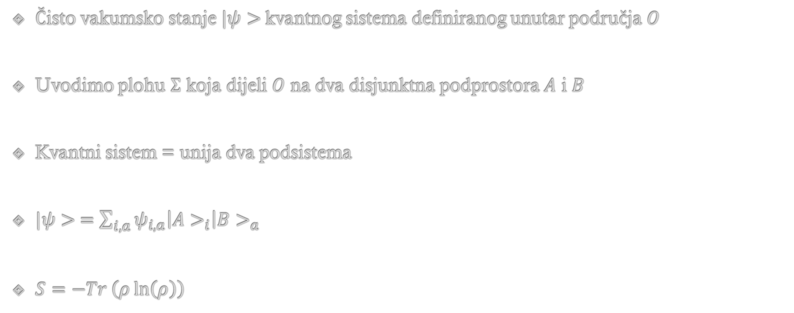



Entropija sprege
Čisto vakumsko stanje $|ψ>$kvantnog sistema definiranog unutar područja $O$
Uvodimo plohu $Σ$ koja dijeli $O$ na dva disjunktna podprostora $A$ i $B$
Kvantni sistem = unija dva podsistema
$|ψ> =\sum_{i,a}{ψ_{i,a}\left|A>_{i}\right|B>_{a}}$
$S=−Tr \left(ρ\ln\left(ρ\right)\right)$
$$O$$
$$A$$
$$Σ$$
$$B$$

Slide 22
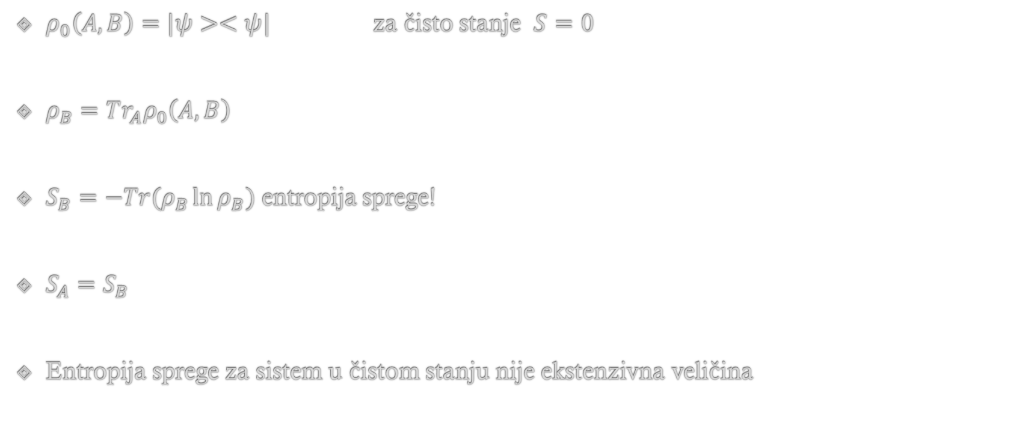
$ρ_{0}\left(A,B\right)=|ψ><ψ|$ za čisto stanje $S=0$
$ρ_{B}=Tr_{A}ρ_{0}\left(A,B\right)$
$S_{B}=−Tr(ρ_{B}\ln{ρ_{B}})$ entropija sprege!
$S_{A}=S_{B}$
Entropija sprege za sistem u čistom stanju nije ekstenzivna veličina

Slide 23
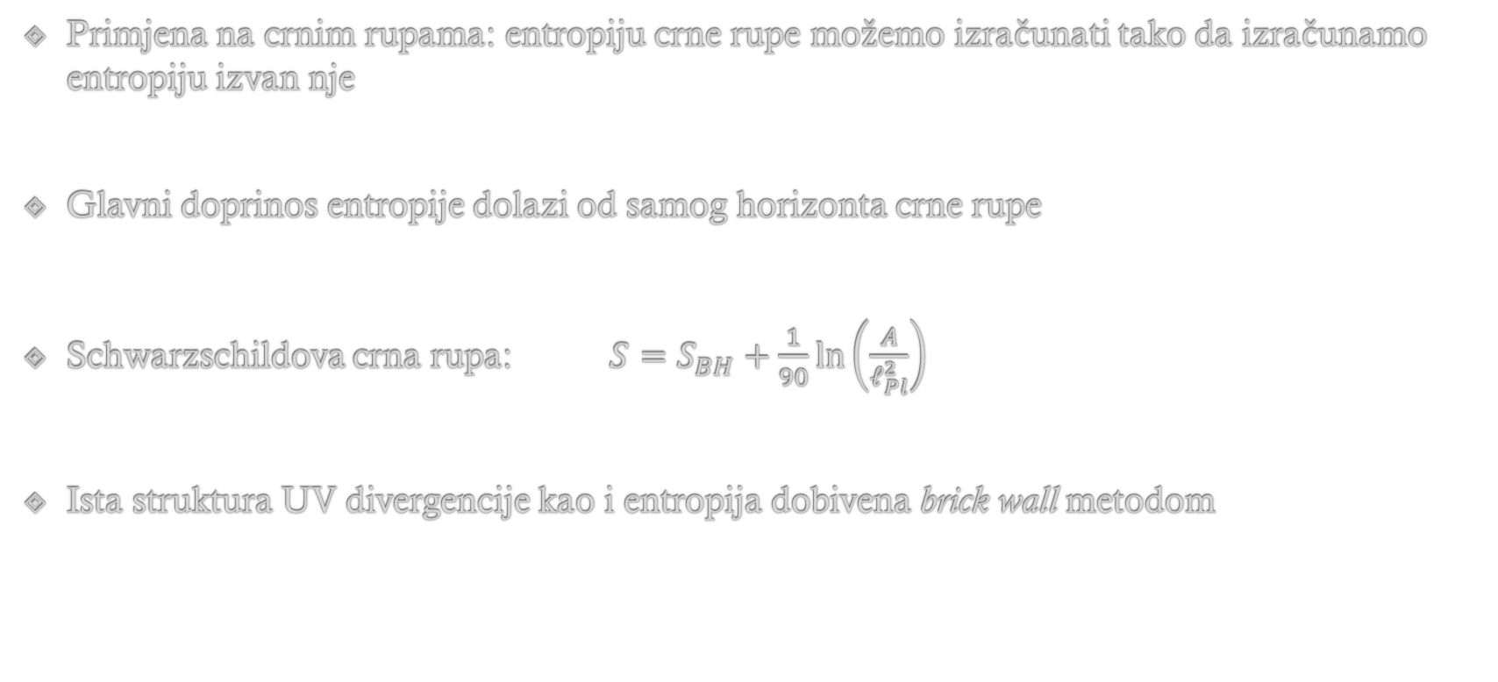
Primjena na crnim rupama: entropiju crne rupe možemo izračunati tako da izračunamo entropiju izvan nje
Glavni doprinos entropije dolazi od samog horizonta crne rupe
Schwarzschildova crna rupa: $S=S_{BH}+\frac{1}{90}\ln\left(\frac{A}{ℓ_{Pl}^{2}}\right)$
Ista struktura UV divergencije kao i entropija dobivena brick wall metodom

Slide 24
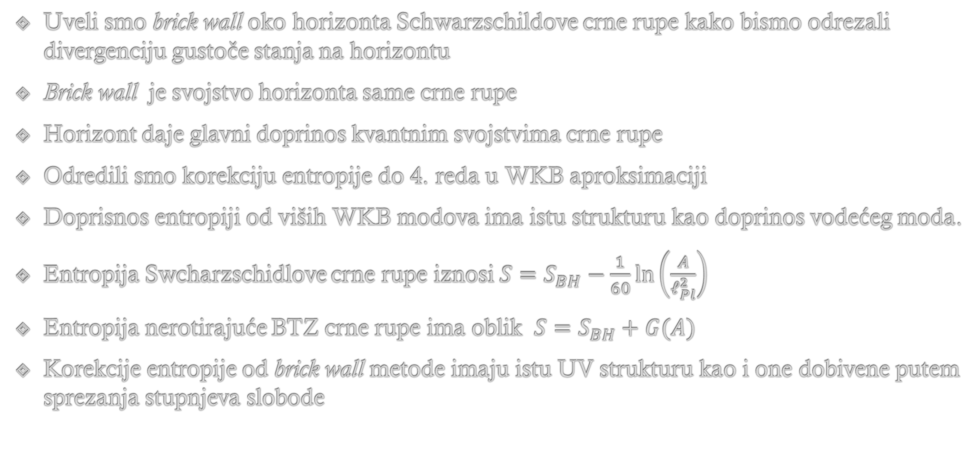
Zaključak
Uveli smo brick wall oko horizonta Schwarzschildove crne rupe kako bismo odrezali divergenciju gustoče stanja na horizontu
Brick wall je svojstvo horizonta same crne rupe
Horizont daje glavni doprinos kvantnim svojstvima crne rupe
Odredili smo korekciju entropije do 4. reda u WKB aproksimaciji
Doprisnos entropiji od viših WKB modova ima istu strukturu kao doprinos vodećeg moda.
Entropija Swcharzschidlove crne rupe iznosi $S=S_{BH}−\frac{1}{60}\ln\left(\frac{A}{ℓ_{Pl}^{2}}\right)$
Entropija nerotirajuće BTZ crne rupe ima oblik $S=S_{BH}+G(A)$
Korekcije entropije od brick wall metode imaju istu UV strukturu kao i one dobivene putem sprezanja stupnjeva slobode

