Slide 1
Rast stanica u kulturi

Slide 2
Vrste staničnih kultura:
suspenzijske
adherirane:
ovisnost o usidrenju
Notes:
Jednoslojna kultura "monolayer" raste na čvrstoj podlozi
u jednom sloju, prilijepljena za supstrat
: preduvjet proliferacije pričvršćivanje za podlogu

Slide 3
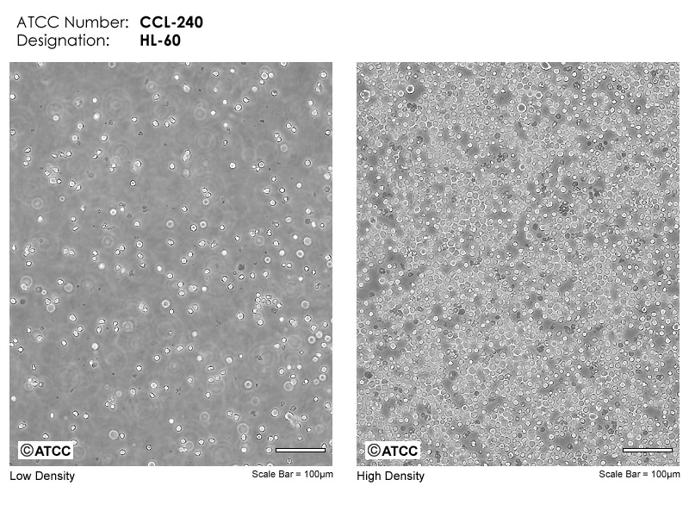
Limfoblastoidne stanice HL-60

Slide 4
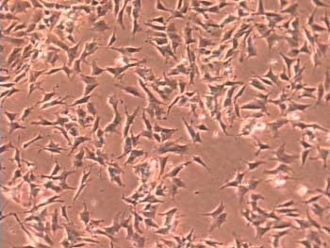
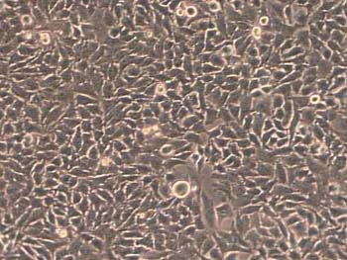
stanična linija neurona
epitelne stanice HeLa

Slide 5
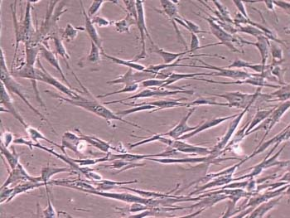
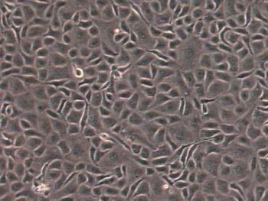
fibroblasti MRC5
endotelne stanice BEA

Slide 6
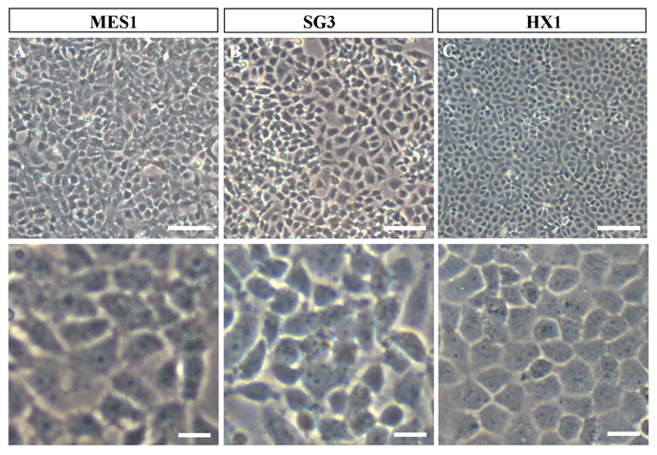
Matične stanice riba

Slide 7
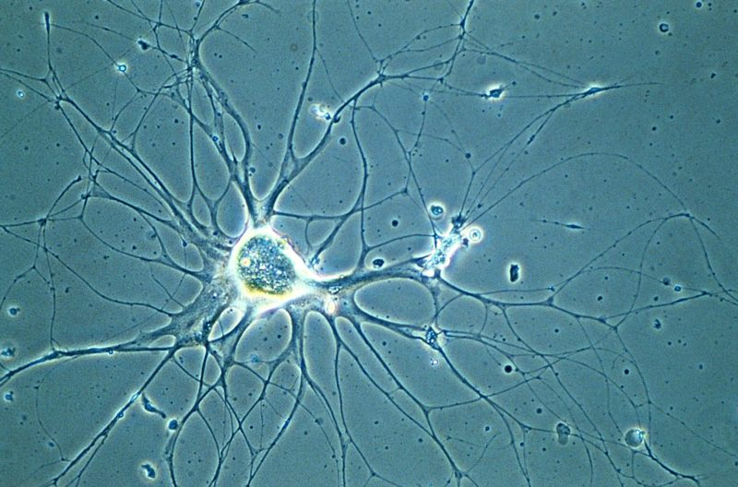
Neuron puža u staničnoj kulturi

Slide 8
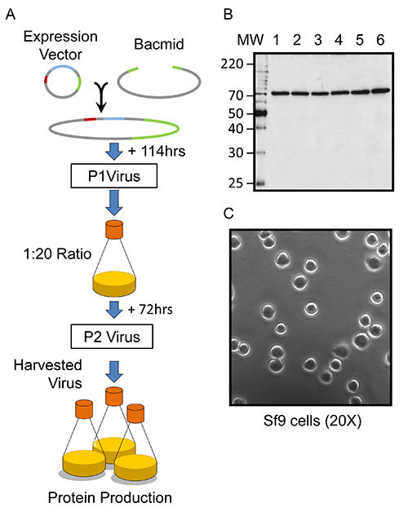
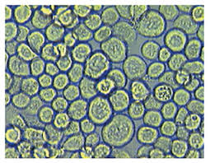
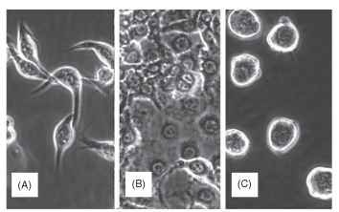
Stanične kulture kukaca
Spodoptera: domaćin bakulovirusa: ekspresija proteina
A: nalik fibroblastima
B: nalik epitelu
C: okrugle
Notes:
Cell culture is the technique in which cells are removed from ■ an organism and placed in a fluid medium. Under proper conditions, the cells can live and even grow. The growth can be characterized by cell division (mitosis) or by other processes, such as differentiation, during which the cells can change into specific types that are capable of functions analogous to tissues or organs in the whole organism. The practice of cell culture (and its close cousins, tissue culture and organ culture) originated in a Yale University laboratory in 1907, when Ross Harrison removed nerves of a frog and maintained them in a simple salt solution for several days. Within a very few years a visiting scientist in Harrison’s laboratory, Richard Goldschmidt, reported on the first cell cultures from an insect. For the next half-century, insect cell culture was used periodically in a variety of experiments, such as studying the pathogenesis of viruses, but the field received a great boost when the Australian Thomas D. C. Grace succeeded in obtaining four cell lines from the emperor gum moth, Antheraea eucalypti. These lines were capable of continuous growth, requiring periodic subculturing.
In the years since Grace’s report, numerous other continuous insect cell lines have been developed—over 500 lines from more than 100 different insect species. Under microscopic examination, cells take on one of several distinct morphologies, including spindle shaped, epithelial, and round to oval (Fig. 1). Cell cultures are frequently used in research and biotechnology.
USES IN PHYSIOLOGY AND DEVELOPMENTAL BIOLOGY
Harrison’s earliest work was designed to examine the physiology of a nerve outside the living organism, and similar uses have been made of insect cells and tissue. By removing the tissue or cells from the insect, it is possible to delineate how individual compounds affect them. Some of the most useful work has been with ecdysone,the insect molting hormone. In 1972 Anne-Marie Courgeon showed that exposing a cell line from Drosophila melanogaster to (3-ecdysone (a particular form of ecdysone now known as 20-hydroxyecdysone) caused rounded cells to change to aggregates of highly elongated cells. Lynn and Hung found that a cell line from a small wasp can undergo a similar morphogenesis with the added feature that the elongated cells are highly contractile, like muscle cells (Fig. 2 ).
FIGURE 2 Cell shape change in response to treatment with the insect-molting hormone: (A) untreated cells and (B) cells treated for 2 weeks with 20-hydroxyecdysone. Arrows point to cells that were contracting in the culture.
USES IN PATHOLOGY
Certain disease-causing organisms, such as viruses, rickettsia, and certain protozoans are obligate pathogens. Cell cultures can be extremely useful with such pathogens because this is often the only way to grow them outside a whole animal or plant and make them much easier to study. Some of the early work with insect cell culture was initiated with a group of viruses known as nucleopolyhedrovirus. These viruses cause diseases in a large number of pest insects and thus are potential biological control agents. Cell cultures grown in large volumes can be used to produce these viruses for biologically based pesticides.
Some insects are also notorious for their ability to transmit diseases (such as malaria and yellow fever) to higher animals and plants. Cell cultures from mosquitoes and other insects can also be used to study these pathogens.
USES IN MEDICINE AND PHARMACOLOGY
Decades ago, researchers showed that a gene in baculoviruses could be replaced through genetic engineering with genes for other proteins. When insect cells are infected with these modified viruses, the cultures can produce a large quantity of the protein. This tech-nique—the baculovirus expression vector system—has facilitated a new use for insect cell cultures for the production of vaccines, growth factors, and other materials useful in medicine. Over 1800 articles have been published on the use of insect cells to produce various recombinant proteins.
FIGURE 1 Typical appearances of insect cells in culture by phase contrast microscopy: (A) spindle shaped (fibroblast-like), (B) epithelial shaped, and (C) round.

Slide 9
Stanične linije
kontinuirane (imortalne, beskonačne):
imortalne, tumorske
konačne (mortalne)
stanična linija: okarakterizirana, uniformna stanična populacija
primarne ili početne kulture: kulture uspostavljene iz tkiva ili stanica uzetih iz organizma

Slide 10
Osnovne stanične linije
Normalne stanične linije (zdravo tkivo)
Naziv vrsta tkivo st. tip
MRC-5 humani pluća embrija fibroblastni
3T3-L1 miš embrio fibroblastoidni
MDCK pas bubreg epitelni

Slide 11
Osnovne stanične linije
Transformirane, adherirane
Naziv vrsta tkivo st. tip
HEK293 čovjek bubreg embrija epitelne
HeLa čovjek cervikalni karcinom epitelne
Cos-7 majmun bubreg epiteloidne
MCF-7 čovjek karcinom dojke epitelne
Hep G2 čovjek hepatom epitelne
PC-12 štakor feokromocitom živčane
Leukemijske, suspenzija
HL-60 čovjek mijeloične
Jurkat čovjek T limfociti
K562 čovjek eritrocitne

Slide 12
Katalozi staničnih linija: ATCC: American type culture collection
Cell Biology
ATCC® Number: | CCL-2™ | Price: | £255.00; €460.00
Designations: | HeLa | Depositors: | WF Scherer
Biosafety Level: | 2 [CELLS CONTAIN PAPOVAVIRUS] | Shipped: | frozen
Medium & Serum: | See Propagation | Growth Properties: | adherent
Organism: | Homo sapiens (human) | Morphology:
Source: | Organ: cervix Cell type: epithelial Disease: adenocarcinoma
Cellular Products: | keratin

Slide 13
Related Cell Culture Products
Applications: | screening for Escherichia coli strains with invasive potential [21447] [21491] [21553] testing [92382] transfection host [21491] (technology from amaxa)
Virus Susceptibility: | Poliovirus 1 Adenovirus type 3 Poliovirus 2 Human poliovirus 3 Encephalomyocarditis virus
Reverse Transcript: | negative
DNA Profile (STR): | Amelogenin: X CSF1PO: 9,10 D13S317: 12,13.3 D16S539: 9,10 D5S818: 11,12 D7S820: 8,12 THO1: 7 TPOX: 8,12 vWA: 16,18

Slide 14
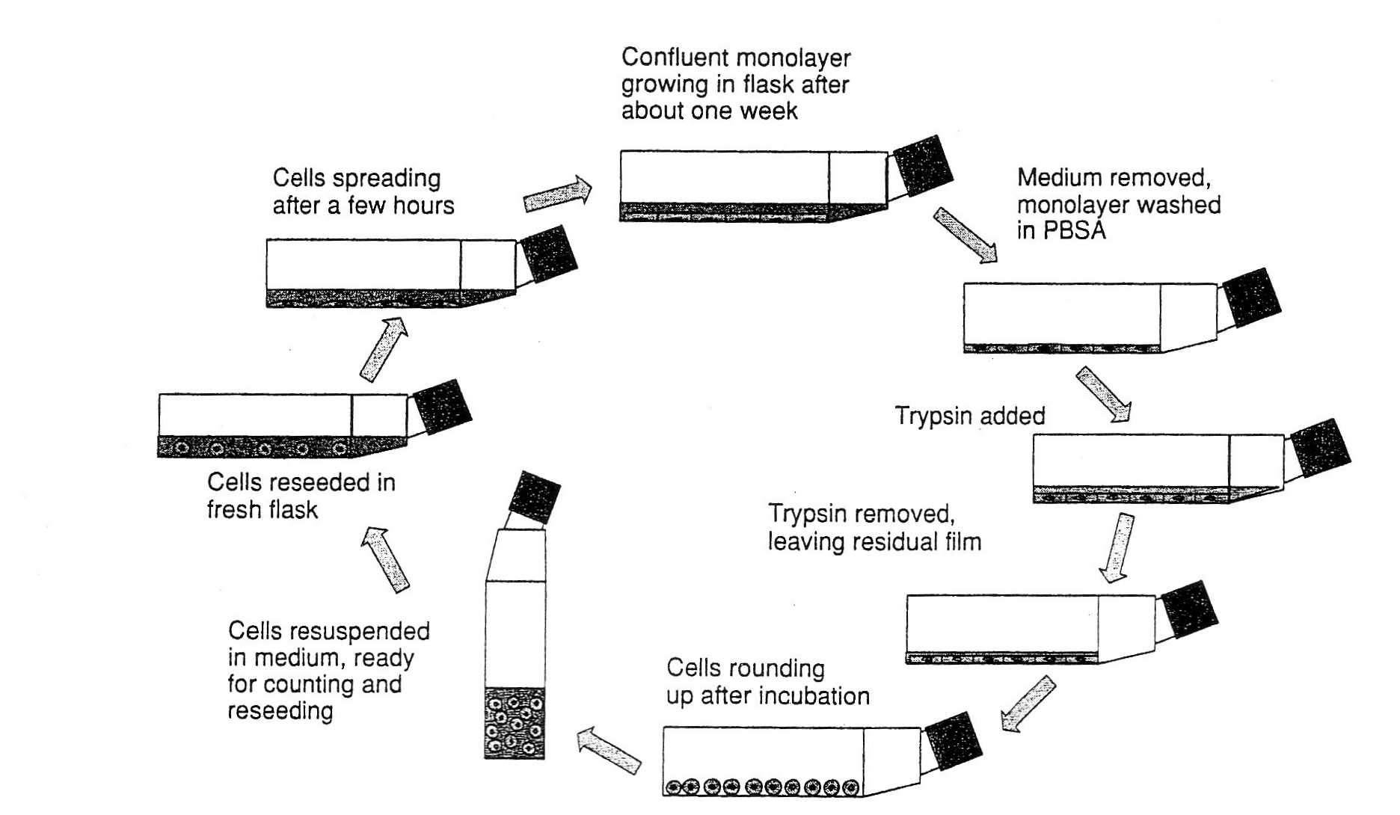
konfluentni sloj stanica nakon tjedan dana rasta
stanice se prihvate i
šire nakon nekoliko sati
medij se ukloni
stanice isperu s PBS
tripsin
stanice se presade
u svježi medij
stanice se zaokruže i odlijepe
stanice se resuspendiraju u mediju za brojanje i nasađivanje
Presađivanje stanica

Slide 15
I
II
2 h
Kontrola
12 h
krajnja
točka:
skupljanje
uzoraka:
stanica,
njihovih
dijelova,
mikroskopiranje
24 h
48 h
različite koncentracije neke tvari
72 h
96 h
Shema eksperimenta određivanja krivulje rasta (I)
i krivulja utjecaja neke tvari (II)

Slide 16
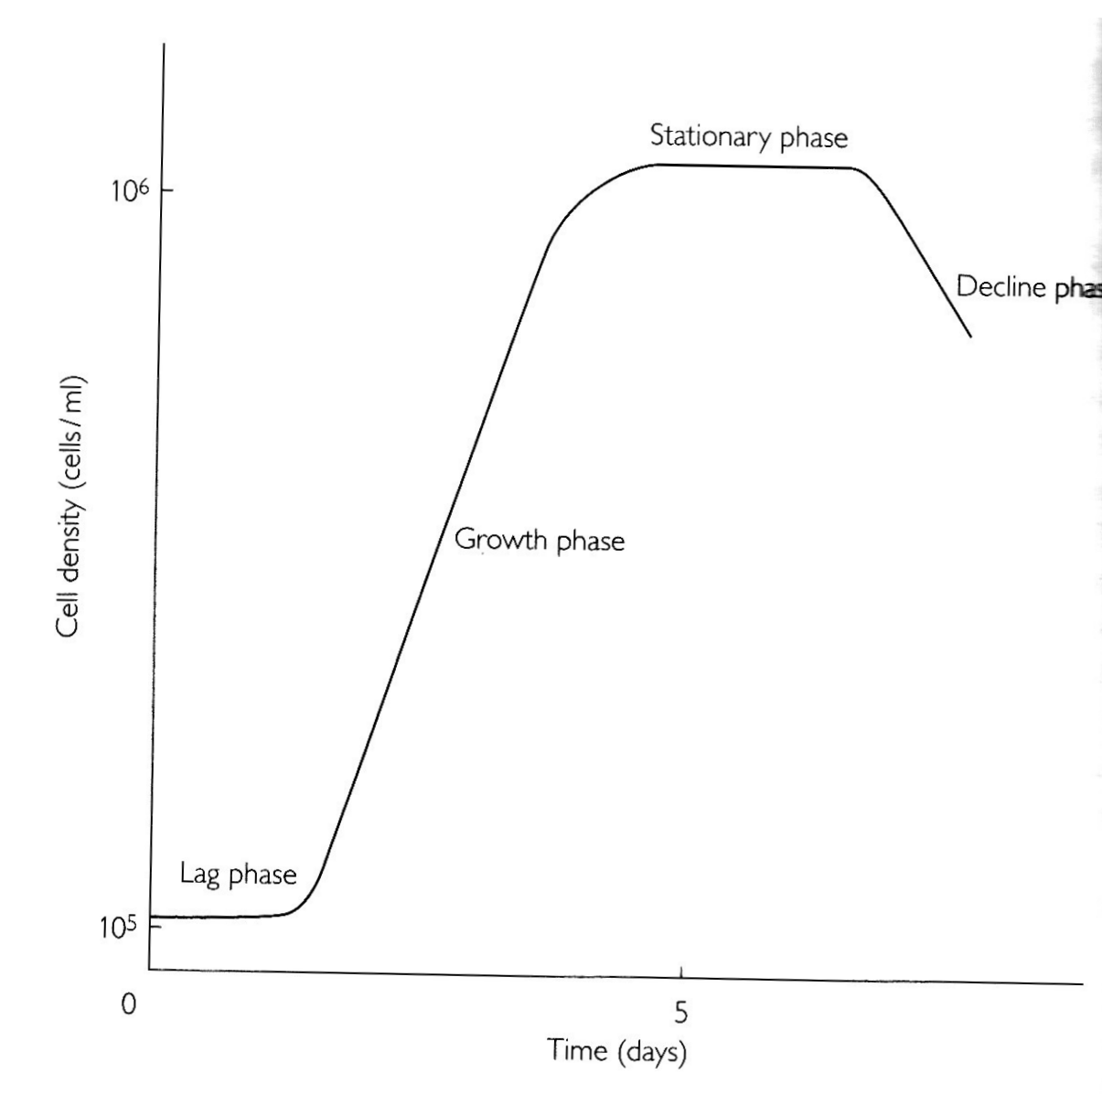
faza opadanja
stacionarna faza
broj stanica
faza
eksponencijalnog
rasta
lag faza
dani u kulturi
Krivulja rasta stanica
Notes:
duplikacijsko i generacijsko vrijeme
lag: koncentracija GF i solubilnih faktora za prihvaćanje, obnova proteina

Slide 17
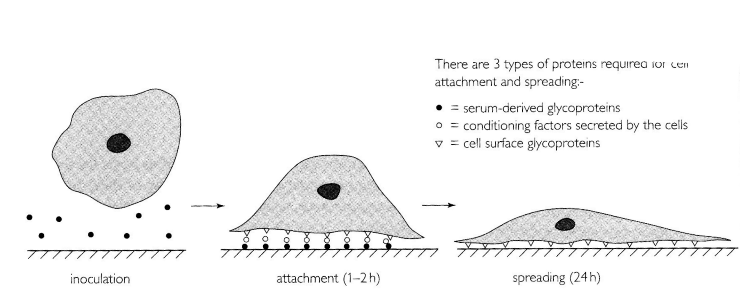
a
a
a
a
inokulacija
prihvaćanje
1-2 h
širenje 24 h
Tri su tipa proteina potrebna za prihvaćanje i širenje:
● glikoproteini seruma
○ faktori koje luče stanice
▽ glikoproteini na površini stanice

Slide 18
Efikasnost nasađivanja
PE plating efficiency
broj prihvaćenih stanica
PE =
broj nasađenih stanica
određuje se nekoliko sati nakon nasađivanja
-lag faza: obnova proteina, prihvaćanje za podlogu, lučenje
solubilnih faktora rasta...

Slide 19
-faza eksponencijalnog rasta
broj stanica
4
2
dani u kulturi
duplikacijsko vrijeme = vrijeme udvostručavanja populacije
određuje se u eksponencijalnoj fazi rasta
generacijsko vrijeme = vrijeme od jedne do druge diobe jedne stanice

Slide 20
faza opadanja
stacionarna faza
broj stanica
faza
eksponencijalnog
rasta
lag faza
dani u kulturi
Krivulja rasta stanica
Notes:
duplikacijsko i generacijsko vrijeme
lag: koncentracija GF i solubilnih faktora za prihvaćanje, obnova proteina

Slide 21
"normalne stanice":
mehanizmi kontrole:
gustoća - dodirna (kontaktna) inhibicija
dodir s podlogom
nedostatak seruma
faktora rasta
aminokiselina - mirovanje
starenje
tumorske stanice:
nemaju mehanizama kontrole
imortalne

Slide 22
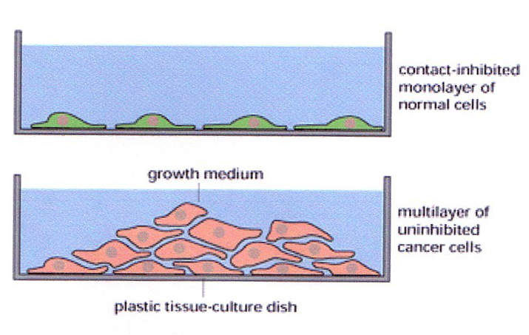
Kontaktna inhibicija

Slide 23
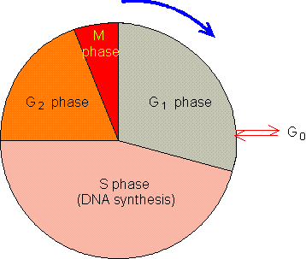
"normalne stanice"
dodirna inhibicija
nedovoljna ishrana
Stanični ciklus

Slide 24
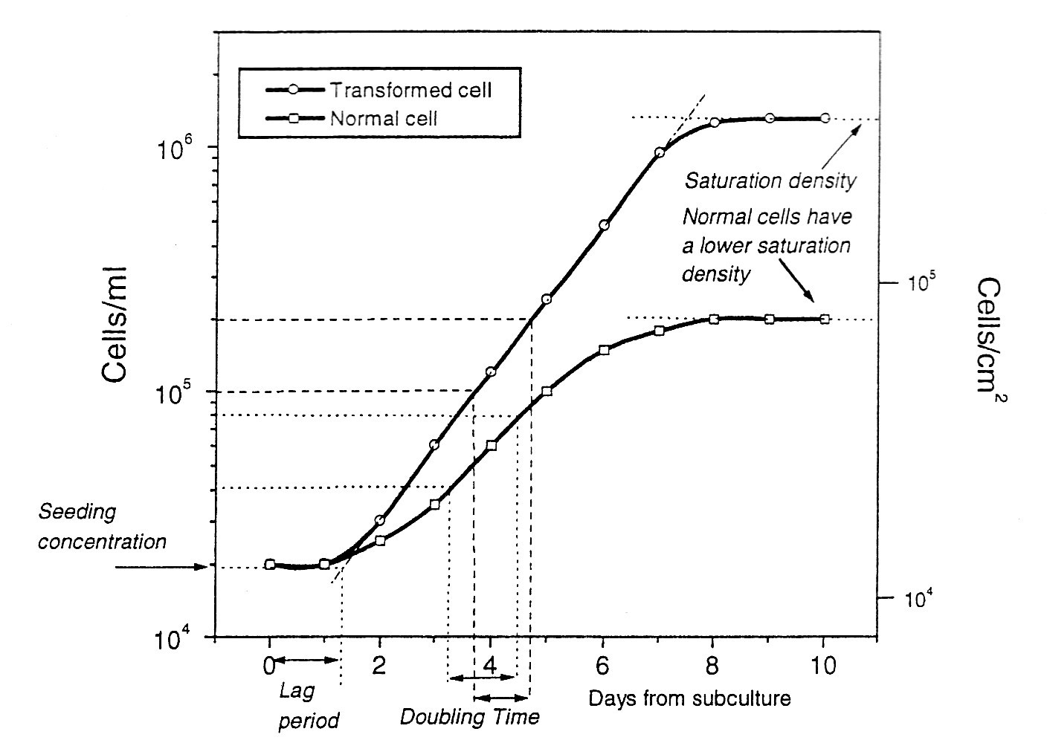
gustoća zasićenja:
tumorske
normalne - manja gustoća
Usporedba krivulje rasta normalnih i transformiranih stanica

Slide 25
faza opadanja
stacionarna faza
broj stanica
faza
eksponencijalnog
rasta
lag faza
dani u kulturi
Krivulja rasta stanica

Slide 26
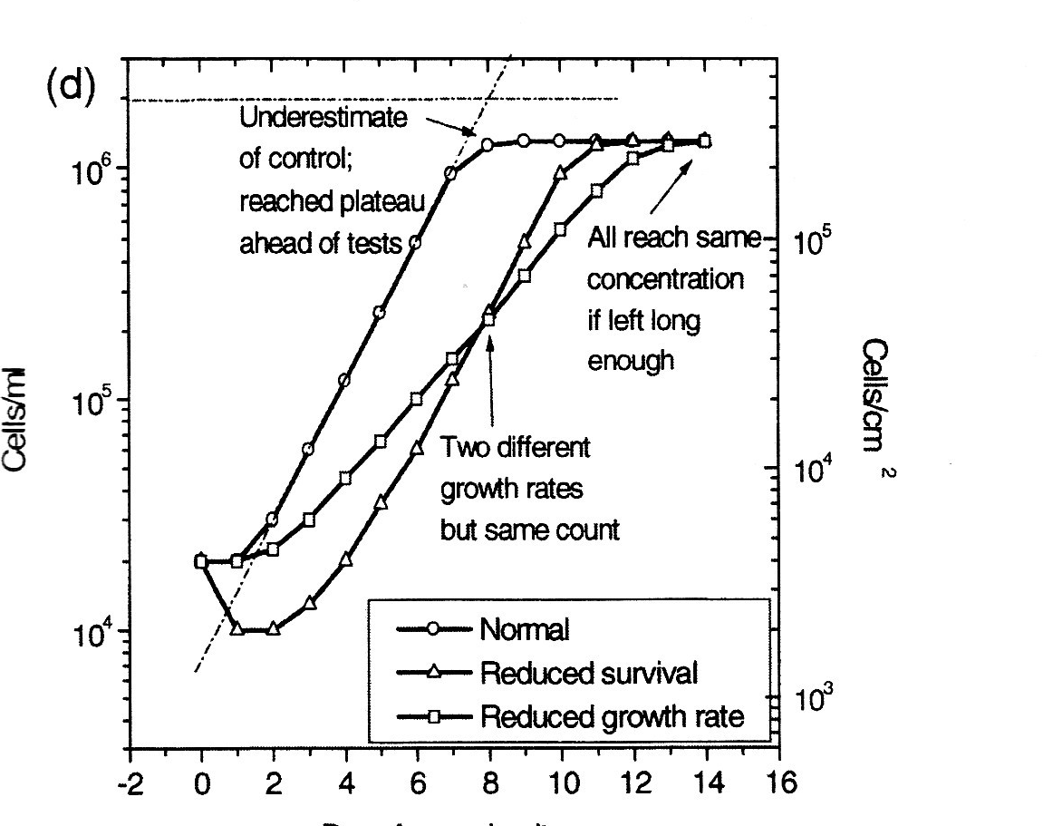
days
koliko traje lag faza
kakav je nagib krivulje
kad se dosiže stacionarna faza
Dinamika krivulja rasta

Slide 27
Efikasnost nasađivanja
PE plating efficiency
broj prihvaćenih stanica
PE =
broj nasađenih stanica
-lag faza: obnova proteina, prihvaćanje za podlogu, lučenje
solubilnih faktora rasta...

Slide 28
Kvantizacija stanica

Slide 29
Kvantizacija = određivanje količine/broja stanica
optimalni uvjeti eksperimenta
mjerenje brzine rasta stanica: početnih kultura
staničnih linija
klonova
mjerenje učinka metabolita
citotoksičnih tvari na rast stanica

Slide 30
Metode kvantizacije
brojanje stanica
količina staničnih tvari
stanične aktivnosti
praćenje vijabilnosti
praćenje proliferacije
praćenje tipa stanične smrti
praćenje staničnih aktivnosti

Slide 31
Metode brojanja
hemocitometar
elektronički brojači stanica

Slide 32
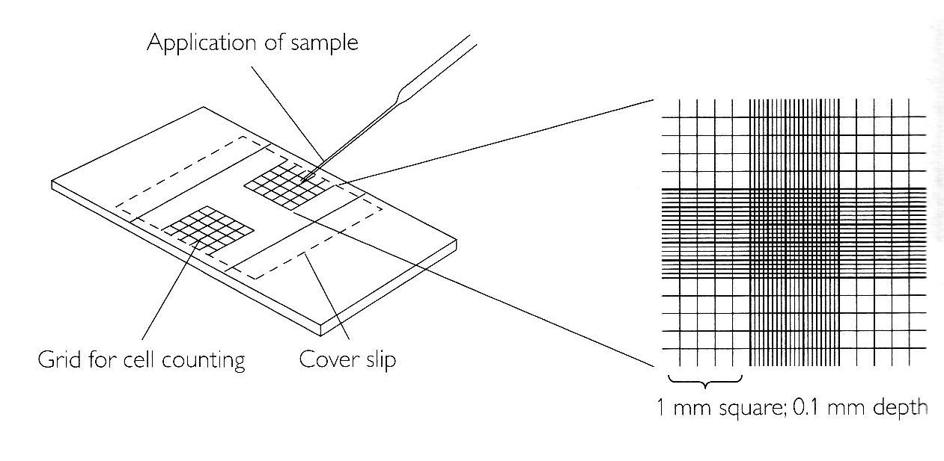
stavljanje uzorka
mrežica za
brojanje
pokrovnica
Hemocitometar
određivanje broja stanica u standardnom volumenu
pomoću predmetnice s mrežicom

Slide 33
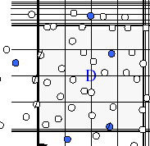
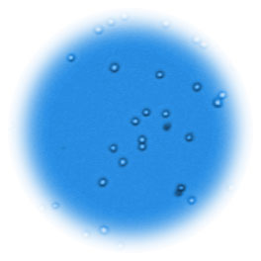
Testovi vijabilnosti:
test ekskluzije ("isključivanja" ) boje (eritrozin ili tripansko modrilo)
plave su mrtve stanice oštećene membrane
Notes:
naftalensko crnilo

Slide 34
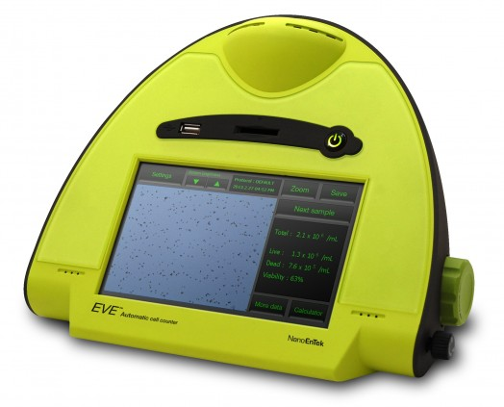
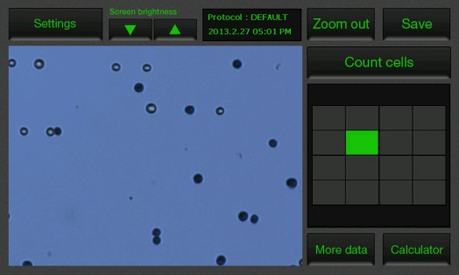
Automatski brojači stanica
(princip hemocitometra)

Slide 35
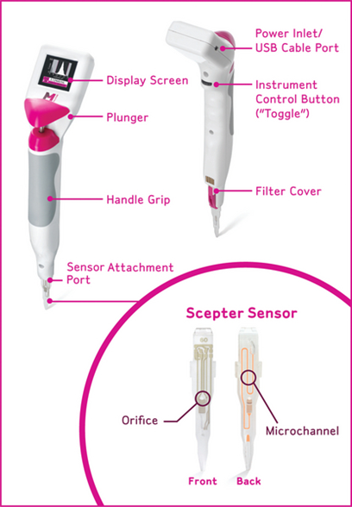
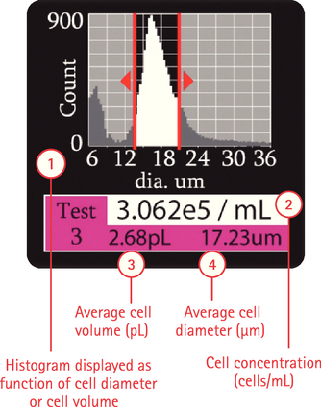
Automatski brojači stanica

Slide 36
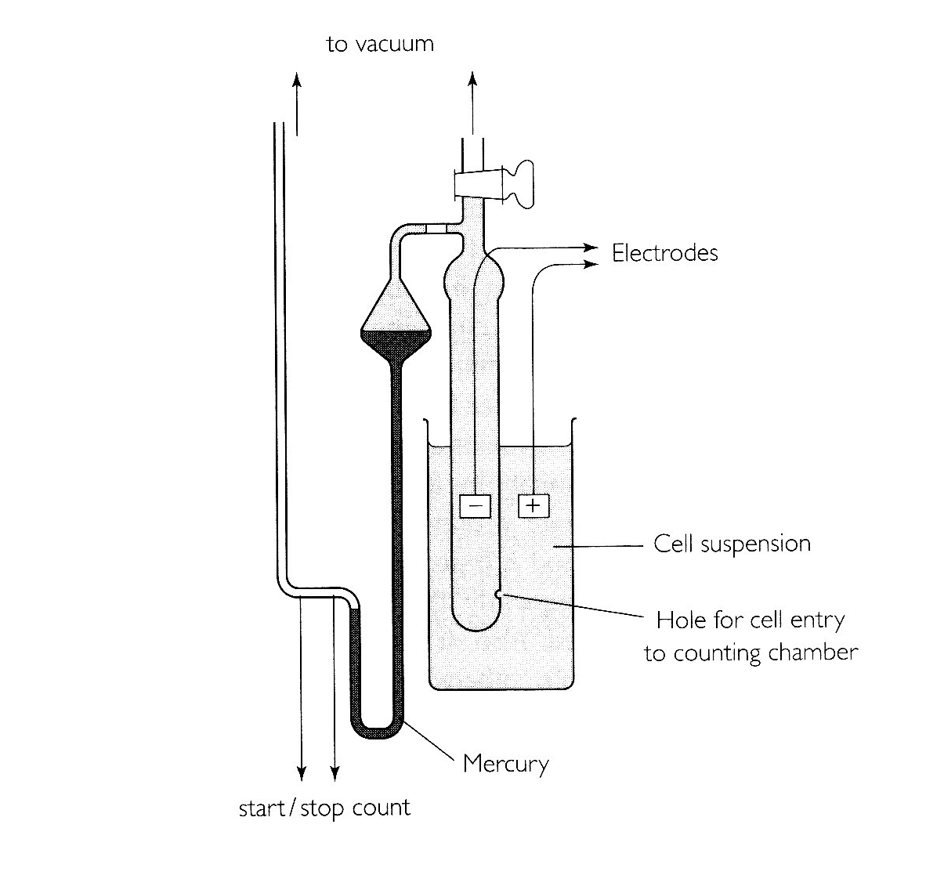
za vakuum
Shema brojača stanica
Coulter counter
elektrode
osnovni princip: promjena otpora tekućine pri prolazu stanice između dviju elektroda
stanična suspenzija
rupica za ulaz stanica
u komoru za brojanje
živa
start/stop
brojača
Notes:
osnovni princip: promjena otpora tekućine pri prolazu stanice kroz dvije elektrode

Slide 37
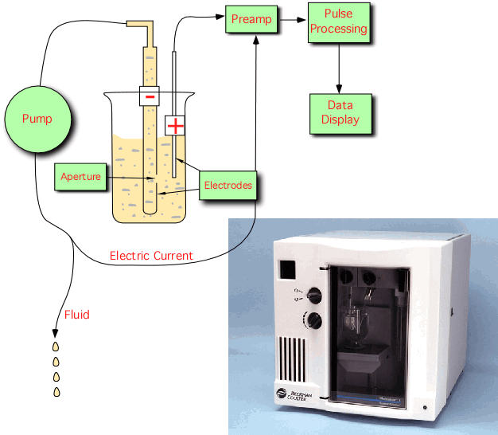
Brojači stanica
https://instruction.bact.wisc.edu/instr/book/displayarticle/105
Notes:
While under contract to the United States Navy in the late 1940s, Wallace H. Coulter developed a technology for counting and sizing particles using impedance measurements. The technology was principally developed to count blood cells quickly by measuring the changes in electrical conductance as cells suspended in a conductive fluid passed through a small orifice. Presently, over 98% of automated cell counters incorporate this technology, which is referred to as the Coulter Principle. In the past seventy-five years, the technology has also been used to characterize thousands of different industrial particulate materials.
Beckman Coulter instrument systems which utilize this principle are called COULTER COUNTER instruments. Drugs, pigments, fillers, toners, foods, abrasives, explosives, clay, minerals, construction materials, coating materials, metals, filter materials, and many other sample types have all been analyzed using the Coulter Principle. This method can be used to measure any particulate material that can be suspended in an electrolyte solution. Particles as small as 0.4 µm and as large as 1600 µm in diameter can routinely be measured. Over 8,000 references to the uses of this technology have been documented.
In a COULTER COUNTER instrument, a tube with a small aperture on the wall is immersed into a beaker that contains particles suspended in a low-concentration electrolyte. Two electrodes, one inside the aperture tube and one outside the tube but inside the beaker, are placed and a current path is provided by the electrolyte when an electric field is applied (Figure 1). The impedance between the electrodes is then measured. The aperture creates what is called a "sensing zone". Particles in low concentration, suspended in the electrolyte, can be counted by passing them through the aperture. As a particle passes through the aperture, a volume of electrolyte equivalent to the immersed volume of the particle is displaced from the sensing zone. This causes a short-term change in the impedance across the aperture. This change can be measured as a voltage pulse or a current pulse. The pulse height is proportional to the volume of the sensed particle. If constant particle density is assumed, the pulse height is also proportional to the particle mass. This technology is also referred to as aperture technology.
Using count- and pulse-height analyzer circuits, the number and volume of each particle passing through the aperture can be measured. If the volume of liquid passing through the aperture can be precisely controlled and measured, the sample concentration can also be determined. In modern COULTER COUNTER instruments, such as the Multisizer™ 3 and 4, particle counter and sizing instruments, pulses are digitized and saved with several key parameters that describe each pulse such as pulse height, pulse width, time stamp, pulse area, etc. These parameters enable the instrument to better discriminate between noise and real pulses as well as between normal and distorted pulses due to various reasons when particles pass through the aperture. Saved pulses can be used to monitor sample changes over the measurement time period should pulses be arranged in time sequence. In practice, particle volume is often represented in terms of equivalent spherical diameter. The measured particle volume (or size) can be then used to obtain particle size distribution.
With counting and sizing rates of up to 10,000 particles per second, it takes less than one minute to perform a typical measurement with a COULTER COUNTER instrument. The accuracy of size measurements can be better than 1%. Aperture size typically ranges from 20-2000 µm. Each aperture can be used to measure particles within a size range of 2 to 80% of nominal diameter. Therefore, an overall particle size-range of 0.4-1600 µm is feasible. However, the ability of the technology to analyze particles is limited to those particles that can be suitably suspended in an electrolyte solution. The upper limit therefore may be 500 µm for sand but only 75 µm for tungsten carbide particles. Moreover, the lower size limit is restricted by electronic noise generated mainly within the aperture itself. The selection of the most suitable aperture size is dependent upon the particles to be measured. If the sample to be measured is composed of particles largely within a 30:1 diameter size range, the most suitable aperture can be chosen. For example, a 30 µm aperture can measure particles from about 0.6 to 18 µm in diameter. A 140 µm aperture can measure particles from about 2.8 to 84 µm. If the particles to be measured cover a wider range than a single aperture can measure, two or more apertures must be used and the test results can be overlapped to provide a complete particle size distribution.
Highest Resolution for Particle Size Analysis
During the Coulter Principle measurement, as a particle passes through the sensing zone when the liquid is drawn from the container, a volume of the electrolyte equivalent to the immersed volume of the particle is displaced from the sensing zone. This causes a short-term change in the resistance across the aperture. This resistance change can be measured either as a voltage or current pulse. By measuring the number of pulses and their amplitudes, one can obtain information about the number of particles and the volume of each individual particle.
The number of pulses detected during measurement is the number of particles measured, and the amplitude of the pulse is proportional to the volume of the particle. Because this is a single-particle measurement process, it yields the highest resolution that any particle characterization technique can achieve. The particle diameter can be determined at the resolution of voltage or current measurement which can be very accurately using current electronics technology. The distribution amplitude can be determined to the accuracy of a single particle.
The advantages of such high resolution are multiple with the most obvious being the capability to display details of a particle size distribution. In a particle size distribution measurement, typically each distribution, whether displayed cumulatively or differentially, is composed of a few-hundred data points in a pre-set size range. Each data point is called a bin. Since every particle is measured, each bin is a collection of particles in a given size range. Depending on the distribution broadness, the total size range can be reset to a finer division, therefore showing the distribution details (i.e., each bin can be pre-set to cover a smaller size range).
Other advantages include fine differential between two particles and more accurate statistic values calculated from the distribution. The figures below show a sample measured using the Beckman Coulter Multisizer 4 and displayed in different size ranges. The pulse data was resorted into a finer set of bins in the right figure in which more detail of the distribution is displayed.
Digital Pulse Process
In Coulter Principle instrumentation, the change in electric resistance due to passages of particles through the aperture is determined using fast electronic circuitry. Detected signals are instantaneously digitized at a rate of a few-million times per second into digital signals. The digital signal is then recorded for every pulse in the form of pulse parameters (i.e., timing, height, width of pulses, etc.). As most measurements seek to obtain particle counting or size distribution, the recorded pulse height is converted to particle size using the calibration constant and placed into one of the pre-set size bins. Particle size distribution and counting are the cumulative result of all pulses measured. All recorded pulse parameters are still available for purposes other than standard, full-range particle size distribution. These parameters can be subtracted or sorted (i.e., reprocessed differently based on specific applications). For example, if an operator seeks to have a zoom-in size distribution showing every detail of the distribution, then a narrower size range can be selected and all pulses can be sorted and placed into the new set of finer bins. Another example is found when pulse heights (or sizes) are sorted in a time sequence (for samples of narrow size-distribution) t monitor sample change during measurement. Still another example is using one plot pulse height as a function of pulse width to find information of particle shape.
As a particle passes through the aperture, it creates a resistance. The bigger the particle, the more the resistance, the greater the voltage. Each voltage spike is directly proportional to the size of the cell. Today every modern hematology analyzer depends in some way on the Coulter Principle.

Slide 38
“Brzina” rasta:
krivulja rasta: određivanje vremena udvostručenja populacije
određivanje broja dioba populacije (PD) u određenom vremenu

Slide 39
broj stanica
u eksponencijalnoj fazi rasta
4
2
dani u kulturi
duplikacijsko vrijeme = vrijeme udvostručavanja populacije
generacijsko vrijeme = vrijeme od jedne do druge diobe jedne stanice

Slide 40
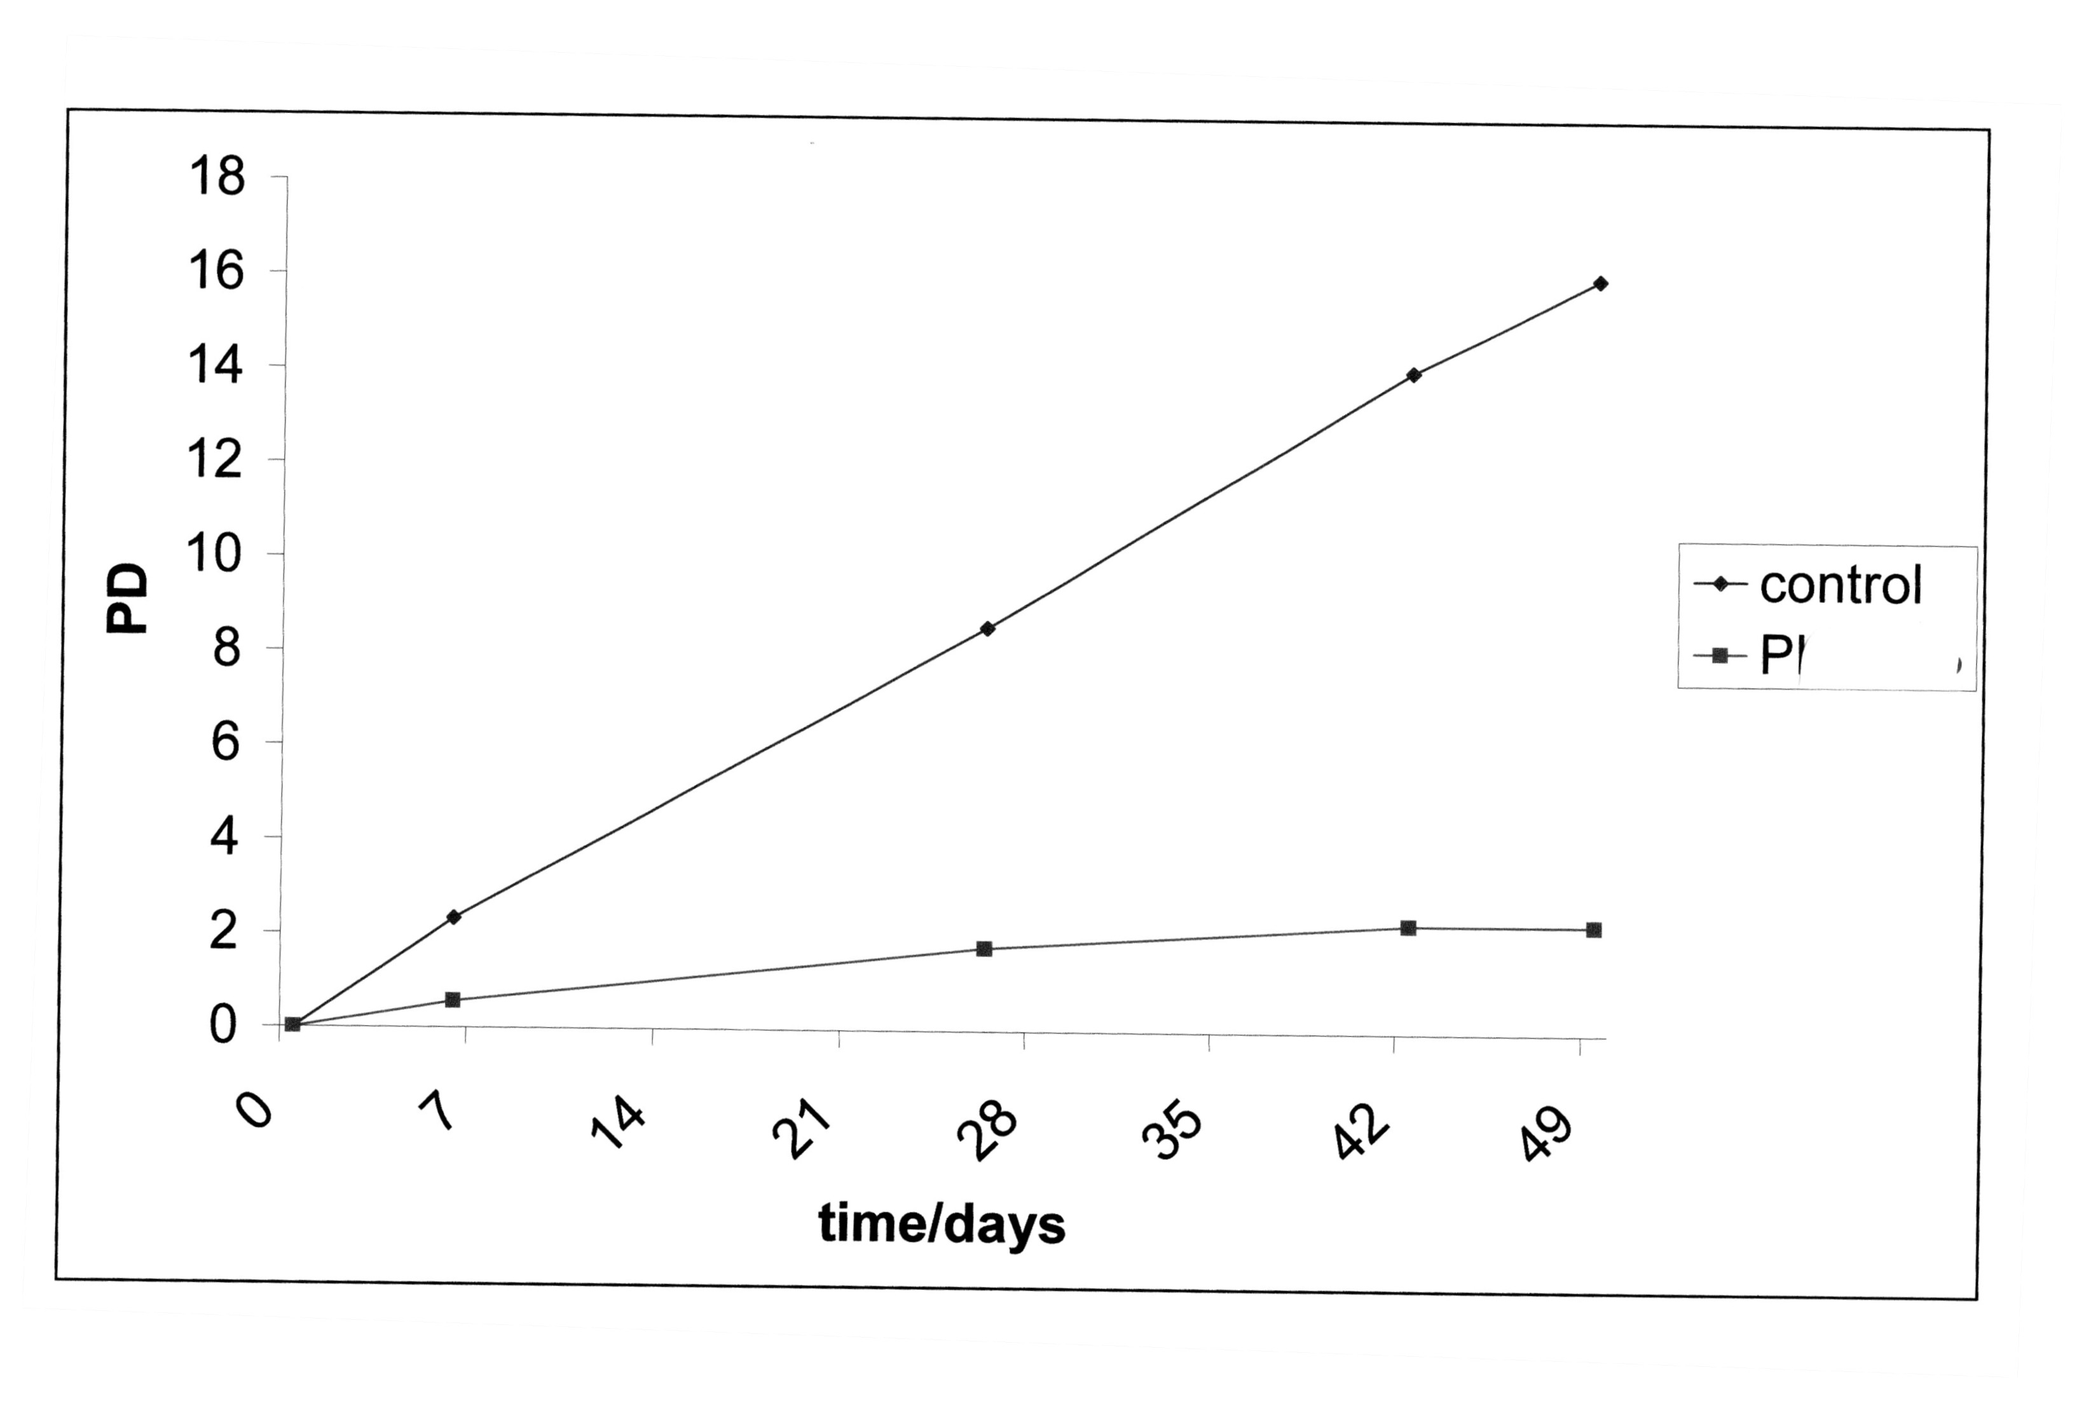
broj udvostručenja populacije
PD = population doublings
N = N₀ x 2^{x}
N
PD = log ------- : log2
N₀
N broj naraslih stanica
N₀broj nasađenih stanica
-usporedba broja duplikacija populacije u određenom vremenu
kontrola
tretirane
stanice
Krivulja rasta kontrolnih i tretiranih stanica
kroz duži vremenski period
stanice se presađuju i broje pri nasađivanju i
tripsinizaciji

Slide 41
Metode određivanja količine stanica:
količina DNA
količina proteina
količina glukoze i laktata - biotehnologija
Notes:
DNA: A260, Hoechst boja u homogenatu stanica, boje za "mrtve" i "žive" stanice
količina proteina Bradford

Slide 42
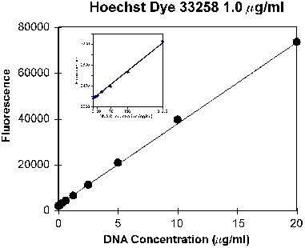
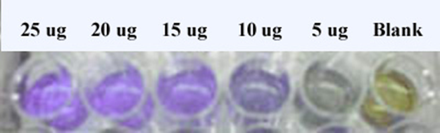
Mjerenje koncentracije DNA pomoću fluorescentnih
boja koje vežu DNA
Bradfordov esej za određivanje
količine proteina
Notes:
Hoechst - žive stanice
Propidij jodid - mrtve stanice

Slide 43
Praćenje stanične vijabilnosti i proliferacije
https://www.youtube.com/watch?v=duTGC4gkRdM
¸

Slide 44
Stupanj sinteze DNA – mjera proliferacije
DNA
ugradnja radioaktivinog timidina (³H timidin)
ugradnja bromdeoksiuridina
specifični markeri sinteze DNA i stanica u ciklusu
proteini
radioaktivni aminokiselinski prekursori (³H-leucin, ³⁵S-metionin)

Slide 45

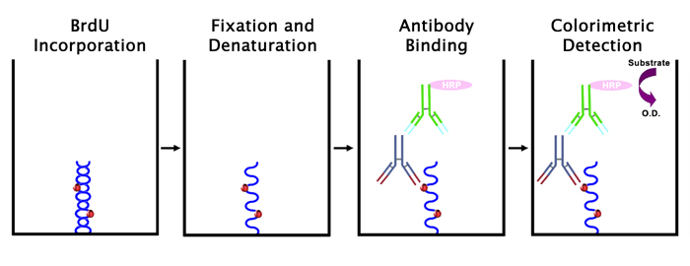
Semikonzervativna duplikacija DNA
radioaktivno obilježavanje
ugradnja analoga BrdU – detekcija antitijelima
obilježenim enzimom ili fluorescencijom
³H timidin

Slide 46
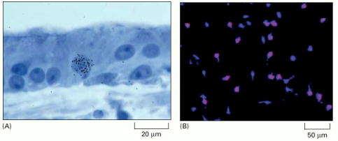
Praćenje sinteze DNA
A ugradnja radioaktivnog timidina
B ugradnja bromdeoksiuridina
udio stanica u proliferaciji
pokazatelj zastoja u proliferaciji zbog starenja ili tretmana tvarima
metode imunobojanja ili enzimske reakcije/spektrofotometrijsko mjerenje

Slide 47
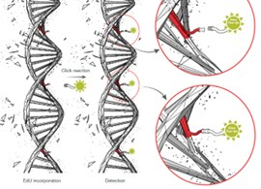
Praćenje proliferacije ugradnjom analoga timina
analiza slike
„Click-iT EdU (5 etinil 2 deoksiuridin) – obilježi se različitim fluorescentnim bojama
https://www.youtube.com/watch?v=AZ35QQDPlH8

Slide 48
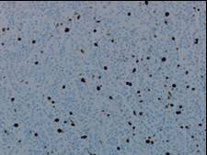
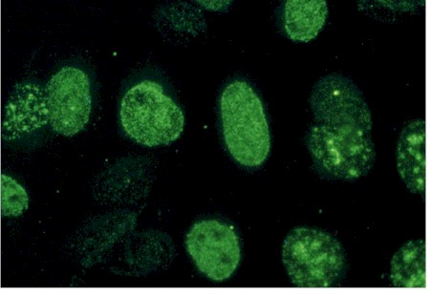
Imunobojanje na Ki67 :
proliferacijski indeks 5%
Imunobojanje na PCNA
(proliferative cell nuclear antigen
kofaktor polimeraze)
Proliferacijski indeks: postotak stanica koji proliferira u nekoj populaciji
- mjera brzine rasta tumora

Slide 49
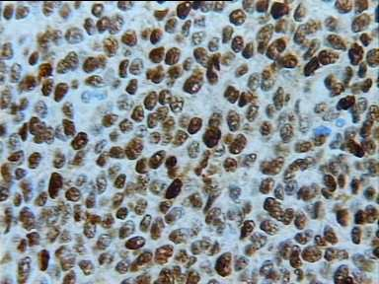
Imunobojanje na PCNA
(proliferative cell nuclear antigen)

Slide 50
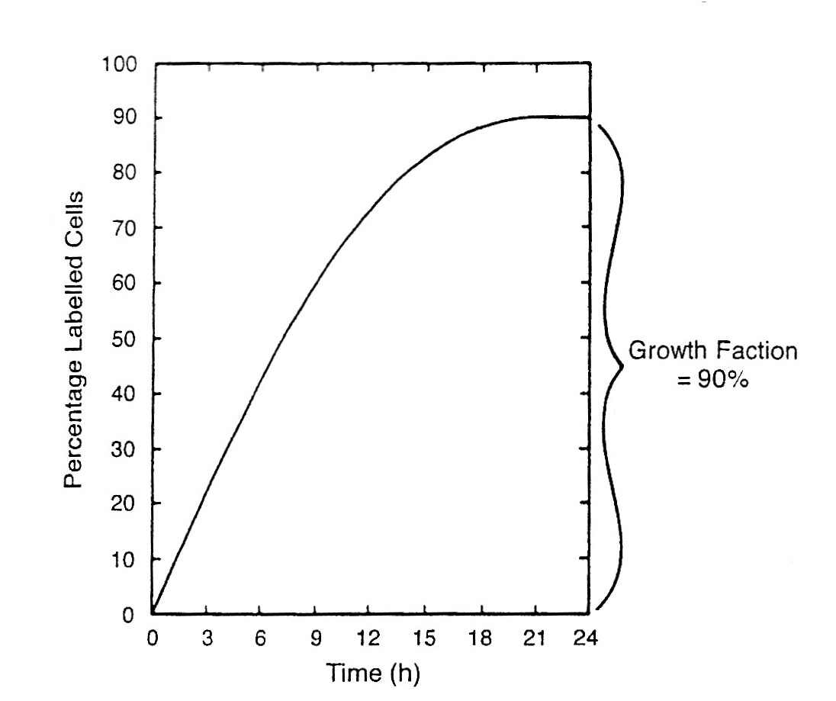
frakcija koja raste
90%
postotak obilježenih stanica
vrijeme (sati)
- rast tumora – proliferacijski indeks

Slide 51
Testovi vijabilnosti:
promjena permeabilnosti membrane
test isključivanja boje: tripansko modrilo, propidij jodid (boji mrtve stanice)
uzimanja boje: diacetil fluorescein (protočni citometar)
(boji žive stanice)
-vidljive boje i fluorescentne (za protočni citometar: diacetil fluorescein, propidij jodid, Hoechst)

Slide 52
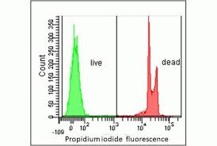
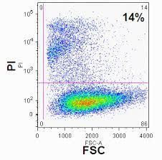
Analiza vijabilnosti protočnom citometrijom

Slide 53
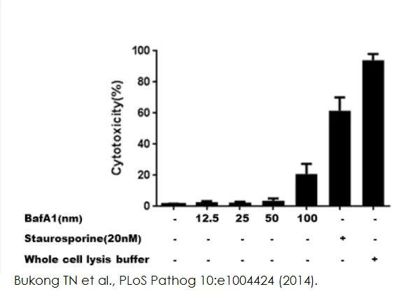
Testovi vijabilnosti:
Određivanje laktat dehidrogenaze LDH
LDH oslobađa se u medij kod oštećenja membrane
aktivnost se mjeri spektrofotometrijski (potrošnja NADH: 340 nm)
-mjerenje kinetike (vrijeme linearne promjene apsorbancije)
piruvat + NADH + H+ ↔ laktat + NAD+
LDH
Notes:
aktivnost = formula, jedinice po mL, 1 U je 1 mikromol NADH koji se potrošio u minuti
mjerenje svake min.
kontrole O = žive stanice,
mrtve_ odmrznuta pločica

Slide 54
Testovi vijabilnosti
-metabolički testovi
supstrat
produkt (boja, apsorpcija)
stanični enzim ili
komponenta razmjerna
količini (živih) stanica

Slide 55
Metabolički testovi
MTT - 4,5,dimetiltiazol-2-il)-2,5-difenil tetrazolij bromid
žuta tetrazolijska boja purpurni formazanski produkt
(topiva u vodi) (netopiv u vodi)
mali volumeni
jednostavnost, brzina, pogodna cijena
velik broj uzoraka
žive stanice
https://www.youtube.com/watch?v=vn6enA6lSKs
https://www.youtube.com/watch?v=2mJ8lKfOgs0 detaljan
Notes:
Jeftino, brzo, jednostavno, velik broj uzoraka

Slide 56
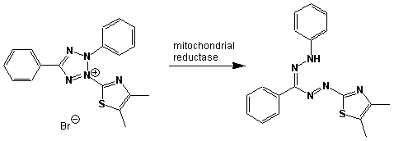
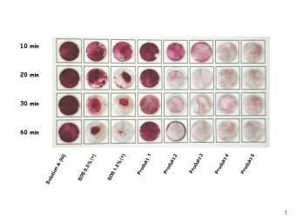
mitohondrijska
reduktaza
MTT
4,5,dimetiltiazol-2-il)-2,5-difenil tetrazolij bromid
Notes:
neutralno crvenilo-lizosomi, Golgij, živih stanica, spektrofotometrijski

Slide 57

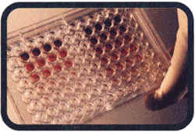

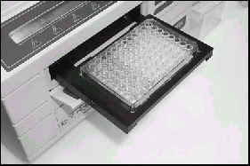
Test vijabilnosti pomoću testa MTT (aktivnost mitohondrijske reduktaze
MTT - 4,5,dimetiltiazol-2-il)-2,5-difenil tetrazolij bromid)
stanice se nasade na mikrotitracijsku
pločicu, obrade nekom tvari i ostave rasti 24 sata (ili duže)
doda se žuta tetrazolijska boja i nakon 3 sata reakcija se prekida pomoću dimetil sulfoksida koji otapa boju (ljubičasto obojenje netopivog formazana) mjeri se apsorpcija (570 nm)
-intenzitet boje mjera je broja živih stanica
Notes:
fiksacija u formaldehidu, solubilizacija u aceto-etanolu

Slide 58
Test vijabilnosti pomoću neutralnog crvenila
(lizosomi)
stanice se nasade na mikrotitracijsku
pločicu, obrade nekom tvari i ostave
rasti
neutralno se crvenilo doda na tri sata, stanice liziraju i mjeri se apsorpcija (540 nm)
-stanice aktivno uzimaju
boju i koncentriraju je u
lizosomima
Notes:
fiksacija u formaldehidu, solubilizacija u aceto-etanolu

Slide 59
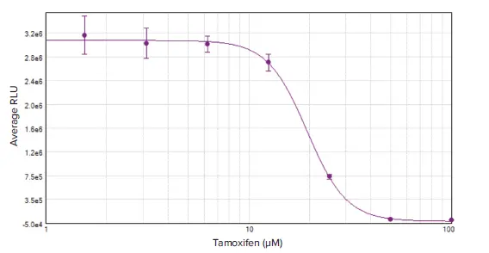
srednja vrijednost apsorbancija tretiranih stanica
vijabilnost =
srednja vrijednost apsorbancija kontrolnih stanica
- IC 50 koncentracija za inhibiciju rasta 50 % stanica
Notes:
https://worldwide.promega.com/resources/guides/cell-biology/cell-viability

Slide 60
praćenje apoptoze
apoptoza:
programirana stanična smrt
uklanjanje “neželjenih stanica”
fagocitoza makrofagima
nema upale
nekroza:
bubrenje i pucanje membrane
izlijevanje sadržaja i upala
Notes:
virusi, razvoj, mutacije

Slide 61
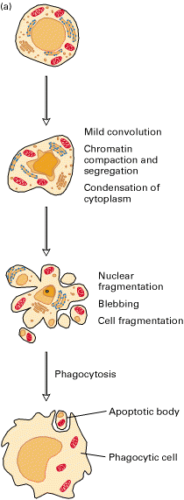
Apoptoza
kondenzacija
kromatina
kondenzacija
kromatina
fragmentacija DNA
fragmentacija jezgre
bubrenje
stanična fragmentacija
fragmentacija DNA
fragmentacija jezgre
bubrenje
stanična fragmentacija
fagocitoza
fagocitoza
apoptotsko tjelešce
apoptotsko tjelešce
fagocit
fagocit

Slide 62
Apoptoza u organizmu:
embrionalni razvoj (mozak, prsti) i metamorfoza
"nepotrebne" stanice (hematopoetske)
oštećeno tkivo
u staničnoj kulturi: metode detekcije tipa stanične smrti
Notes:
metamorfoza

Slide 63
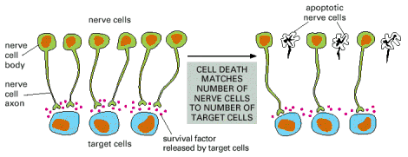
Apoptoza živčanih stanica u nedostatku NGF:
broj preživjelih stanica = broj ciljnih stanica

Slide 64
Pokretači apoptoze:
vanjski: aktivacija "receptora smrti"
unutarnji: oštećenje DNA
aktivacija onkogena
hipoksija - nedostatak kisika
nedostatak faktora rasta
poremećaj staničnog ciklusa
puno "varijanti" puteva apoptoze

Slide 65
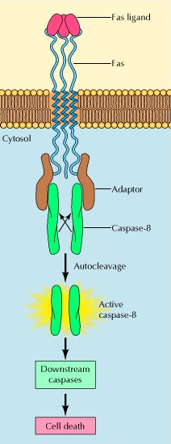
Fas
TNF receptor
Aktivacija "receptora smrti“
-vanjski put aktivacije
Notes:
Fas: imunološki sustav, virusi tumori

Slide 66
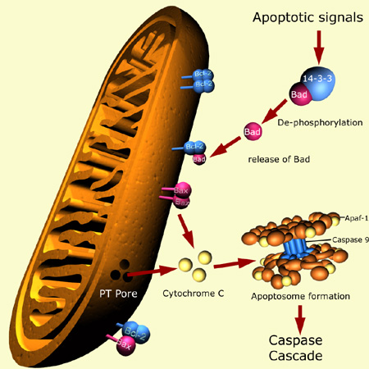
apoptotski signal
↓
promjena proteina obitelji Bcl-2
na mitohondrijskoj membrani
↓
oslobađanje citokroma c
↓
aktivacija prokaspaza u kaspaze
↓
kaskada aktivacija kaspaza
↓
cijepanje supstrata: DNA i proteina
↓
smrt stanice

Slide 67
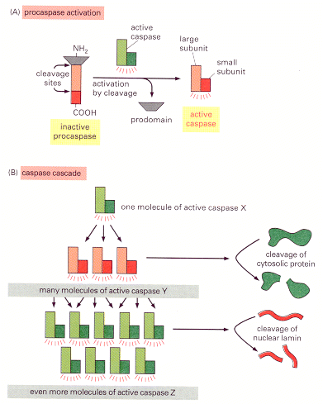
aktivacija kaspaza
cijepanjem prokaspaza
kaspazna kaskada:
amplifikacija djelovanja
cijepanje citosolnih
proteina i jezgrene lamine
aktivacija endonukleaza

Slide 68
aktivatori apoptoze (unutrašnji)
↓ ↓
aktivacija porodice Bcl-2 aktivacija p53
↓ ← transkripcija gena za apoptozu
(Bcl-2 obitelj, "receptori smrti")
oslobađanje citokroma c
iz mitohondrija
↓
aktivacija "aktivacijskih" kaspaza
↓
aktivacija izvršnih kaspaza
↓
kondenzacija kromatina
cijepanje DNA (između nukleosoma - oko 200 pb)
cijepanje jezgrene ovojnice i drugih proteina
↓
fagocitoza apoptotskih tjelešaca - fragmenata stanice
inicijalna faza
faza odluke
izvršna faza
završna faza
Notes:
8 i 10
3 i 7
inicijalna faza
faza odluke
izvršna
završna

Slide 69
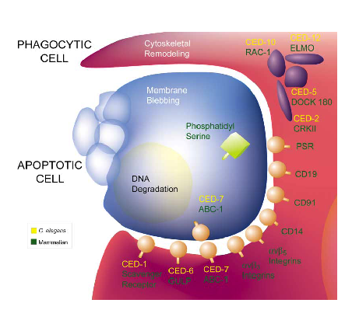
Regulacija fagocitoze apoptotske stanice kod C. elegans i sisavaca

Slide 70
Metode detekcije apoptoze:
fosfatidil serin
detekcija lomova DNA – ljestvice, TUNEL (end labeling)
protočni citometar: subG1 količina DNA
bojanje – specifični izgled
cijepanje specifičnih proteina kaspazama (PARP-1, detekcija kaspaza)
-inhibitori kaspaza
Notes:
inhibitori kaspaza
TUNEL Universal Apoptosis Detection Kit (biotin-labeled POD) (Cat. No. L00290) is used for assaying adherent cells, paraffin-embedded tissue sections, and cryopreserved tissue sections. The kit can detect fragmented DNA in the nucleus during apoptosis. In this modified TUNEL assay kit, biotinylated nucleotide is labeled at the DNA 3'-OH ends using the natural or recombinant terminal deoxynucleotidyl transferase (TdT or rTdT). Then, horseradish peroxidase-labeled streptavidin (streptavidin-HRP) is bound to these biotinylated nucleotides, which are detected using the peroxidase substrate, hydrogen peroxide, and 3,3’-diaminobenzidine (DAB), a stable chromogen. Using this procedure, apoptotic nuclei are stained dark brown.

Slide 71


Aneksinski esej:
žive stanice: neobojane propidij iodidom
i fluoresceinom
rane apoptotske stanice:
obojane fluoresceinom (fosfatidilserin)
neobojane PI: intaktna membrana
kasne apoptotske ili nekrotične stanice
obojane fluoresceinom i PI

Slide 72

Princip detekcije ranih apoptotskih stanica prepoznavanjem fosfatidil-serina s vanjske strane stanice

Slide 73

apoptotske
stanice
intaktna membrana
fragmentacija
Limfociti tretirani kamptotecinom (kemoterapeutik)
Molecular probes
Notes:
detekcija apoptoze: morfološki bojanje Hoechstom i PI, fosfatidilserin, PARP cijepanje
detekcija dvolančanih lomova, FACS – sub G1
TUNEL: terminal deoksinukleotidil transferase mediated dUTP end labeling

Slide 74

„Blebbing” – nastanak malih mjehurićastih struktura i vezikula nazvanih apoptotskim tjelešcima
Notes:
Blebbing Bodies
By Thomas Deerinck and Mark Ellisman, NCMIR, UCSD
When cells apoptose, they appear to collapse, forming small blebs and vesicles called apoptotic bodies. Here, an apoptotic HeLa cell (center) sits among its healthy and dividing counterparts, revealing a striking collection of blebs on its surface. Although HeLa cells are the workhorse of many in vitro cell biological experiments, they are far from normal. They are propagated from a cervical tumor and contain an aberrant genome with multiple copies of several human chromosomes, some of which also carry papilloma viral genes.

Slide 75

Detekcija apoptoze “ljestvicama”
Stanice Jurkat tretirane kamptotecinom
nakon 0 sati (1), 6 (2) i 12 sati (3).
Biomax

Slide 76

Sub G1 frakcija apoptotskih stanica
/www.mpimagdeburg.mpg.de/research

Slide 77

TUNEL esej: obilježavanje dvolančanih lomova terminalnom transferazom

Slide 78

Kvantitativne metode detekcije apoptoze:
detekcija specifičnog produkta apoptoze (kaspaze, dvolančani lom itd.) pomoću antitijela obilježenog enzimom, fluorescencijskom bojom ili pomoću „potencijalno fluorescentnog ili luminiscentnog” supstrata
-kompleti za istovremeno mjerenje vijabilnosti, citotoksičnosti i apoptoze – dobiva se omjer te ne ovisi o broju stanica
Notes:
kaspaze: svijetle ako im se doda specifičan susptrat
The Caspase-Glo® 3/7 Assay provides a homogeneous luminescent assay that measures caspase-3/7 activities. The assay provides a proluminescent caspase-3/7 DEVD-aminoluciferin substrate and a proprietary thermostable luciferase in a reagent optimized for caspase-3/7 activity, luciferase activity and cell lysis. Adding the single Caspase-Glo® 3/7 Reagent in an "add-mix-measure" format results in cell lysis, followed by caspase cleavage of the substrate. This liberates free aminoluciferin, which is consumed by the luciferase, generating a "glow-type" luminescent signal. The signal is proportional to caspase-3/7 activ...
The ApoTox-Glo™ Triplex Assay combines three assay chemistries to easily assess viability, cytotoxicity and apoptosis events in the same cell-based assay well. First, viability and cytotoxicity are determined by measuring two differential protease biomarkers simultaneously with the addition of a single nonlytic reagent containing two peptide substrates. The live-cell protease activity is restricted to intact viable cells and is measured using a fluorogenic, cell-permeant peptide substrate (GF-AFC Substrate). The substrate enters intact cells, where it is cleaved to generate a fluorescent signal proportional to the number of living cells. This live-cell protease activity marker becomes inactive upon loss of membrane integrity and leakage into the surrounding culture medium. A second, cell-impermeant, fluorogenic peptide substrate (bis-AAF-R110 Substrate) is used simultaneously to measure dead-cell protease activity that has been released from cells that have lost membrane integrity. This results in ratiometric, inversely correlated measures of cell viability and cytotoxicity. The ratio of viable cells to dead cells is independent of cell number and, therefore, can be used to normalize data. A second reagent containing luminogenic DEVD-peptide substrate for caspase-3/7 and Ultra-Glo™ Recombinant Thermostable Luciferase is added. Caspase-3/7 cleavage of the substrate releases luciferin, which is a substrate for luciferase and generates light. The light output, measured with a luminometer, correlates with caspase-3/7 activation as a key indicator of apoptosis

Slide 79
Vijabilnost
kratkoročni odgovor
brojanje stanica
kvantitativno određivanje količine nekog produkta karakterističnog za žive/mrtve stanice:
protočnim citometrom
mikroskopijom
spektrofotometrijom

Slide 80
Preživljenje/proliferacija
esej rasta kolonija
dugoročni test
sposobnost regeneracije - popravka
efikasnost nasađivanja: rast kolonija
Notes:
broj pacijenata s tumorima koji će rasti in vtro i to u dovoljnoj količini da se može testirati i slijediti kroz duže vrijeme kako reagira na razne citostatike je jako malen. Zato je teško koristiti in vitro testove kao prediktore odgovora ili provjeriti pouzdanost eseja.

Slide 81
Parametri testova preživljenja/vijabilnosti
Kontrola
kvantitativno
mjerenje
parametra
preživljenja
ili vijabilnosti
različite
koncentracije
neke tvari
koncentracija i
duljina izlaganja
završna točka u kojoj se
kvantizira efekt
vrijeme
"oporavka"
vrsta kulture
gustoća stanica

Slide 82
Ispitivanje citotoksičnosti:
pronalaženje aktivnih spojeva
ispitivanje antitumorske aktivnosti
koncentracija i duljina ekspozicije
mehanizam djelovanja
osjetljiva/rezistentna populacija stanica
primarne kulture
adherirane stanične linije
rast u mekom agaru

Slide 83
Ograničenja eseja in vitro
farmakokinetika
(metabolizam, prodor u tkivo, izlučivanje)
metabolizam (jetra)
tkivni i sistemski odgovor (upala, porast temperature)
Notes:
jednostavnost, standardiziranost, ekonomičnost
adme

Slide 84

Preživljenje kolonija (klonova nastalih iz jedne stanice)
uspoređuje se sposobnost proliferacije (kod vijabilnosti: mjera živih stanica, stanice moguće oštećene; kod preživljenja: sposobnost da diobama stvore koloniju

Slide 85



Automatski brojač kolonija
Freshney i sur. CULTURE OF ANIMAL CELLS; 6 iz.

Slide 86
Efikasnost nasađivanja kolonija
Colony plating efficiency
broj naraslih kolonija
CPE =
broj nasađenih stanica
Preživjela frakcija
broj kolonija tretiranog uzorka
SF =
broj kolonija kontrolnog uzorka
CPE obrađene kulture
Preživljenje (%) =
CPE kontrolne kulture
http://www.abnova.com/abvideo/Clonogenic-Assay.html

Slide 87

-krivulje s koljenom:
više staničnih meta
koje trebaju biti
pogođene da bi
stanica uginula
koljeno krivulje
n>1
n=1
preživjela frakcija
IC₅₀
IC₉₀
koncentracija citotoksičnog spoja
Krivulja preživljenja
IC: inhibitorna koncentracija – mjera citotoksičnosti
LD: letalna doza

Slide 88

Metode izolacije kolonija
-selekcija: prežive samo pojedine
stanice
serijsko razrijeđenje
nasađivanje pojedinačnih stanica
nasađivanje na ploču s 96 jažica
izolacija kolonija zračenjem/
selektivnim ubijanjem
prstenima za izolaciju
nasađivanje kolonija
za izolaciju (selekcija)
za brojanje (kvantizacija)

Slide 89
https://www.youtube.com/watch?v=9eE9grrj3rI
kontaminacija
https://www.youtube.com/watch?v=WWS9sZbGj6A
hemocitometar
https://www.youtube.com/watch?v=BeJu5Qj6JLc
odmrzavanje stanica

