Slide 1
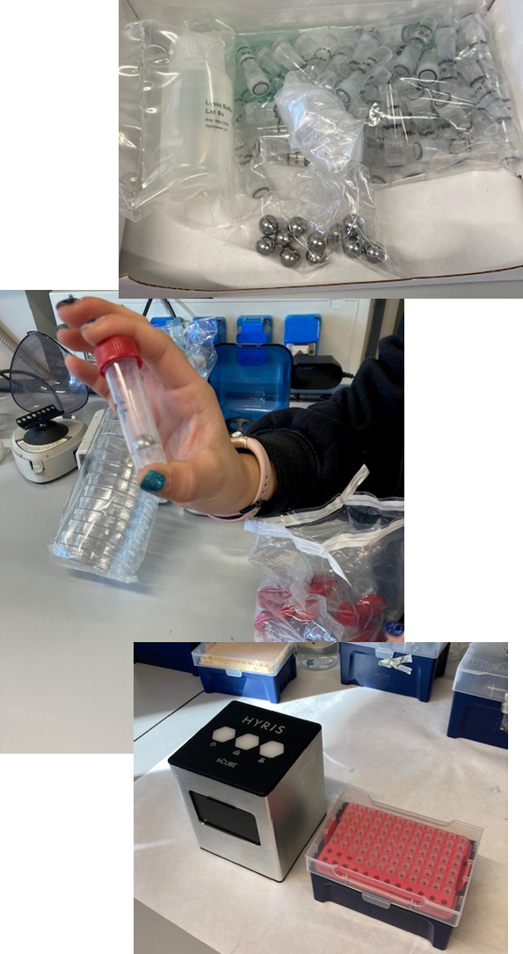
Loop-mediated isothermal amplification of DNA
Paper Notomi et al. 2000, Nucleic Acids Res. 28, e63
LAMP
Specific, fast, efficient (10⁹ copies in 1 h), isothermal!
High selectivity because 4 primers recognize 6 target sequences.
DNA polymerase with strand displacement activity (Bacillus stearothermophilus)
Efficiency increased by:
The addition of 0.5-1.5 M betaine (N,N,N-trimethylglycine) – reduces base stacking
Not for long targets – 300 bp is the limit
Not suitable for multiple targets, but there were some attempts recently.
Downstream analyses (sequencing, cloning) are not possible.
RNA templates can be used along with reverse transcriptase.
Simple to perform, no complicated machinery or laboratory needed.

Slide 2
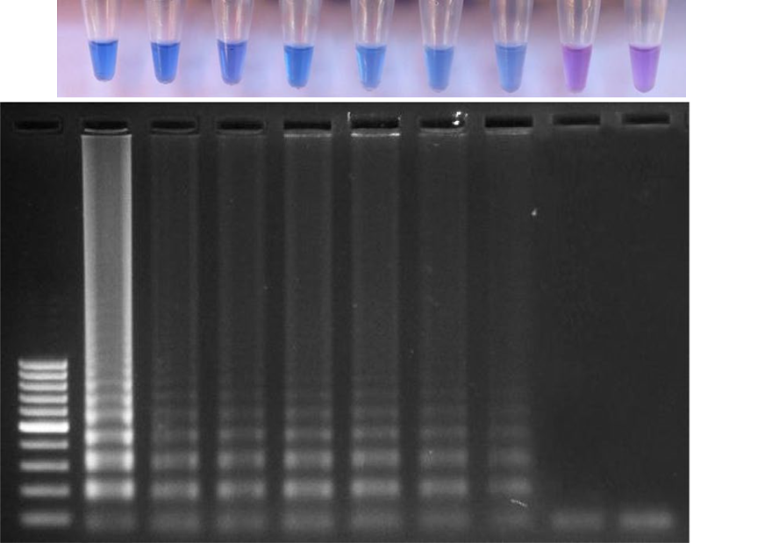
Accelerated LAMP
Paper Nagamine et al. 2002, Molecular and Cellular Probes 16, 223-229.
The use of additional primer pair (loop primers) is the basis for „acceleration”.
Reaction can be performed in half of the time needed for LAMP.
The concept and the primer design is a bit complicated but the procedure is simple!
The result is not one band but amplicons of different sizes and structures.
Detection is easy – with or without electrophoresis:
Intercalating dyes (ethidium bromide, sybr green, etc…)
Magnesium pyrophosphate turbidity
Hydroxy naphthol blue (HNB) in tubes (Figure - right) – it is important to use trisodium salt (120 µM in water), not disodium
Fluorescent dyes in real-time PCR machine.
Marimuthu et al. 2020, Loop‐mediated isothermal amplification assay for the detection of Plasmopara viticola infecting grapes. Journal of Phytopathology, 168: 144–155.

Slide 3
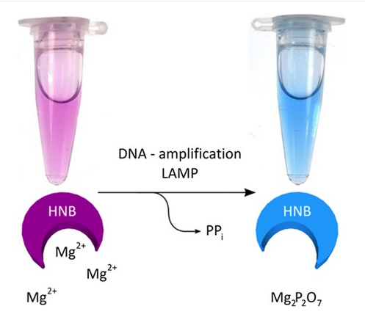
Scheme of color change of HNB after positive LAMP assay. Magnesium ions react with pyrophosphate derived from dNTPs during LAMP reaction and generate a precipitate, the resulting depletion of magnesium ions in solution results in a color change from violet to blue, indicating a positive reaction.

Slide 4
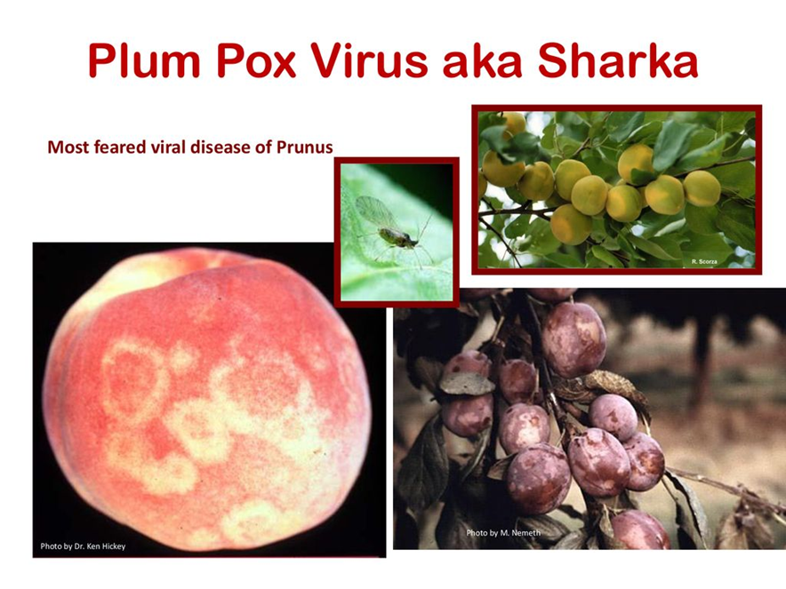
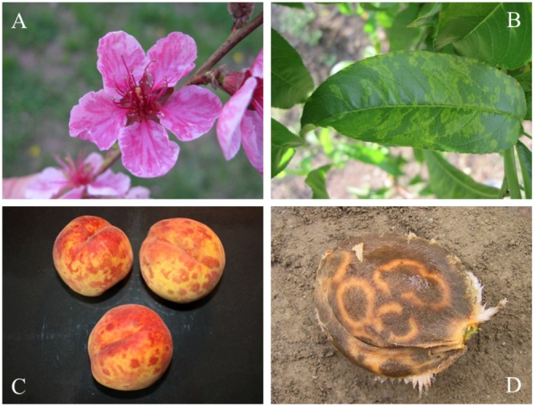
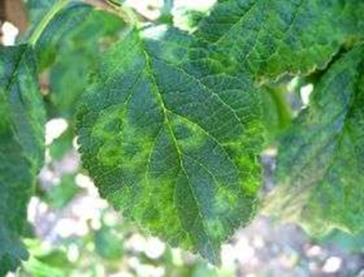
Sochor et al. 2012, Viruses 4, 2853-2901; doi:10.3390/v4112853

Slide 5
Use of reverse transcription loop-mediated isothermal amplification for the detection of plum pox virus
Varga & James, 2006, J. Virol. Meth. 138: 184–190.
plum pox virus (PPV), Potyviridae
Sochor et al. 2012, Viruses 4, 2853-2901; doi:10.3390/v4112853
Targets C-terminus of the PPV coat protein (CP) gene.
RT-LAMP detects isolates five (out of currently 10 known Dideron (D), Marcus (M), Recombinant (Rec), Cherry (C), Cherry Russian (CR), EL Amar (EA), Winona (W), Turkish (T), Ancestral (An) and Cherry Volga (CV)) PPV strains including D, M, EA, C, and W.

Slide 6
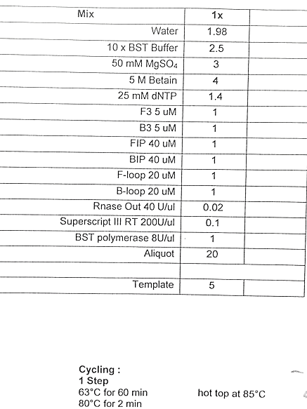
Table for PPV RT-LAMP master mix and reaction conditions from the paper Varga & James 2016.
We do not do this procedure in 2026 but we do use primers as a mix from this paper!
??
19
HNB dye 2 mM stock
1

Slide 7
We will be using very simple procedure from the protocol of the kit for colorimetric Warm Start LAMP detection of DNA or RNA templates by New England BioLabs (NEB brochure is in the materials online).
Procedure:
Prepare the list of samples. Include positive controls (PPV-D from ELISA kit, diluted PPV+ no. 2 from plum 2003)
Homogenize in bags 100 mg of fresh tissue samples with 1ml of LAMP “extraction” buffer
Transfer homogenate to 1.5 or 2ml Eppendorf tubes and do 100x dilution with PCR water in another row of tubes. Keep them on ice. Alternatively, just transfer 10 microliters of homogenate to a tube with 90 microliters of PCR water.
The diluted homogenate will be your reaction template (RNA).
Prepare the reaction mix for all samples according to the following recipe for one sample:
12.5 µl of colorimetric 2x master mix (kit)
2.5 µl of 10x mix of six primers (pre-prepared by D. Škorić – molarities according to the kit requirements)
9 µl of water for PCR
The subtotal is 24 microliters. Multiply by number of samples, including PTC (positive template controls) and NTC (water control) + 1 sample.
6. Prepare the PCR tubes (0.2 ml), number them (include controls!) distribute mix in PCR-tubes (24 µl aliquot per 0.2 ml tube).
7. Add RNA template (1 µl of 100x diluted extract) or water (NTC) to a respective tube.
8. Run the RT-LAMP in a PCR cycler or thermoblock at 65°C for at least 30 minutes. It is better to keep it 45 minutes!
9. Photograph the results in the tubes on a white background. Upload a photo in the Teams folder!

Slide 8
10. Do the electrophoresis in 1.5% agarose gel -
calculate the mass of (mg) of agarose, add 30 ml TBE with StainIn Green, dissolve in a microwave oven, cool to about 50°C, add 0.7µl StainIn Green, swirl and pour into the mold with a placed comb.
Use cold 1xTBE with StainIn Green for the apparatus.
11. Load the submerged gel – each slot houses 5μl + about 1μl of 6x Loading Dye premixed on a piece of Parafilm. Include an appropriate DNA marker in one of the slots.
12. Run the electrophoresis at 10 or 11 V/cm, 45 min, at room temperature and visualize RT-PCR products on a UV- transilluminator.
13. Record and analyze the results. Compare RT-PCR and RT-LAMP results and procedures.
14. Upload a photo of the gel as well.

