Slide 1
Flood in Middle Europe June 2013
Natural Hazards
Cornelia Ploß
18.04.2016

Slide 2
Table of Contents
Causes of the flood
Overview affected areas
Consequences in Germany
Examples of heavily affected cities
Immediate measures to defend danger and damage
Organisation of crisis management
Changes in crisis management after flood 2002
Financial damage caused by flooding
Financial and legal measures
General causes and prevention of floods
Conclusion

Slide 3
Causes of the flood
Enormous amounts of rain in early summer 2013
  Up to 22.5 billion m³ in Alps and southern middle Europe
  Catchment area of rivers like Elbe and Danube
wet spring: soil not able to absorb more water
Worst flood since 50 years
Notes:
Area: 150km x 150km where the water stands 1m high
once in a century occasion
In some areas >400mm rain in 4 days
Flooding 2013 worst then 2002
(cubic metre)

Slide 4
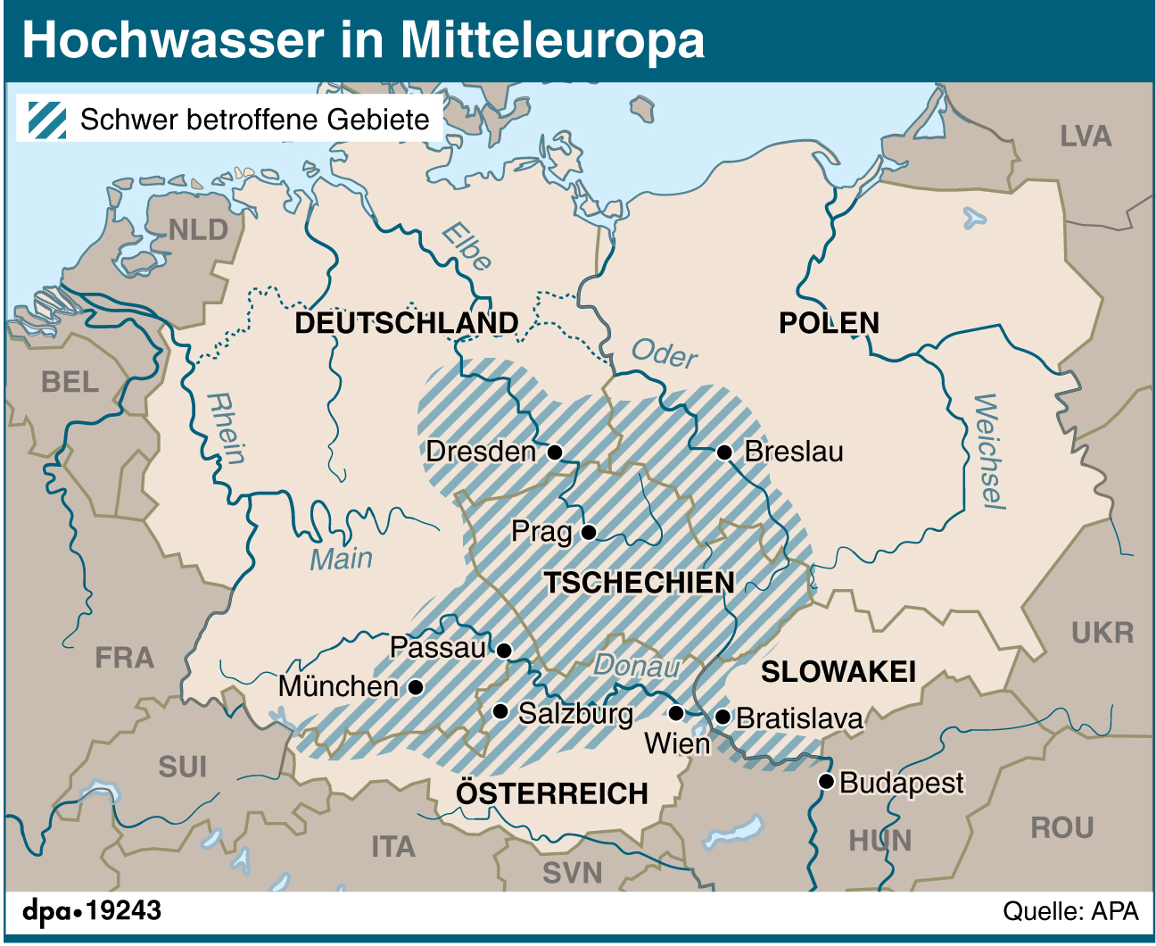
Overview affected areas
Notes:
Affected areas: southern and eastern Germany, nothern austria, complete czech republic, some areas of poland and slovakia

Slide 5
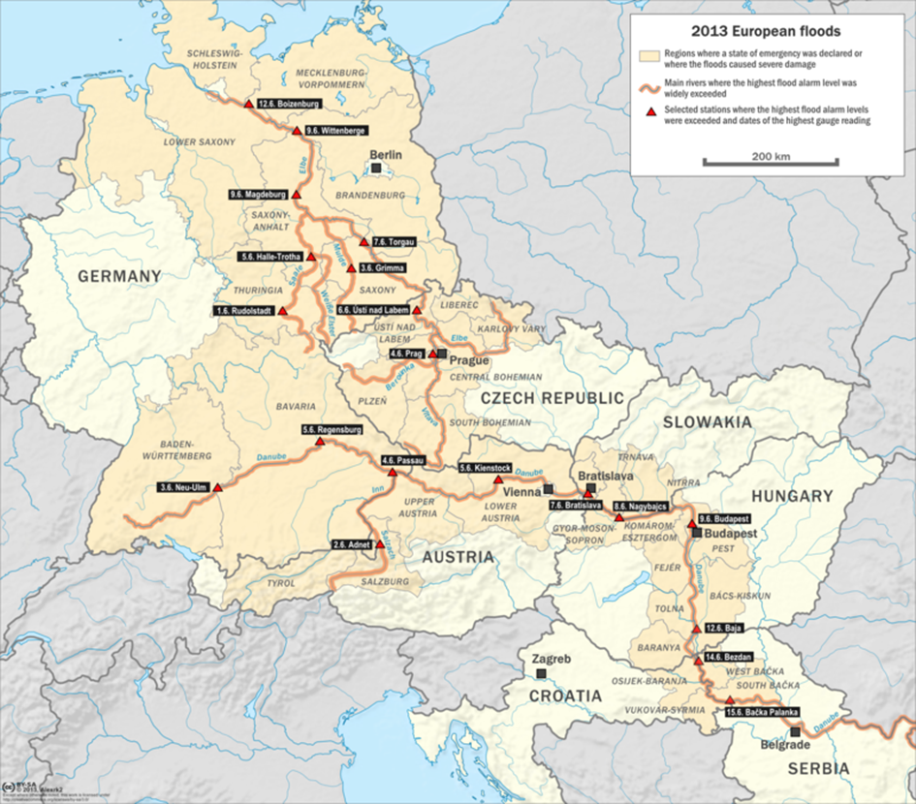
Overview affected areas
Notes:
Course of rivers Elbe and Danube can be seen and many affected rivers
cities with highest alarms levels
e.g. Passau, Magdeburg, but also Prague, Bratislava and Budapest

Slide 6
Consequences in Germany
Numerous flooded rivers and areas
  Rhine, Elbe, Danube….
40% of German inshore waters affected
High tide travelling north and causing floods
Lower Bavaria
Notes:
More affected rivers: Weser, Main

Slide 7
Consequences in Germany
10 out of 16 federal states heavily affected
  E.g. Bavaria, Saxony, Saxony-Anhalt
Disaster alert in 43 administrative districts
Freital (Saxony)
Notes:
All affected states: Brandenburg, Baden- Württemberg, Bavaria, Hesse, Mecklenburg Western Pomerania, Lower Saxony, Rhineland Palatinate, Schleswig Holstein, Saxony, Saxony Anhalt, Thuringia

Slide 8
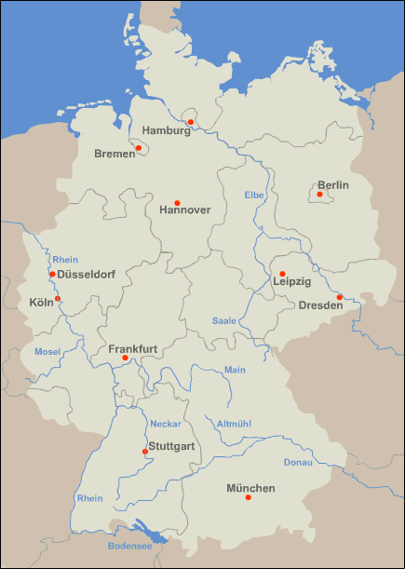
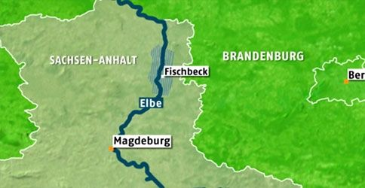
Examples of heavily affected cities
Passau, Magdeburg, Fischbeck
Passau

Slide 9
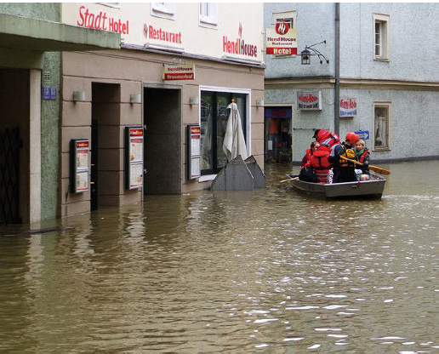
Examples of heavily affected cities
Passau
  Rivers Danube, Inn and Ilz caused water level of almost 13m
  Worst flooding in 500 years
City of Passau

Slide 10
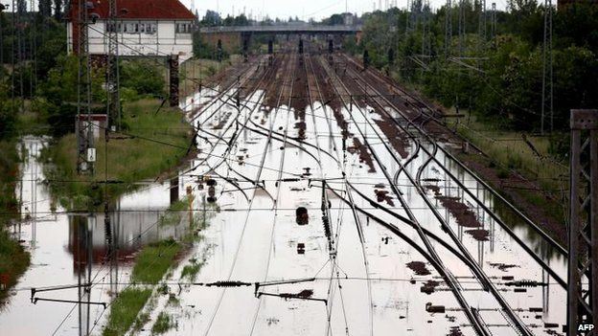
Examples of heavily affected cities
Magdeburg
  Historical water level of about 7.5 m
  Evacuation of 23.000 inhabitants
  High impacts on railway traffic
Railways in Magdeburg area

Slide 11
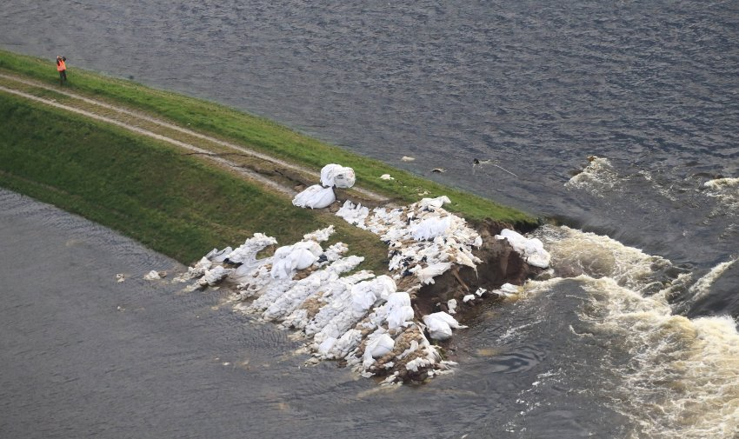
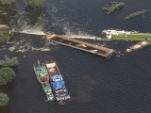
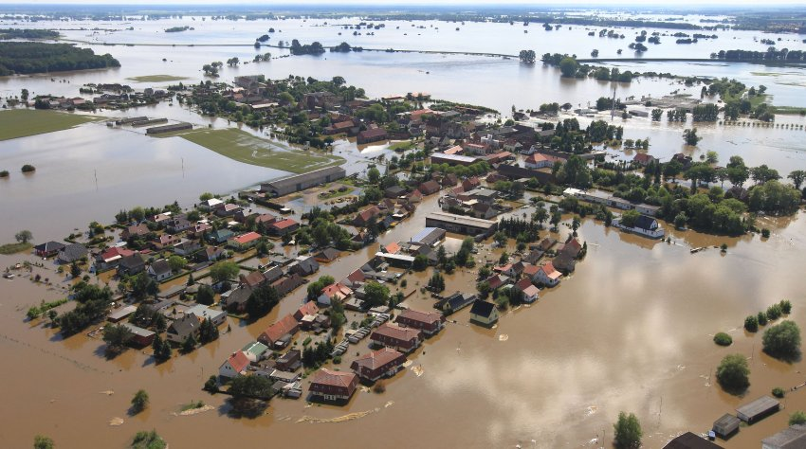
Examples of heavily affected cities
Fischbeck
  Breaking dike on 50 meters
  Whole village flooded
  Old ships were sunk to close hole in the dike
  Symbol of catastrophe

Slide 12
Immediate measures to defend danger and damage
Strengthening of dikes
Temporary dikes
Flooding of polders
Repair of damages caused by the water
Air transportation
Ensuring drinking water supply
Evacuation of parts of the population
Notes:
Strengthening of the dikes plus building them higher
On June 10 85.000 persons were evacuated

Slide 13
Organisation of crisis management
Action forces
  Fire brigade, police, relief organisations, forces of the government, technical aid organisation, federal law enforcement officers, German federal armed forces
  Among those 1.7 mil. voluntary workers (e.g. technical help organisation)
Crisis management groups
Collaboration between different states
Notes:
Crisis management groups: provide coordination between different levels of authorities
Collaboration between different states in case of shortcuts
Nationwide cooperation of the states shall also be used in the future
Nation state was supporting the federal states as well

Slide 14
Changes in crisis management after 2002
Evaluation of flood at Elbe and Oder 2002
New federal office for civil defence and disaster management
  Coordinates aid requests
  Divides resources (e.g. sandbags)
  Provides detailed maps
Crisis management simulations
Training positions for crisis management
Improved crisis management in 2013
New evaluation due after 2013
Notes:
Federal office also asked neighbour countries for help
Maps: bases on satellite data in order so support organisation of emergency measures
crisis management simulations: improve communication between federal state, states and municipalities
More training positions in the municipalities, e.g. for crises management

Slide 15
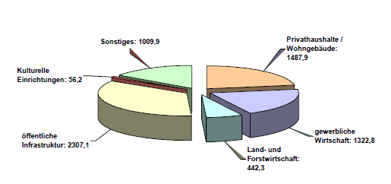
Financial damage caused by flooding
Overall financial claims ca. 6.7 billion €
Notes:
Private households, economy, industry, agriculture and forestry, public infrastructure, cultural institutions, others

Slide 16
Financial and legal measures
Application for EU solidarity fund
Aid organisations
Nation state gave federal states about 500 mil. € emergency relief
Law for reconstruction aid in July 2013
  For medium- and long-term reconstruction
  Relief fund “reconstruction aid” of 8 billion €
Notes:
Federal states had to distribute emergency relief to the people/ companies a.so., not the nation state. E.g. for repairing buildings
Relief fund made up of nation state and federal state expences

Slide 17
Fischbeck: two years after the disaster
New dike is built
People couldn’t live in their houses for months
Long term damages on houses
2015 about 90% of damages in private accommodations repaired
Public infrastructure not yet repaired -> delay in handling applications for reconstruction aid money

Slide 18
Human made enhancement of floods
River regulations
Land use
  Sealing of soil
  Reduction of forest stand
  Consolidation of soil in agriculture
  Reduction of natural flooding areas
Dikes
Notes:
Shortens the course of the river, water runs faster

Slide 19
Possibilities to influence floods
Protection and recovery of natural flooding areas
  Polders
  Repositioning of dikes
Retention of rainfall
Hydro dams and flood control basins
Polder
Dam
Retention
Notes:
Retention e.g. in fields and so on but also in settlement, e.g. use floor covers that can absorb water

Slide 20
Reduction of damage
Area management
Technical solutions
Forecasts and warning systems
Adjusted architecture
Improvement in insurance
Mobile walls
Notes:
Area management: no buildings in flood endangered areas
Technical solutions: Dikes, walls, mobile walls
Adjusted architecture: e.g. no cellar/basement

Slide 21
Conclusion
One of the biggest floods in Europe with century highs or even 500 year highs
Dramatic effects on cities, people and economy
Crisis management was relatively efficient
Damages still not removed completely
Crisis management and prevention measures need to be improved further
  90% of natural flooding areas have been lost to industrialisation

Slide 22
References
Literature
  Lohmann Dieter 2015: Im Fokus: Naturkatastrophen: Zerstörerische Gewalten und tickende Zeitbomben. Berlin, Heidelberg: Springer Berlin Heidelberg
  Bundesministerium des Innern (Hg.) 2013: Bericht zur Flutkatastrophe 2013: Katastrophenhilfe, Entschädigung, Wiederaufbau. Berlin: o.V.
  Tietz, Hans-Peter 2015: Hochwasserschutz. Fachplanung Umwelt und Energie, planerischer Umweltschutz. Dortmund

Slide 23
References
Internet sources
  https://en.wikipedia.org/wiki/2013_European_floods#/media/File:Map_of_2013_European_floods.png
  http://www.bpb.de/gesellschaft/umwelt/hochwasserschutz/164042/grafiken-das-hochwasser-2013-auf-einen-blick?show=image&k=3
  http://www.spiegel.de/fotostrecke/fischbeck-zwei-jahre-nach-deichbruch-noch-baustelle-fotostrecke-127376.html
  http://www.spiegel.de/fotostrecke/fischbeck-zwei-jahre-nach-deichbruch-noch-baustelle-fotostrecke-127376-2.html
  http://www.spiegel.de/panorama/fischbeck-zwei-jahre-nach-deichbruch-noch-baustelle-a-1037963.html
  http://www.spiegel.de/panorama/hochwasser-bei-fischbeck-drittes-schiff-nach-deichbruch-versenkt-a-906047.html
  http://www.bbc.com/news/world-europe-22835154
  http://at.wetter.com/news/hochwasserwelle-rollt-nach-norden_aid_15889.html
  http://www.reiserat.de/reisen_deutschland/fluesse/fluesse.gif

