Slide 1


Faculty of Science
Department of Chemistry
Doctoral study in Chemistry
Field: Biochemistry
Organophosphate detoxification by membrane-engineered red blood cells
Paige N. Smith, Leran Mao, Kaustubh Sinha, Alan J. Russell
Chemistry seminar I
Petar Nakić, univ. mag. ing. biotechn.

Slide 2
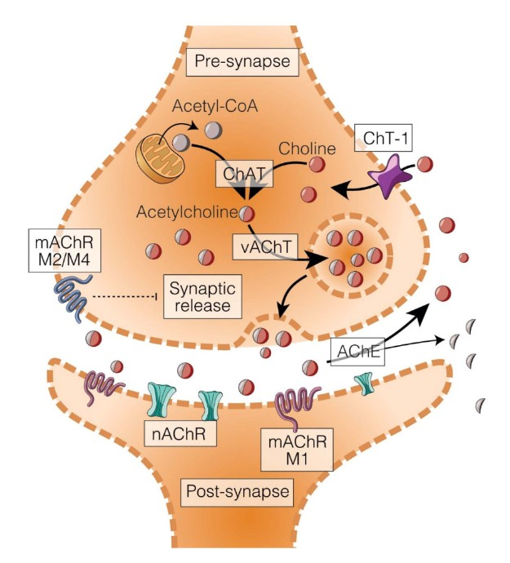
Cholinergic synapse
Communication site between neurons
  Acetylcholine (ACh) as a neurotransmitter
Critical in controlling cognitive functions, motor and reward system
ACh is synthesized from acetyl-CoA (formed from glucose) and choline
Primarily found in forebrain cholinergic nuclei, the brain stem and as interneurons in the striatum
Acetylcholinesterase (AChE) terminates ACh action via enzymatic cleavage
System failure results in cholinergic crisis which leads to:
  Cognitive decline
  Neurological/Psychiatric disorders
  Toxicity
  Lethality
Cholinergic synapse (Klein, 2025.)

Slide 3
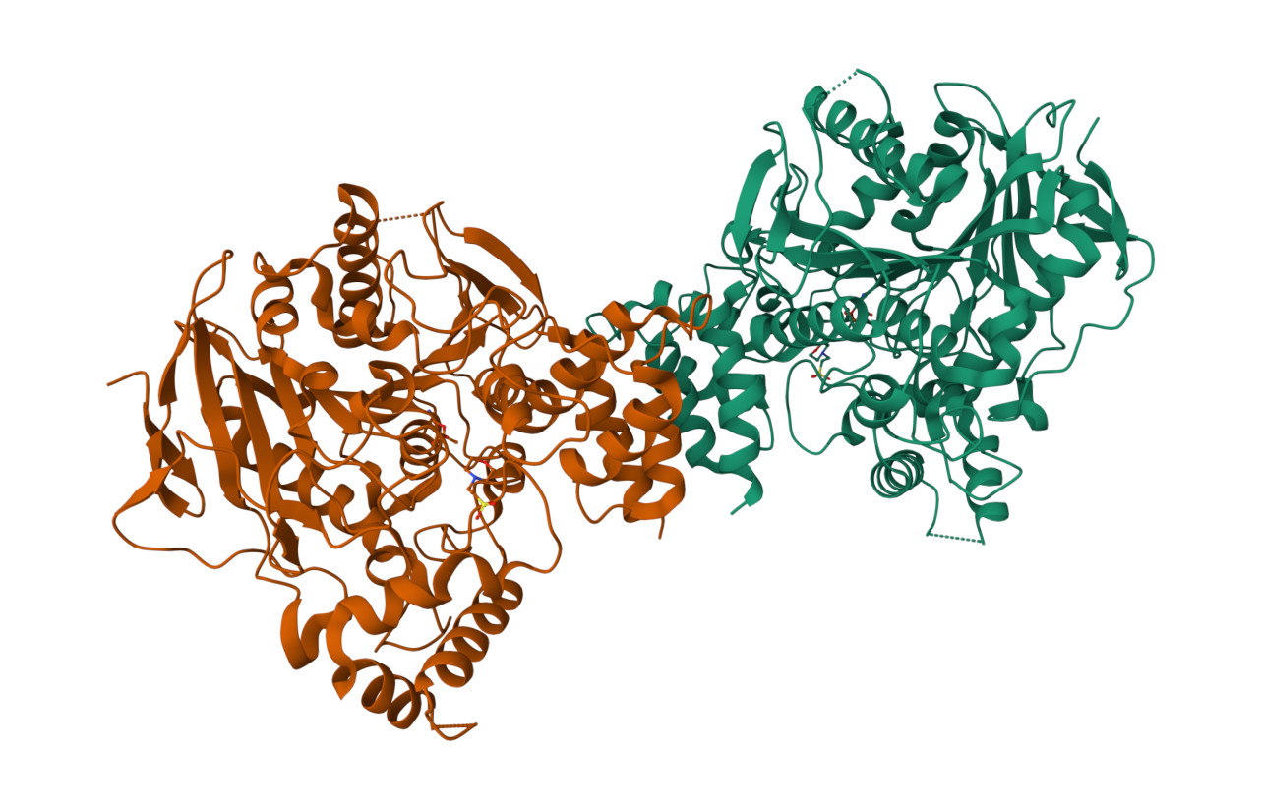
Acetylcholinesterase (AChE)
  Fundamental for controlling transmission of nerve impulses
    In both the central and peripheral nervous systems
    Rapidly hydrolyzes neurotransmitter Ach
      Terminates chemical signal
      Prevents overstimulation of cholinergic receptors
  It is located in brain, muscles and bonded to the membrane of red blood cells
  Non-catalytic roles
    Neuritogenesis
    Cell adhesion and differentiation
    Amyloid fiber assembly
    Non-selective catalysis (arylic esters, anilides, thioesters and amides)
    Widespread biological regulation
Acetylcholinesterase (AChE) (Goldenzweig et al, 2016.))

Slide 4
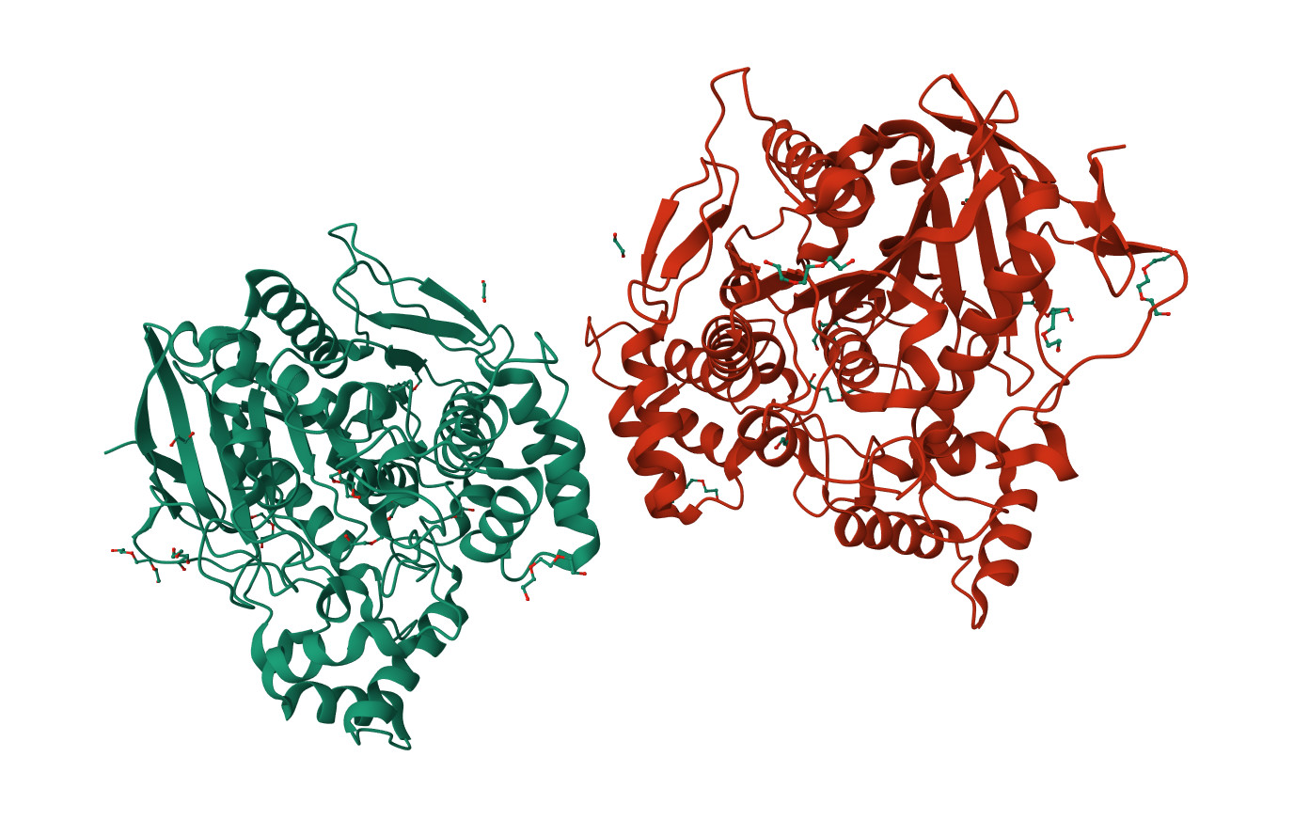
Butyrylcholinesterase (BChE)
Related to AChE
Stable glycoprotein
  Found in human plasma
  High levels of glycosylation
  Throughout body (liver, pancreas, lungs etc.)
Native scavenger
Non-essential enzyme??
  Detoxification function
  Backup system
  Biotransformation of xenobiotics
More than 60 naturally occurring variants of human BChE
  Result of mutations (insertion, deletions, frameshift)
  Differences in level of enzymatic activity
Butyrylcholinesterase (BChE) (Brazzolotto et al, 2017.)

Slide 5
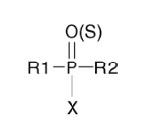
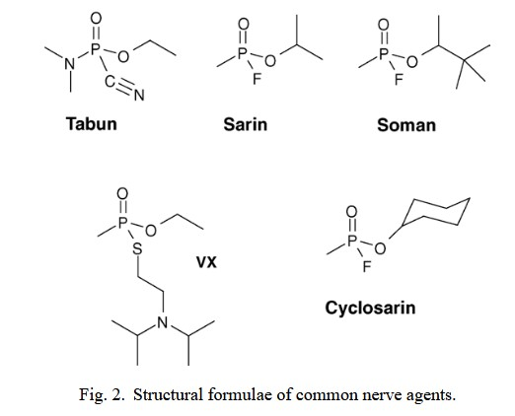
Organophosphorus compounds (OPCs)
Widespread usage in:
  Agriculture→pesticides
  Industrial applications→flame retardants
  Military application→nerve agents
Organic compounds
Their structure contains:
  Phosphoryl (P=O)
  or
  Thiophosphoryl (P=S) group
Ester, thiol or amide derivates
  Phosphorus/phosphonic/phosphinic acid
AChE/BChE inhibitors
  covalent/progressive inhibition
Common nerve agents

Slide 6
OPC
pentavalent transition state
Slow regeneration via water
Catalytic triad of cholinesterase
R₂O
R₂O
Spontaneous dealkylation (aging)
Reactivation
Reactions of OPC with cholinesterase

Slide 7
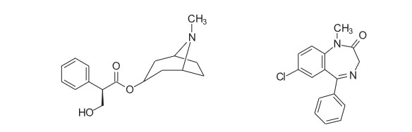
Standard treatment for OPC poisoning
A) Atropine
Anticholinergic agent
  Competitive antagonist at muscarinic acetylcholine receptors
Targets „muscarinic symptoms”
  Miosis (pinpoint pupils)
  Excessive salivation
  Abdominal pain
  Bradycardia
B) Diazepam
anticonvulsant
Belongs to benzodiazepine class of drugs
Prevents or stops convulsions and seizures
Interaction with GABA receptors
Structures of atropine and diazepam (Delfino et al, 2009.)

Slide 8
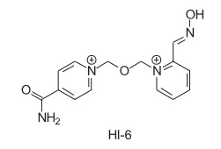
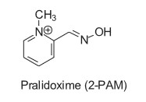
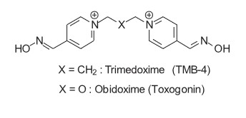
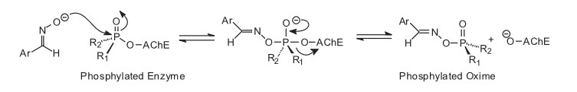
C) Oximes
Cholinesterase reactivators (AChE/BChE)
Most therapeutically relevant oximes are pyridinic oximes
Structure:
  Typically one or two quaternary pyridinium rings
  Oxime groups (=N−OH)
Mechanism of action:
  Nucleophilic attack of the oxime's oxygen
  Breaking of the phosphorus-enzyme bond
  Phosphylated oxime
Structures of most common oximes (Delfino et al, 2009)
Reactivation of phosphylated AChE by oximes (Delfino et al, 2009)

Slide 9
Limitations of current oxime therapy
  Poor blood-brain barrier (BBB) penetration
  Lack of a universal reactivator
  The „aging” problem
  Toxicity and side effects
Prophylactic necessity
  Critical need for a „pre-treatment”
    Oxime effectivness is strictly time-dependent and limited
  Bioscavenging
    Interception and neutralization of toxins in the bloodstream before they reach their physiological targets

Slide 10
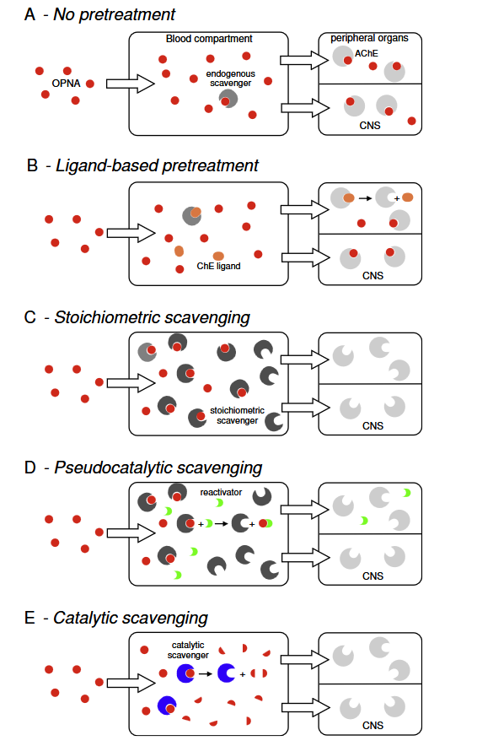
Bioscavangers
OPC
Prophylactic therapy
Endogenous / exogenous proteins
Binding occurs in blood stream
Lowers circulating concentration of OPs
Need for pharmacokinetic optimization
  Potential interference with biochemical pathways
3 groups of bioscavengers:
  Stoichiometric scavenging
  Pseudocatalytic scavenging
  Catalytic scavenging
Pretreatment strategies of OPC poisoning (Nachon et al, 2013.)

Slide 11
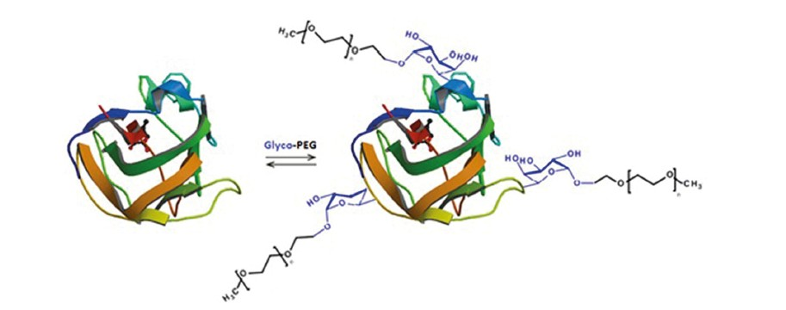
BChE optimization
Need for a more effective system
  Increased time of BChE in circulatiuon
  Lowering of used dosages
  Improved enzyme stability
  Increased time of functional activity
Utilized strategies
  Covalently bonded polyethylene glycol (PEG)
  Enzyme encapsulation
    Coopolimer nanoparticles
Schematic representation of a reversible PEGylation with Glyco-PEG (Torres-Obreque et al, 2018.)

Slide 12
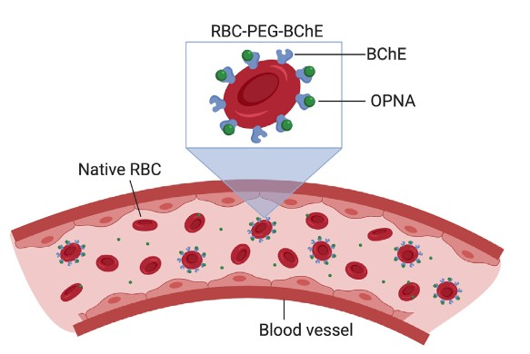
Red blood cells (RBC) modifications
RBCs as ideal carriers
  inherent biocompatibility,
  longevity and
  immune system privilage
Usual loading strategies:
  Hypotonic loading (BChE encapsulation)
  Antibody conjugation
Modern approach
  Flexible PEG chains
  BChE becomes tethered to the RBC membrane
  Prevents interference and preserves BChE activity
RBC-PEG-BChE constructs scavenging nerve agents in vivo ( Smith et al, 2021)

Slide 13
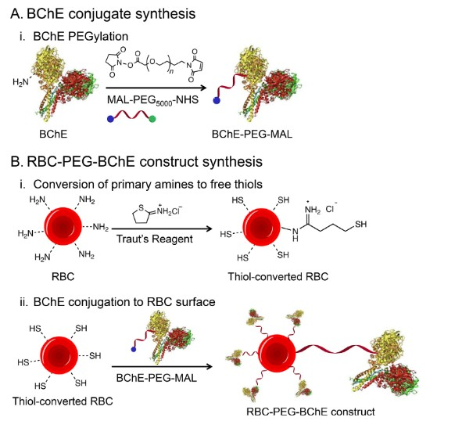
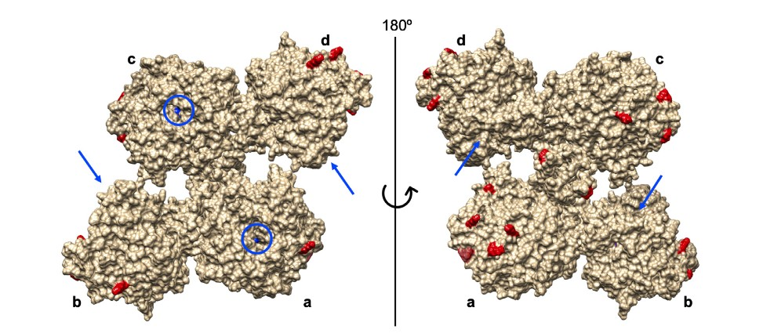
BChE structure presented as a molecular surface with labeled monomers a-d (Leung et al, 2018.)
Three-step synthesis of the RBC-PEG-BChE construct (Smith et al, 2021.)

Slide 14
Materials and methods
Study utilized serum-derived BChE
  modified using heterobifunctional PEG polymers (MAL-PEG-NHS and mPEG-NHS, 5 kDa)
  stable enzyme-carrier links
Analysis of BChE tetramer structure (UCSF Chimera, PROPKA, APBS)
  Prediction of optimal reactive sites
  Assessement of surface amino group reactivity
Three-stage syntheisis of construct
  PEGylation of BChE
  Purification
  RBC surface modification and covalent attachment to PEGylated BChE
Activity and quantity assays
  Ellman method for enzyme activity
  BCA asssay for protein levels
  Fluorogenic probe EMP-MeCyC
Stability and efficacy testing
  Membrane stability
  Cell viability
  Efficiency in neutralizing paraoxon

Slide 15
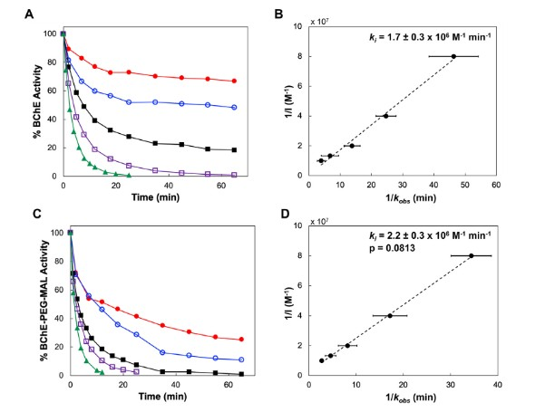
Results and methods
The inhibition rate constants (k_{i}​):
  1.7×10⁶ M⁻¹ min⁻¹ for native BChE and
  2.2×10⁶ M⁻¹ min⁻¹ for the BChE-PEG-MAL construct
Enzyme reactivity maintained
  BChE retained its full ability to neutralize OPCs
  No negative impact from PEG
PEG modification occurs at sites distant from enzymes active center
Successful functionalization
Consistency with structural predictions
Inhibition kinetics of BChE and BChE-PEG-MAL Time course inhibition of BChE (A) and BChE-PEG-MAL (C) by paraoxon in PBS (pH 7.4, 25 ºC). Paraoxon concentrations: 12.5 nM; 25 nM; 50 nM; 75 nM; 100 nM. (Smith et al., 2021.)
Smith, P. N., Mao, L., Sinha, K., et al. (2021) ‘Organophosphate detoxification by membrane-engineered red blood cells’, Acta Biomaterialia, 124, str. 270-281.

Slide 16
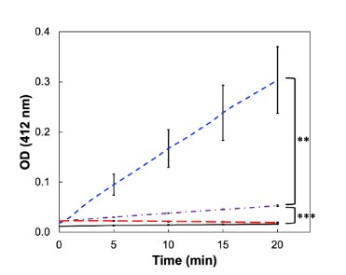
Functional presence confirmed
AChE inhibition baseline
  Pre-treatment with paraoxon to inhibit endogenous AChE activity
Significant activity increase
  BChE-PEG-MAL constructs show spike in enzymatic activity
Reversible activity
  Exposing construct to paraoxon eliminates enzymatic activity
Bioscavenger efficiency and validation of sensitivity
  BChE maintains its role as bioscavenger
  Chemical tethering process does not alter enzyme sensitivity
Confirmation of RBC-PEG-BChE constructs. Time course hydrolysis of
acetylthiocholine substrate in PBS (pH 7.4, 25 °C) by native RBCs (purple dash-dot), RBCs treated with paraoxon and Traut’s reagent (black solid line), RBC-PEG-BChE (blue dash), and RBC-PEG-BChE treated with paraoxon (red long dash) (Smith et al, 2021.)
Smith, P. N., Mao, L., Sinha, K., et al. (2021) ‘Organophosphate detoxification by membrane-engineered red blood cells’, Acta Biomaterialia, 124, str. 270-281.

Slide 17
High binding capacity
  Fluorogenic OPC analog (EMP-MeCyC) assay
  2.4 million BChE molecules per RBC
  ~17,000 molecules/μm²
Enhanced detoxification
  High surface coverage→massive reserve of BChE in bloodstream
Maintained cell viability
  ATP-based luminescence test
  80.4% of all constructs retained normal metabolic activity
Membrane integrity
  Mechanical fragility tests under shear stress
  4.2% hemolysis after 8 h for constructs
  4.7% for native cells in same conditions
Biocompatibility
  Construct forming process does not compromise
    structural integrity of the membrane
    Sensitivity to mechanical load
Smith, P. N., Mao, L., Sinha, K., et al. (2021) ‘Organophosphate detoxification by membrane-engineered red blood cells’, Acta Biomaterialia, 124, str. 270-281.

Slide 18
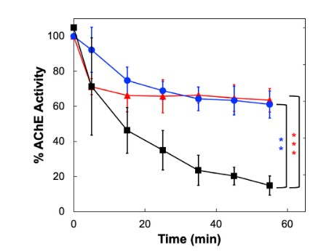
Proof of concept
  Effective removal of OPCs from whole human blood via RBC-PEG-BChE constructs
Significant AChE protection
  Without protection exposure to paraoxon reduces AChE activity to 14%
  Pre-treatment with RBC-PEG-BChE construct→AChE activity at 60%
Organophosphate detoxification in whole blood. Time course inhibition of RBC AChE by paraoxon (25 ºC) in whole blood (■), whole blood with BChE (), and whole blood with RBC-PEG-BChE () (Smith et al, 2021.)
Smith, P. N., Mao, L., Sinha, K., et al. (2021) ‘Organophosphate detoxification by membrane-engineered red blood cells’, Acta Biomaterialia, 124, str. 270-281.

Slide 19
Clinical impact
  Prognosis shift from severe poisoning to mild symptoms and even aysmptomatic cases
Comparable efficacy
  Protective effect of immobilized BChE just as effective as free BChE
Strategic advantage
  RBC-bound version offers longer circulation time within body
    120 days Vs. 12 days
    Allows for dosing every couple of months compared to every few days
    Still requires in vivo tests
Organophosphate detoxification in whole blood. Time course inhibition of RBC AChE by paraoxon (25 ºC) in whole blood (■), whole blood with BChE (), and whole blood with RBC-PEG-BChE () (Smith et al, 2021.)
Smith, P. N., Mao, L., Sinha, K., et al. (2021) ‘Organophosphate detoxification by membrane-engineered red blood cells’, Acta Biomaterialia, 124, str. 270-281.

Slide 20
Conclusions:
Bioengineering RBCs as carriers for BChE addresses the limitations of current therapies, such as short circulation time while providing a stable and long-lasting intravascular shield against OPC toxicity.
The study confirmed that BChE can be covalently bound to RBC membranes via PEGylation without losing catalytic activity, effectively protecting AChE in human blood and maintaining high biocompatibility and cell stability.
RBC-PEG-BChE construct offers a high-capacity detoxification system that could simplify dosing and improve protection for at-risk individuals, with future in vivo studies being the next step to confirm its long-term safety and efficacy.

Slide 21
Literature:
Adi Goldenzweig, Moshe Goldsmith, Shannon E. Hill, Or Gertman, Paola Laurino, Yacov Ashani, Orly Dym, Tamar Unger, Shira Albeck, Jaime Prilusky, Raquel L. Lieberman, Amir Aharoni, Israel Silman, Joel L. Sussman, Dan S. Tawfik, Sarel J. Fleishman, Automated Structure- and Sequence-Based Design of Proteins for High Bacterial Expression and Stability, Molecular Cell, Volume 63, Issue 2, 2016, Pages 337-346, ISSN 1097-2765, https://doi.org/10.1016/j.molcel.2016.06.012.
Brazzolotto, X., Igert, A., Guillon, V., Santoni, G., & Nachon, F. (2017). Bacterial Expression of Human Butyrylcholinesterase as a Tool for Nerve Agent Bioscavengers Development. Molecules, 22(11), 1828. https://doi.org/10.3390/molecules22111828
Delfino, R., Ribeiro, T. i Figueroa-Villar, J. (2009) ‘Organophosphorus compounds as chemical warfare agents: a review’, Journal of the Brazilian Chemical Society, 20. doi: 10.1590/S0103-50532009000300003.
Florian Nachon, Xavier Brazzolotto, Marie Trovaslet, Patrick Masson. Progress in the development of enzyme-based nerve agent bioscavengers. Chemico-Biological Interactions, 2013, 206 (3), pp.536 - 544. ⟨10.1016/j.cbi.2013.06.012⟩
Klein, J. (2025). The Central Cholinergic Synapse: A Primer. International Journal of Molecular Sciences, 26(19), 9670. https://doi.org/10.3390/ijms26199670
M.R. Leung, L.S. van Bezouwen, L.M. Schopfer, J.L. Sussman, I. Silman, O. Lockridge, & T. Zeev-Ben-Mordehai, Cryo-EM structure of the native butyrylcholinesterase tetramer reveals a dimer of dimers stabilized by a superhelical assembly, Proc. Natl. Acad. Sci. U.S.A. 115 (52) 13270-13275, https://doi.org/10.1073/pnas.1817009115 (2018).
Smith, P. N., Mao, L., Sinha, K., et al. (2021) ‘Organophosphate detoxification by membrane-engineered red blood cells’, Acta Biomaterialia, 124, str. 270-281. doi: 10.1016/j.actbio.2021.01.043.
Torres-Obreque, Karin & Meneguetti, Giovanna & Amaro, Beatriz & Rangel-Yagui, Carlota. (2018). Protein PEGylation for the design of biobetters: from reaction to purification processes. Brazilian Journal of Pharmaceutical Sciences. 54. 10.1590/s2175-97902018000001009.
Worek F, Koller M, Thiermann H, Szinicz L. Diagnostic aspects of organophosphate poisoning. Toxicology. 2005 Oct 30;214(3):182-9. doi: 10.1016/j.tox.2005.06.012.

