Slide 1
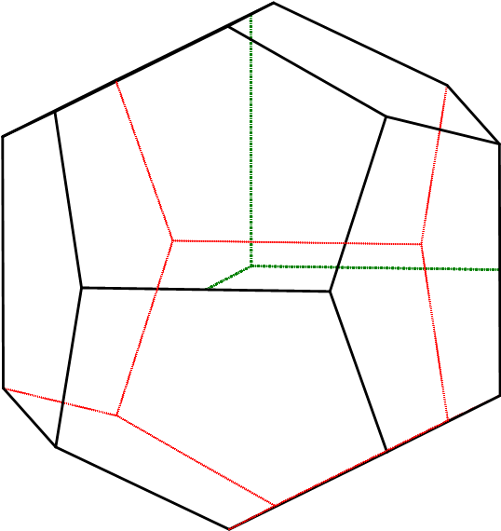
($\overline{2}$01)
($\overline{1}\overline{2}$0)
($\overline{1}$20)
$$\overline{1}$$ | m | 2 | 3 | 4 | 6 | $$\overline{4}$$ | o.f. | z.f.
+ | 3 | 3 | 4 | / | / | / | 0 | 1
(0$\overline{1}2)$
(012)
C, 3P, 3L^{2,} 4L³
(1$\overline{2}$0)
(201)
(120)
$$\frac{2}{m}\overline{3}$$
pentagonska hemiedrija kubičnog sustava
disdodekaedarska klasa
Weissovi koeficijenti: 1a₁: ½a₂: $∞$a₃
Millerov indeks: (120)
Kubični kristalni sustav
a $=$ b $=$ c α = β = γ = 90°
FORME:
{120} pentagonski dodekaedar, 12 ploha, zatvorena forma

