Slide 1
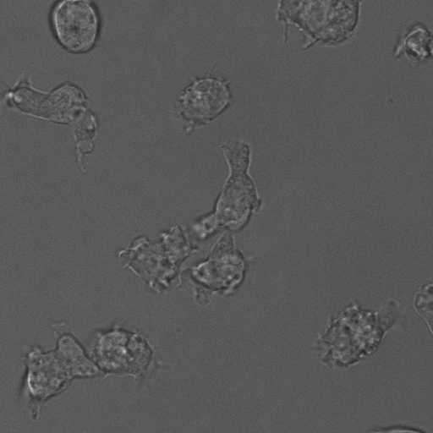
Oscilatorna dinamika GTPaze Rac1 u amebi Dictyostelium discoideum
Blaž Ivšić

Slide 2
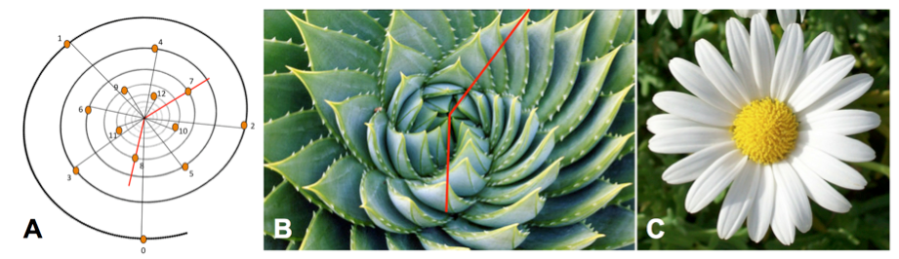

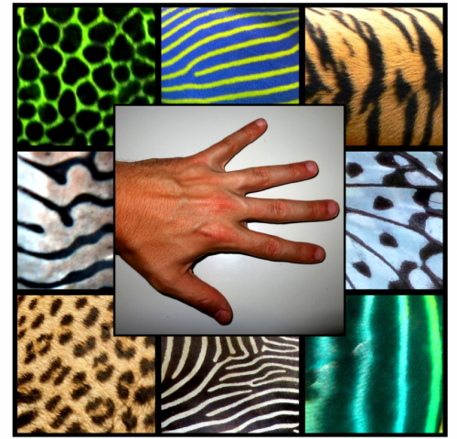
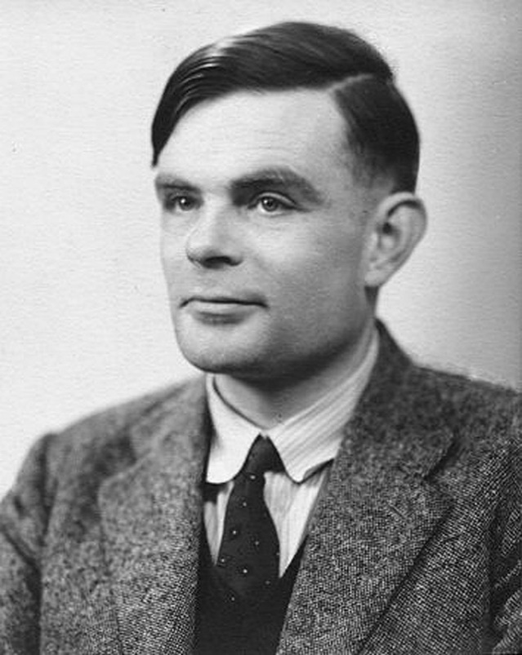
http://sitn.hms.harvard.edu/flash/2012/morphogenesis/
Vector Graphics by <a rel="nofollow" href="https://www.vecteezy.com">Vecteezy.com</a>
https://phys.org/news/2014-07-mathematical-theory-alan-turing-formation.html
https://pocketbookuk.com/2015/02/22/the-imitation-game-alan-turing/

Slide 3
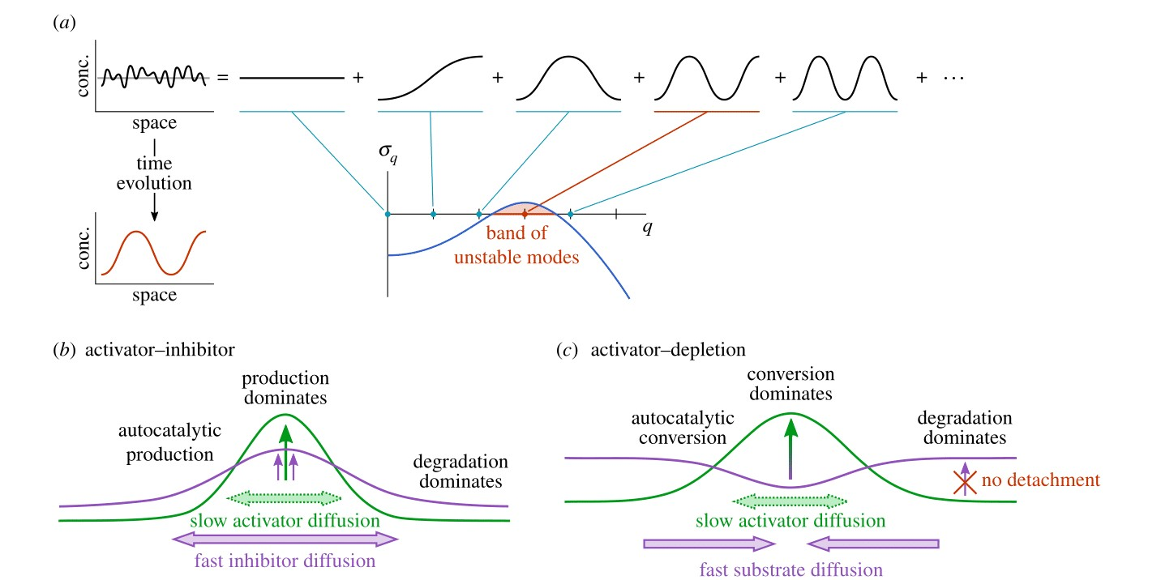
J. Halatek, F. Brauns and E. Frey; 2018.

Slide 4
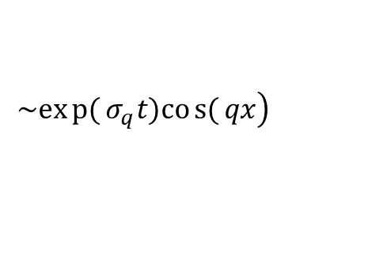
$$\left.\sim exp{(}σ_{q}t)cos{(}qx\right)$$
J. Halatek, F. Brauns and E. Frey; 2018.

Slide 5
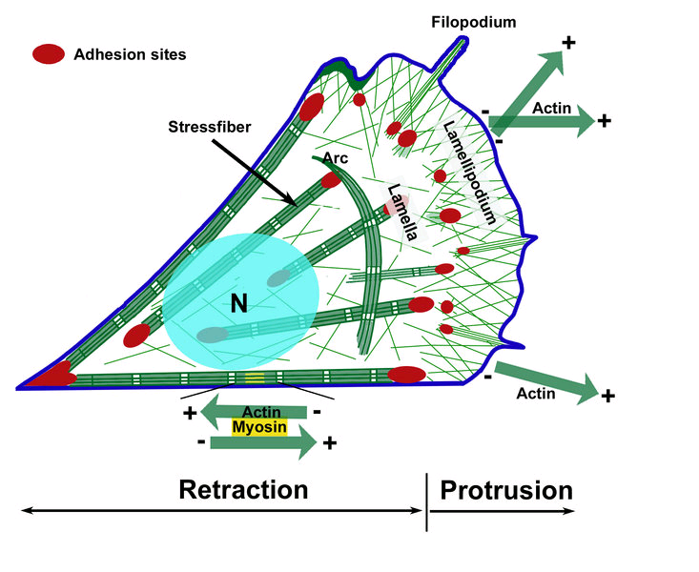
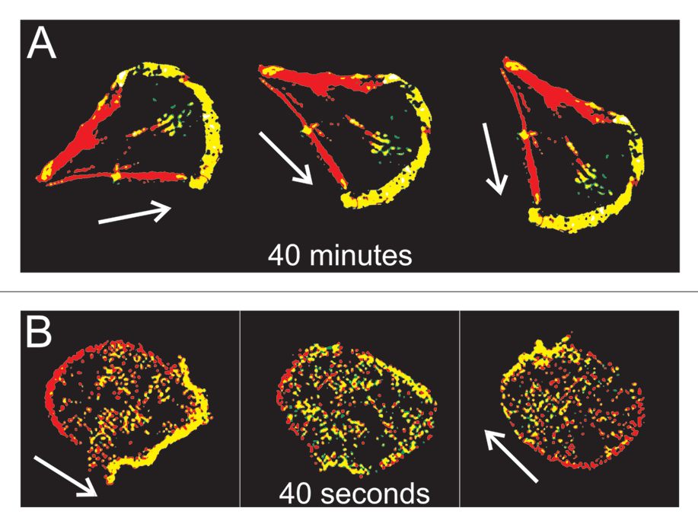
Fibroblast
Dictyostelium discoideum
Jan Faix and Igor Weber; 2013.

Slide 6
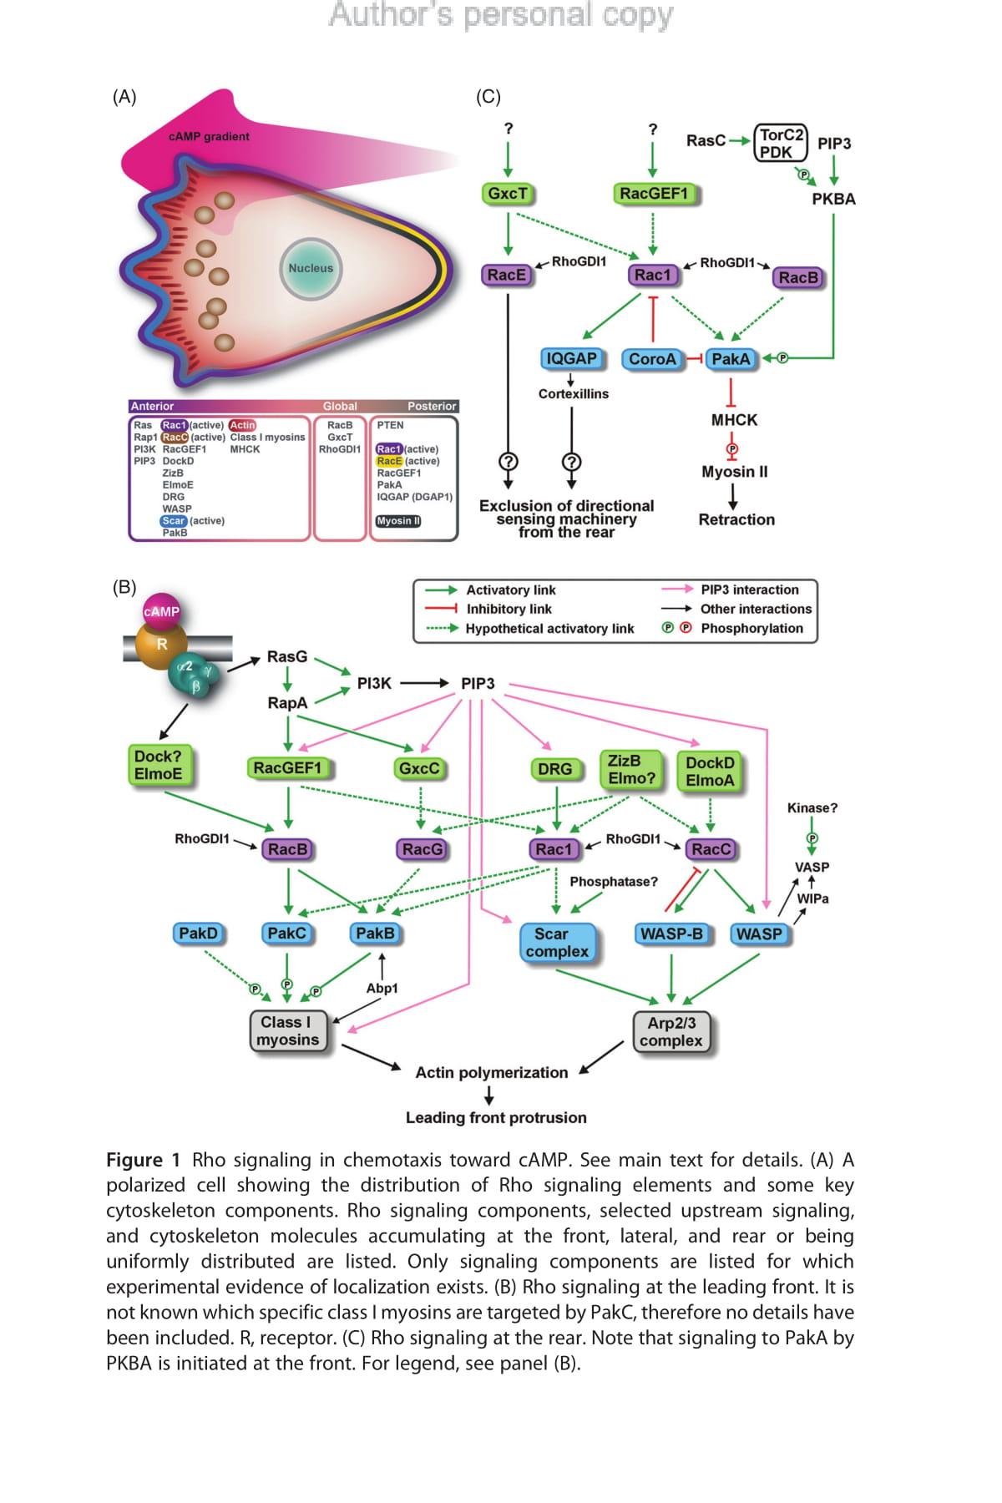
Francisco Rivero; 2016.

Slide 7
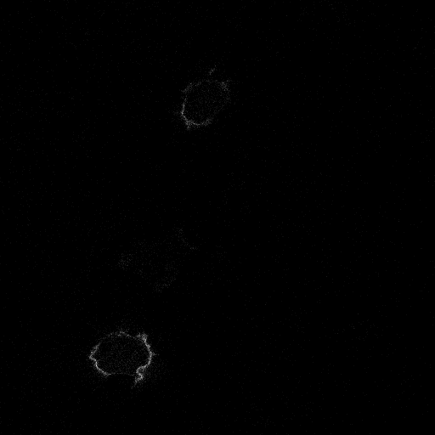
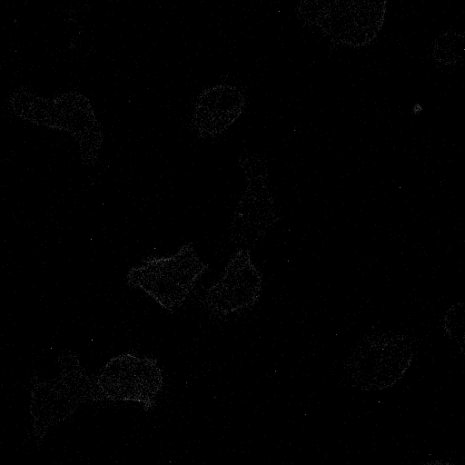
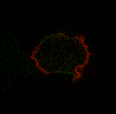
Rac1
DGAP1
Rac1: crveno
DGAP1: zeleno

Slide 8
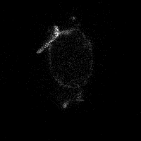
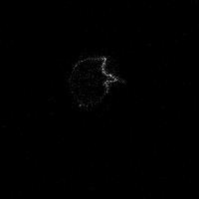
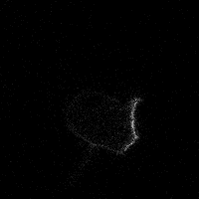
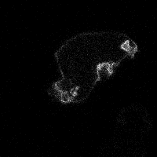
Oscilacije
Rotacija
Monopolarno stanje
Bipolarno stanje

Slide 10

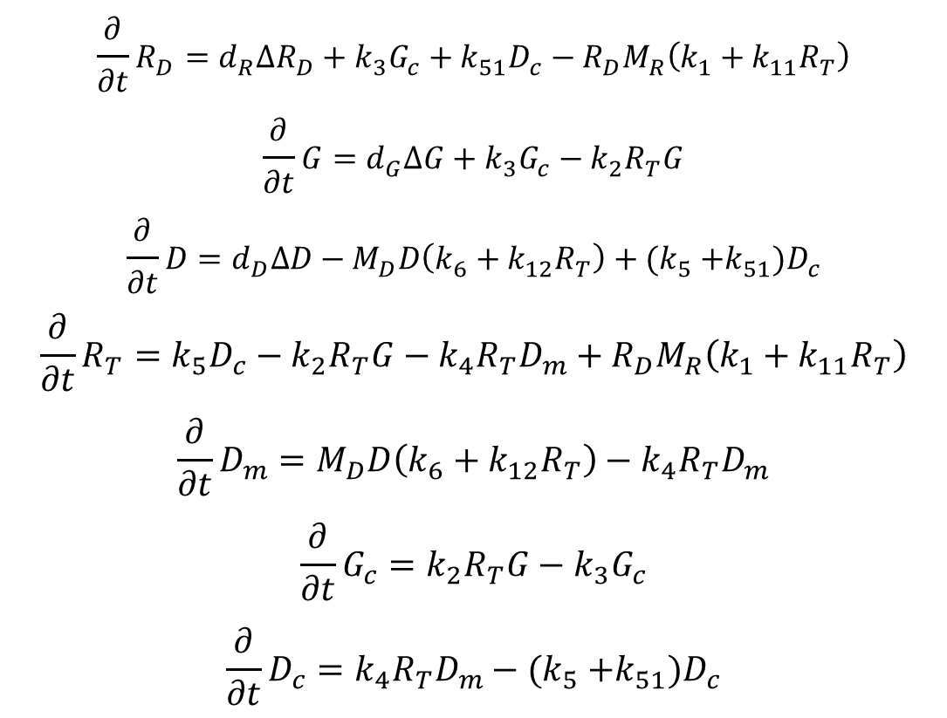

$$\frac{∂}{∂t}R_{D}=d_{R}∆R_{D}+k_{3}G_{c}+k_{51}D_{c}−R_{D}M_{R}\left(k_{1}+k_{11}R_{T}\right)$$
$$\frac{∂}{∂t}G=d_{G}∆G+k_{3}G_{c}−k_{2}R_{T}G$$
$$\frac{∂}{∂t}D=d_{D}∆D−M_{D}D\left(k_{6}+k_{12}R_{T}\right)+(k_{5}{+k_{51})D}_{c}$$
$$\frac{∂}{∂t}R_{T}=k_{5}D_{c}−k_{2}R_{T}G−k_{4}R_{T}D_{m}+R_{D}M_{R}\left(k_{1}+k_{11}R_{T}\right)$$
$$\frac{∂}{∂t}D_{m}=M_{D}D\left(k_{6}+k_{12}R_{T}\right)−k_{4}R_{T}D_{m}$$
$$\frac{∂}{∂t}G_{c}=k_{2}R_{T}G−k_{3}G_{c}$$
$$\frac{∂}{∂t}D_{c}=k_{4}R_{T}D_{m}−(k_{5}{+k_{51})D}_{c}$$
$$M_{R}=\left(R_{T}^{max}−R_{T}\right)$$
$$M_{D}=\left(D_{m}^{max}−D_{m}\right)$$

Slide 12

$$φ=2.4±0.4$$

Slide 14
Sažetak
Obrasci nastaju kao posljedica difuzije i reakcija između proteina
Fizikalni modeli signalnih puteva daju uvid u vrijednosti parametara, koje je ponekad teško izmjeriti
Razumijevanje signalnih puteva omogućava razvoj lijekova

